Slide 1
[insert service name] briefing

Slide 2
What is Local Government Reorganisation (LGR)?
LGR is a UK Government plan to simplify council structures and improve local services
The aims are to:
  Make councils more efficient and financially stable
  Improve service quality and accountability
  Give more power and decision-making to local communities
Lancashire currently has a two-tier system:
  Lancashire County Council
  12 district councils
There are also 2 existing unitary authorities (Blackburn with Darwen, Blackpool)
LGR will replace these arrangements with a smaller number of new unitary councils
Each new council will be responsible for delivering all local services in its area

Slide 3
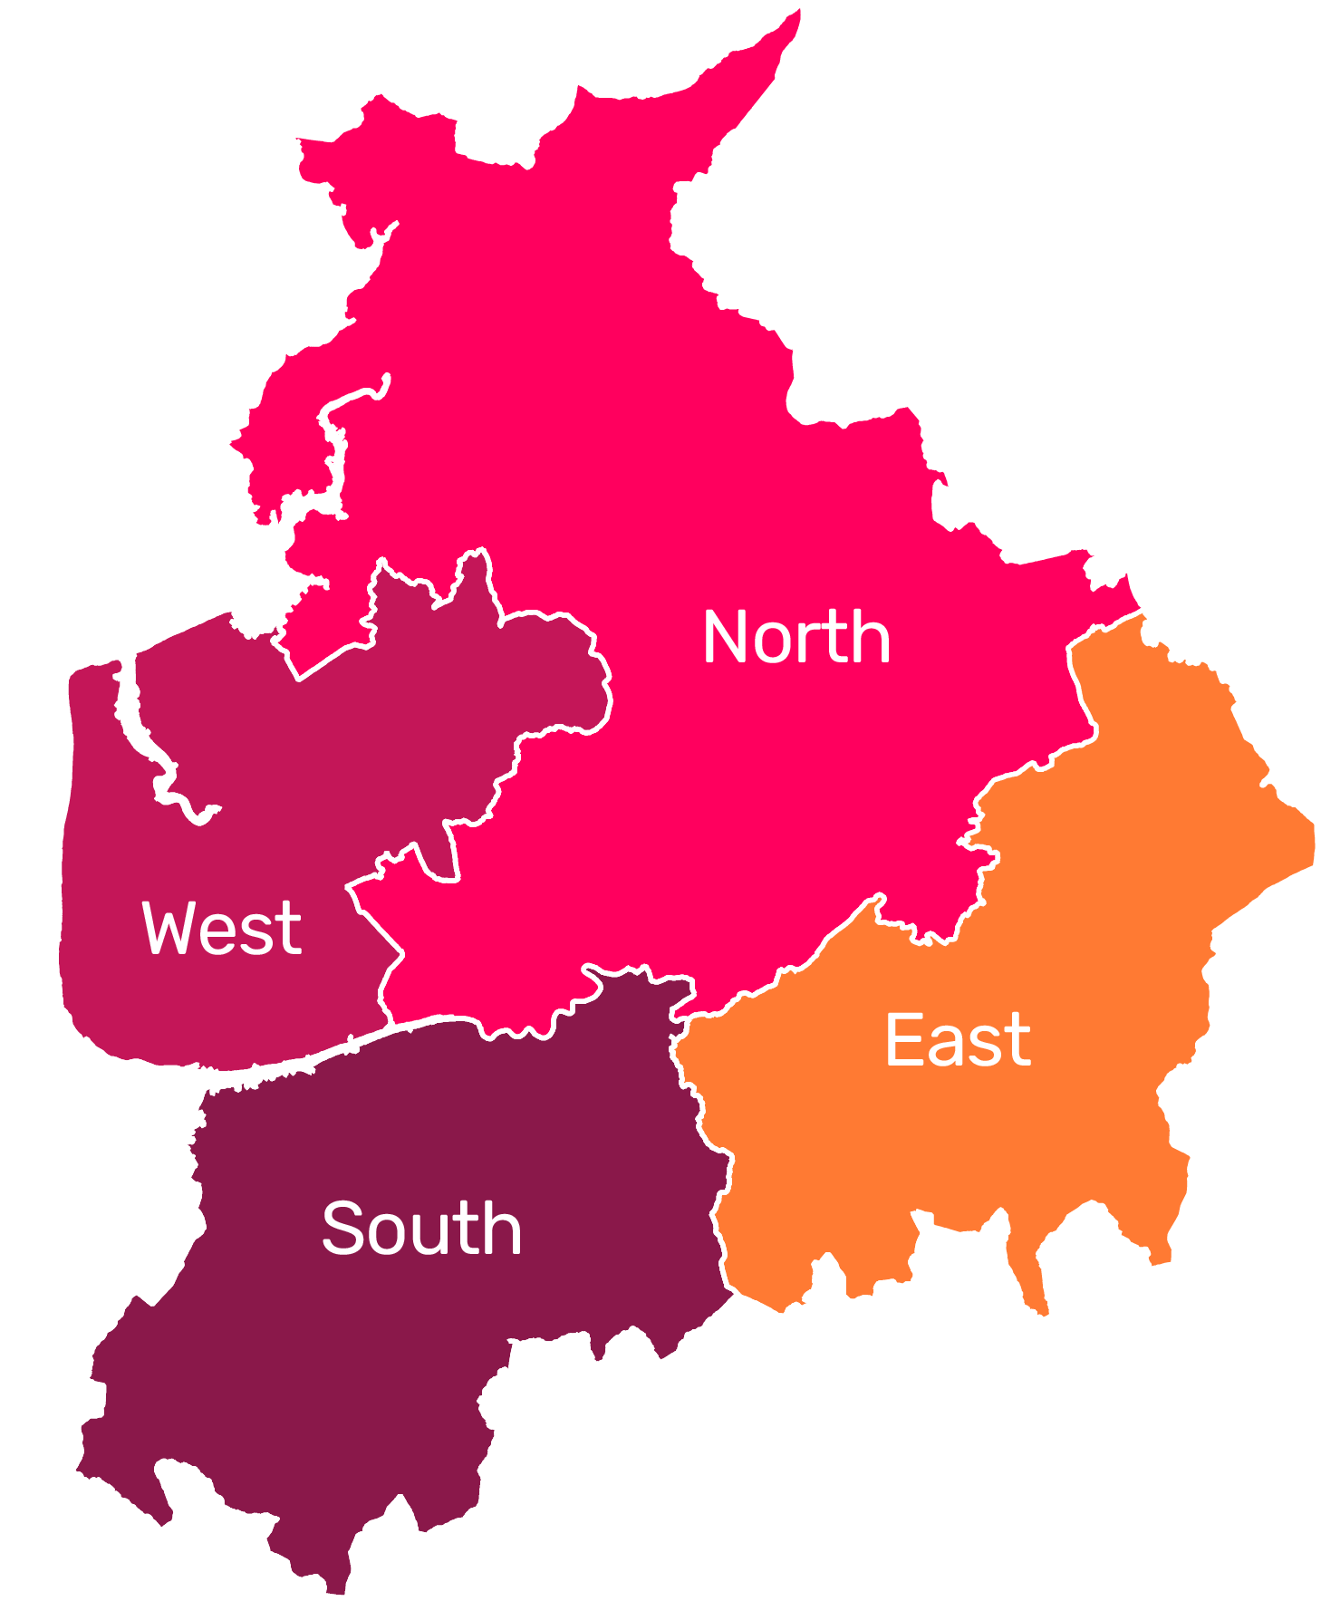
Government decision
Government has decided that Lancashire will have 4 new unitary councils.
North - Lancaster, Preston, Ribble Valley
West - Fylde, Wyre, Blackpool
East - Blackburn with Darwen, Hyndburn, Rossendale, Pendle, Burnley
South - Chorley, South Ribble, West Lancashire

Slide 4
What happens next?
April 2028 (Vesting Day):
New councils begin. Current councils close
Winter 2026: Parliamentary process finalised for order
May 2027:
Elections for the new (shadow) councils
Government will draft a Structural Change Order (SCO) to formally create the new council arrangements for Lancashire.
The SCO is the legal document that establishes the new unitary councils.
Existing councils will continue to operate as normal during the transition period.
An implementation team of officers from the existing councils will support the transition.
Arrangements will be developed for a Joint Committee, made up of councillors from the existing councils.
Councillors for the new councils will be elected in May 2027.
They will form shadow councils to prepare for the new authorities taking over.
Shadow councils will agree budgets, appoint senior officers and establish governance arrangements.
Vesting Day is 1 April 2028, when the new councils officially take over.
On Vesting Day, staff, services, assets and responsibilities will transfer to the new councils.
Existing councils will cease to exist on Vesting Day.

Slide 5
What does this mean for you?
For most staff, it will be business as usual until Vesting Day in April 2028.
Lancashire County Council will remain your employer until Vesting Day.
After Vesting Day you will transfer to one of the new councils.
LGR is about changing council structures, not reducing the services residents rely on.
New councils may bring opportunities for new roles, skills development and career progression.
Some senior management roles are likely to be reviewed as new council structures are put in place.
We do not currently expect a large-scale voluntary redundancy programme.
TUPE regulations will protect staff terms and conditions when transferring to the new council.
Existing terms and conditions, policies and pension arrangements will remain unchanged until Vesting Day.
Staff who are members of the Local Government Pension Scheme (LGPS) will remain in the scheme, and their pension benefits will continue to be protected.

Slide 6
What does this mean for you?
After Vesting Day, work will begin to create a single set of terms and conditions and employment policies for the new councils, with the aim of ensuring fairness and consistency for all staff.
Any proposed changes affecting staff will follow a full HR process and include consultation with staff and trade unions.
Decisions about office locations and ways of working have not yet been made.
Any future changes will take account of service needs, travel implications, hybrid working arrangements and available buildings.

Slide 7
What it means for [insert service name]
[insert information for your service, eg if you already have information about your team/teams that has been confirmed by a senior leader, you can add this here].

Slide 8
Keep up to date
Regular updates will be available through:
  the Intranet
  Staff website: www.lancashire.gov.uk/staff
  The Team Lancashire Facebook Group
    Search for ‘Team Lancashire’ on Facebook or visit: www.facebook.com/groups/teamlancashire
Make sure your address is correct in Oracle to make sure you receive important information
You will have opportunities to ask questions and find out more through:
  Staff briefings
  Online Q&A sessions
  Updates and information on the Intranet and staff website

