Slide 1
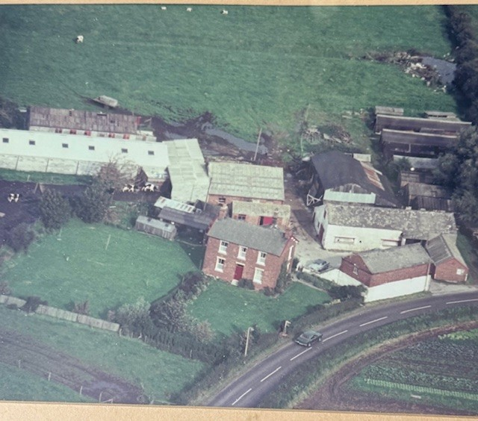
What was Pointer Farm)
Lancaster Road
Arial shot - taken by Sky Views 13 Sep 1975

Slide 2
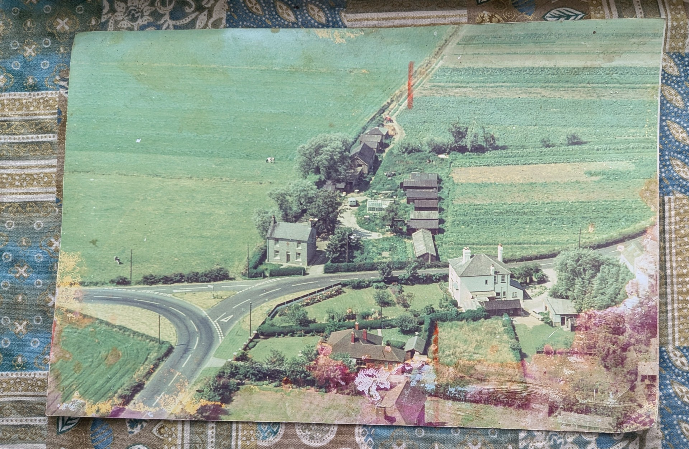
Pointer |House Arial shot circ Seventies or earlier

