Slide 1
Hot Weather Alerts social care briefings
Delivered by the Health Protection Team

Slide 2
Hot Weather Alerts – Action Cards
What
Early warning system
When
Why
Maintain residents
Advice & guidance
1st June to 30th September
Support staff

Slide 3
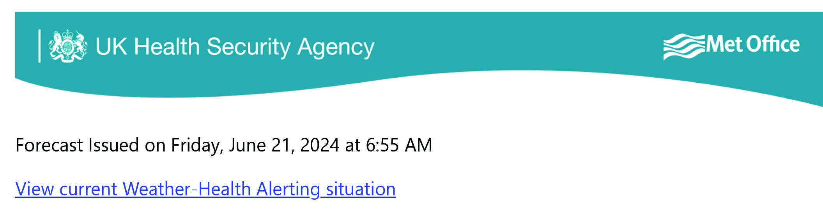
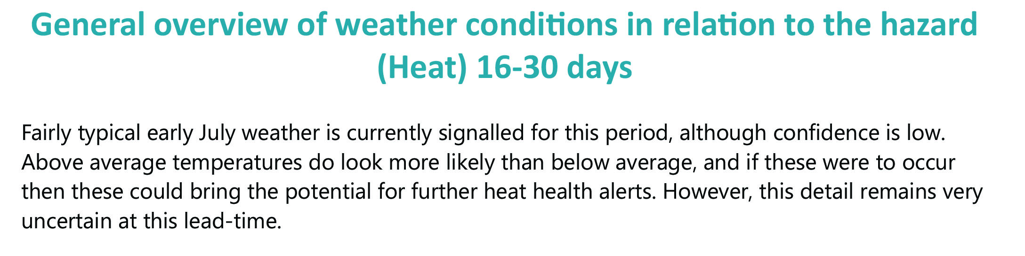
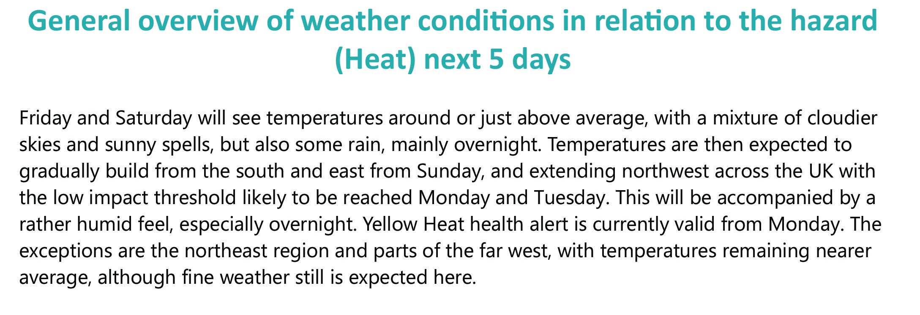
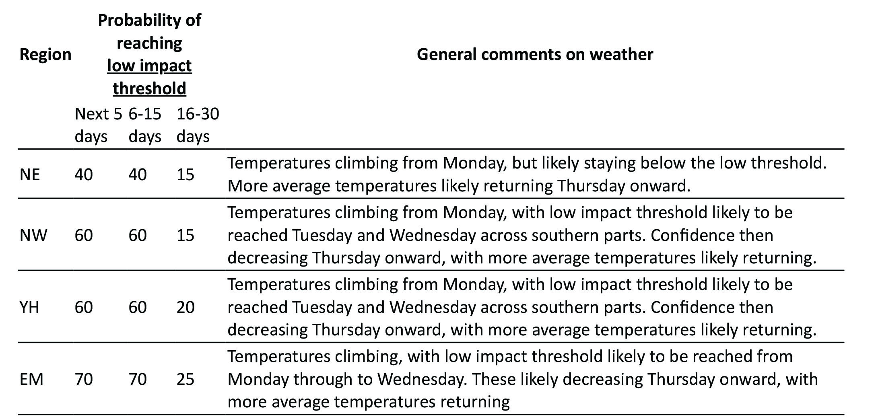
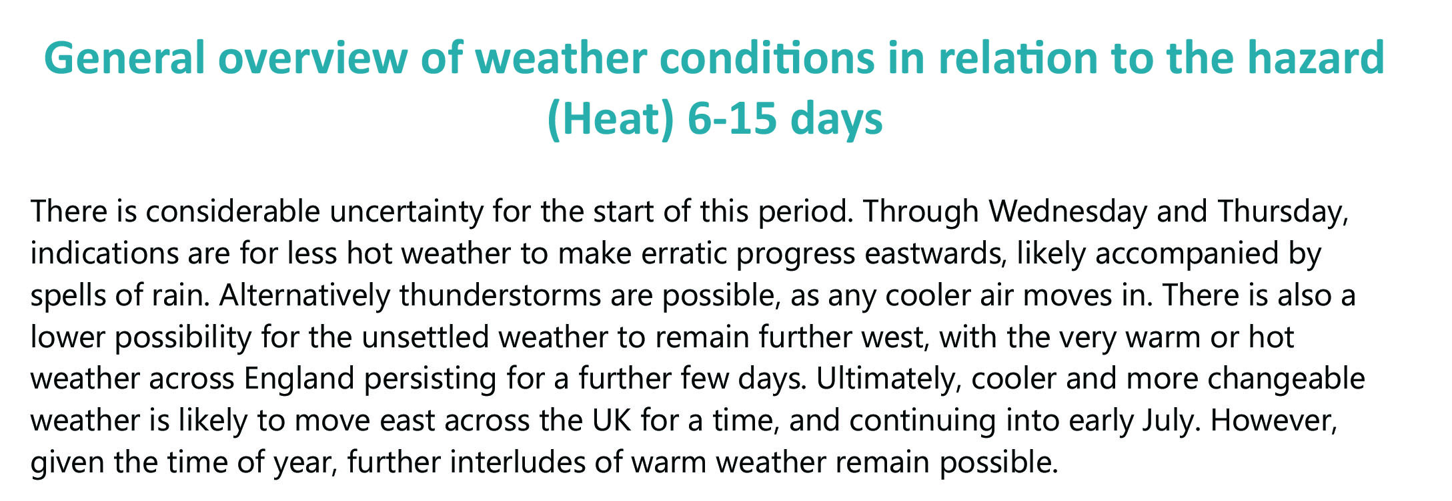
Example of Hot Weather planning advice

Slide 4
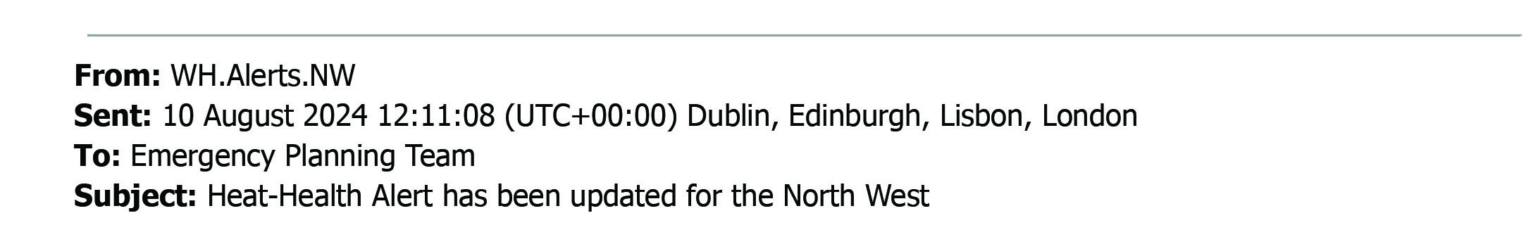
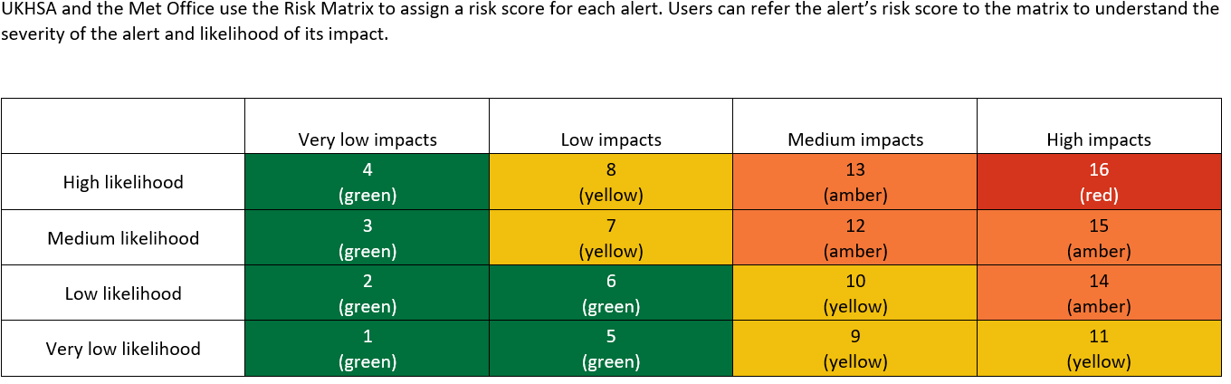
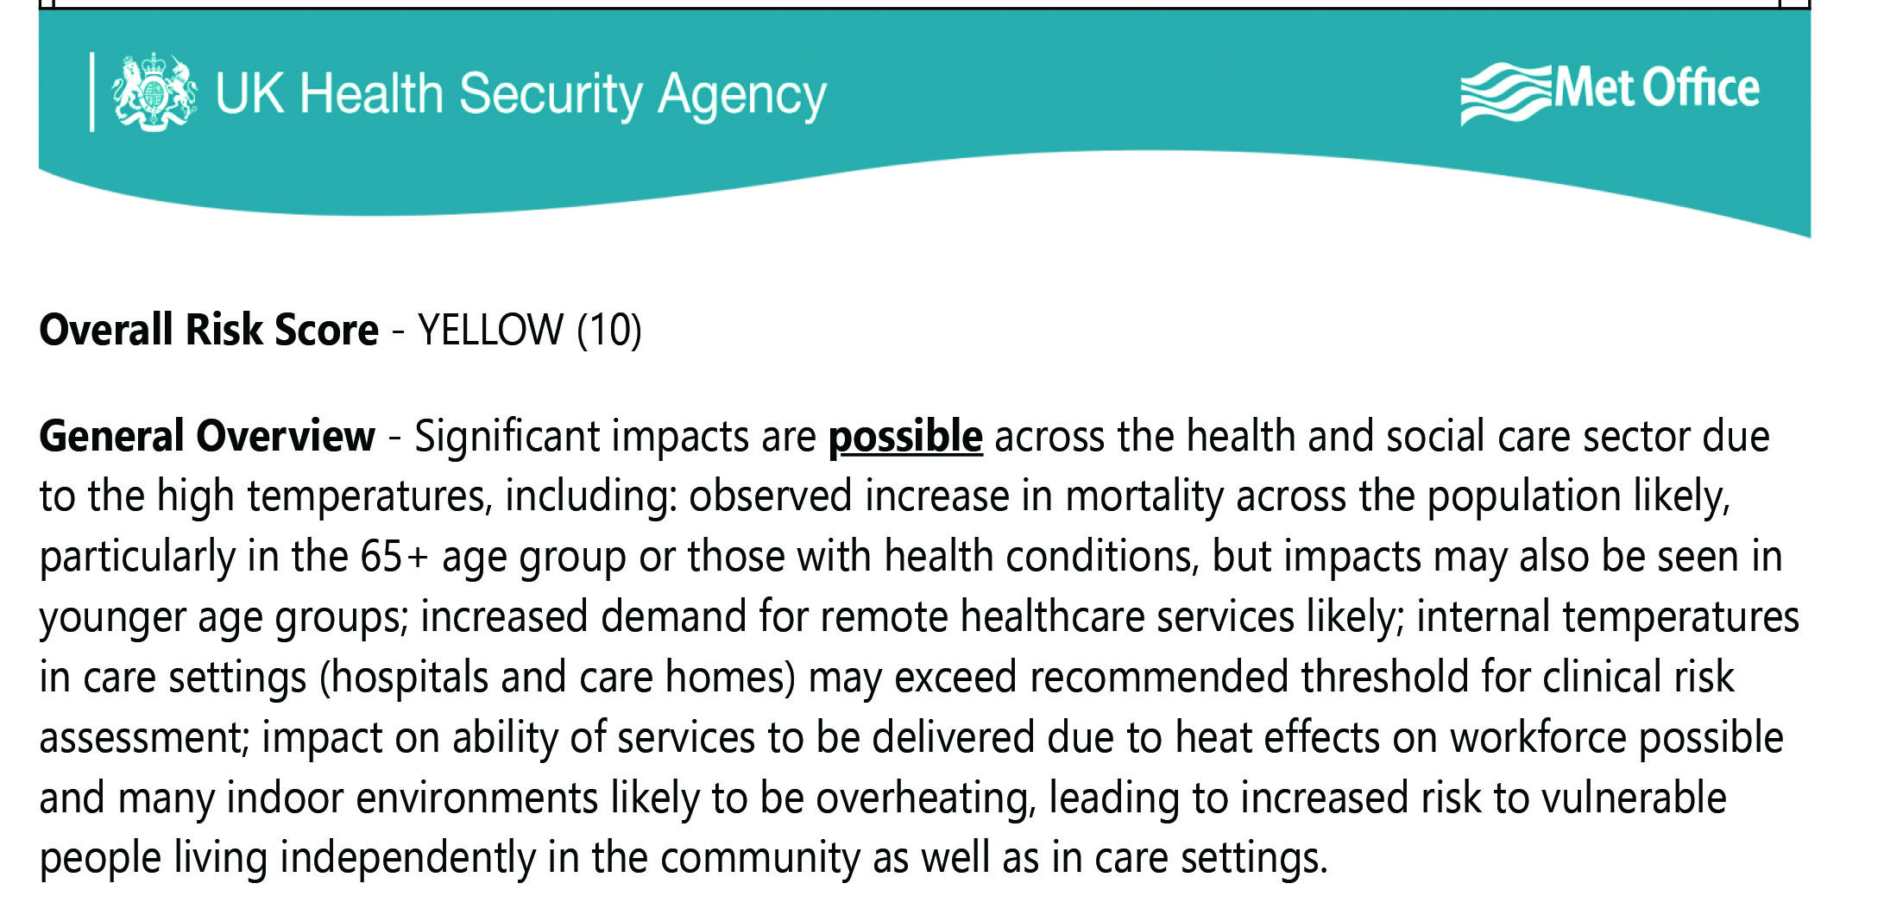
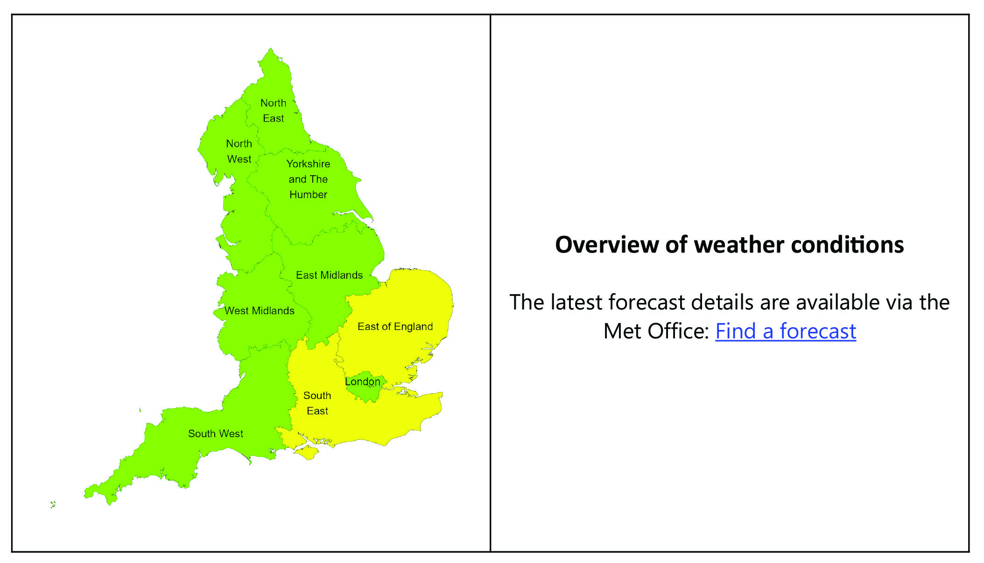
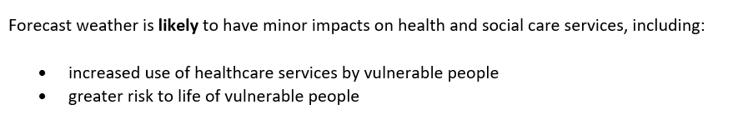
Example of a Yellow alert
Heat-Health Alert has been updated for the North West

Slide 5
How to sign up for alerts
Either go to:
https://www.metoffice.gov.uk/weather/warnings-and-advice/seasonal-advice/heat-health-alert-service and click on ‘signing up for alerts’
Or – click on the link below to take you directly to the registration form
Weather-Health Alerting system
May also wish to sign up for Met Office weather warnings
Met Office – heatwave/thunderstorms/flash flooding/drought

Slide 6
The different levels of response
Green (preparedness) – no alert is issued as the conditions are likely to have minimal impact health; business as usual; summer planning and preparedness activities
Yellow (response) – these alerts cover a range of situations; yellow alerts may be issued during periods of heat that would be unlikely to impact most people but could impact those who are particularly vulnerable
Amber (enhanced response) – an amber alert indicates that weather impacts are likely to be felt across the whole health service, with potential for the whole population to be at risk; non-health sectors may also start to observe impacts, and a more significant coordinated response may be required
Red (emergency response) – a red alert indicates significant risk to life for even the healthy population

Slide 7
Who are the action cards for
All managers –
Share with your team
Helps with planning service activity
Staff who work with vulnerable clients
Help them to be resilient
Staff – personal advice
Shift/outdoor workers
Travel

Slide 8
Who is at risk
Whilst exposure to hot weather can affect ANYONE, some staff and/or service users are particularly at risk. These include: -
older people aged over 65 years
people with underlying health conditions, particularly heart problems, breathing problems, dementia, diabetes, kidney disease, Parkinson’s disease or mobility problems
people on certain medications
people with serious mental health problem
people who are already ill and dehydrated (for example from diarrhoea and vomiting)
people with alcohol or drug dependence
people experiencing homelessness, including rough sleepers and those who are unable to make adaptations to their living accommodation such as sofa surfers or those living in hostels
people who live alone and may be unable to care for themselves
Anyone unable to seek shade during the day
Pregnant women

Slide 9
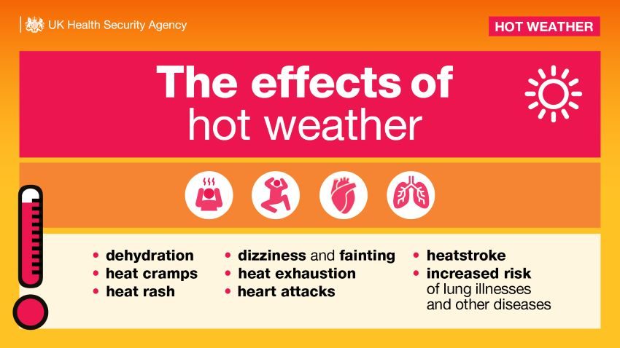

Slide 10
The impacts of hot weather
Even moderate heat can have significant health impacts. Evidence shows that the health burden due to hot weather can occur at temperatures as low as 25-30°C. It doesn't need to be extremely hot to negatively affect your health, as prolonged exposure to moderate heat can still lead to dehydration, heat exhaustion, and exacerbate existing health conditions
Temperature | Health Impact | Effects on the Body | Health Risks
18-25°C | Mild discomfort | Slight increase in sweating, mild dehydration, general discomfort | Increased risk of respiratory issue for those with asthma or allergies
25-30°C | Moderate discomfort | Increased sweating, mild dehydration, fatigue | Higher risk of dehydration and heat-related illnesses
30-35°C | Heat exhaustion | Heavy sweating, weakness, dizziness, nausea, headache | Increased risk of cardiovascular issues, such as heart attacks and strokes
35-40°C | Heat cramps | Muscle cramps, intense sweating, thirst | Higher risk of kidney problems and exacerbation of chronic conditions
40-45°C | Heatstroke | High body temperature, confusion, rapid pulse, potential loss of consciousness | Severe risk of heatstroke, which can be fatal without immediate treatment
Above 45°C | Severe heat-related illness | Risk of organ failure, severe dehydration, potentially fatal without immediate treatment | Extreme risk of multiple organ failure and death

Slide 11
Green (preparedness) – no alert is issued as the conditions are likely to have
minimal impact on health; business as usual; summer planning
and preparedness activities
EXAMPLE ACTIONS
Managers/Staff
All staff to have sight of the Hot – Health Alert Action Card
Business Continuity Plans and emergency contact details up to date
Vulnerable staff – know who they are
Use thermometers to keep a check on the temperature of different rooms
Turn off non-essential lights and electrical equipment – they generate heat
Keep indoor plants and bowls of water indoors as evaporation helps cool the air
Electric fans may provide some relief if temperatures are below 35°C

Slide 12
Yellow (response) – these alerts cover a range of situations; yellow alerts may be issued during periods of heat that would be unlikely to impact most people but could impact those who are particularly vulnerable
EXAMPLE ACTIONS
Managers
Remind staff of Heat – Health Alert Action Card
Maintain contact with all staff – to pre-empt any issues
Consider impacts on service delivery – client visits, trips etc
Clients' restlessness due to heat
Staff
Keep an eye on the weather – Met Office alerts
Hydration of staff/residents
High day/night-time temperatures can affect sleep quality, leading to fatigue and impaired concentration

Slide 13
Amber (enhanced response) – an amber alert indicates that weather impacts are likely to be felt across the whole health service, with potential for the whole population to be at risk; non-health sectors may also start to observe impacts and a more significant coordinated response may be required
Health Impacts
Follow advice from the Contracts Team
Refer to your Business Continuity Plans
Use Risk assessments
Communicate to staff e.g. awareness about self resilience / self care – hydration, suncream etc

Slide 14
Red (emergency response) – a red alert indicates significant risk to life for even the healthy population
Impacts upon your staff/service – know chain of communication
Make sure you are receiving any messages from the contracts management team, and acting upon any advice provided.
You may also be required to provide daily updates back to the contracts management team on any issues you are experiencing to enable us to support you.

Slide 15

Any Questions
Need to know more?
Contact the team at healthprotection@lancashire.gov.uk

