Slide 1
LCC Safeguarding
Adults Service

Slide 2
Safeguarding Support Team (SST)
We are a team set up to support providers, professionals and colleagues across Lancashire.
Our role is to raise awareness of the LSAB guidance that needs to be followed and considered when reporting safeguarding concerns.

Slide 3
What is Safeguarding?
Definition of Safeguarding as written in the Care Act 2014:
“Adult safeguarding” is working with adults with care and support needs to keep them safe from abuse or neglect. It is an important part of what many public services do, and a key responsibility of local authorities.
Safeguarding is aimed at people with care and support needs who may be in vulnerable circumstances and at risk of abuse or neglect. In these cases, local services must work together to spot those at risk and take steps to protect them.

Slide 4
What is a Section 42 Enquiry?
This is set out in Section 42, Care Act (2014)
The Section 42 duty requires consideration of the following criteria under Section 42 (1) and (2) of the Care Act (2014):
S42 (1) Whether there is “reasonable cause to suspect that an adult
i. has needs for care and support (whether or not the authority is meeting any of those needs)
ii. is experiencing, or is at risk of abuse or neglect, and
iii. as a result of their needs is unable to protect themselves.
S42 (2) Making whatever enquiries are necessary v. Deciding whether action is necessary and if so what and by whom.

Slide 5
Things to consider when raising a safeguarding concern
Whether the person has eligible care and support needs.
Whether the person is experiencing or is at risk of abuse or neglect.
Whether as a result of their needs they are unable to protect themselves (i.e. if someone has dementia/LD/Autism).
Need to consider Mental Capacity Act (unwise decision).
Need to consider consent for referral – this can be overridden if others are at risk, or the person does not have capacity around the concerns.

Slide 6
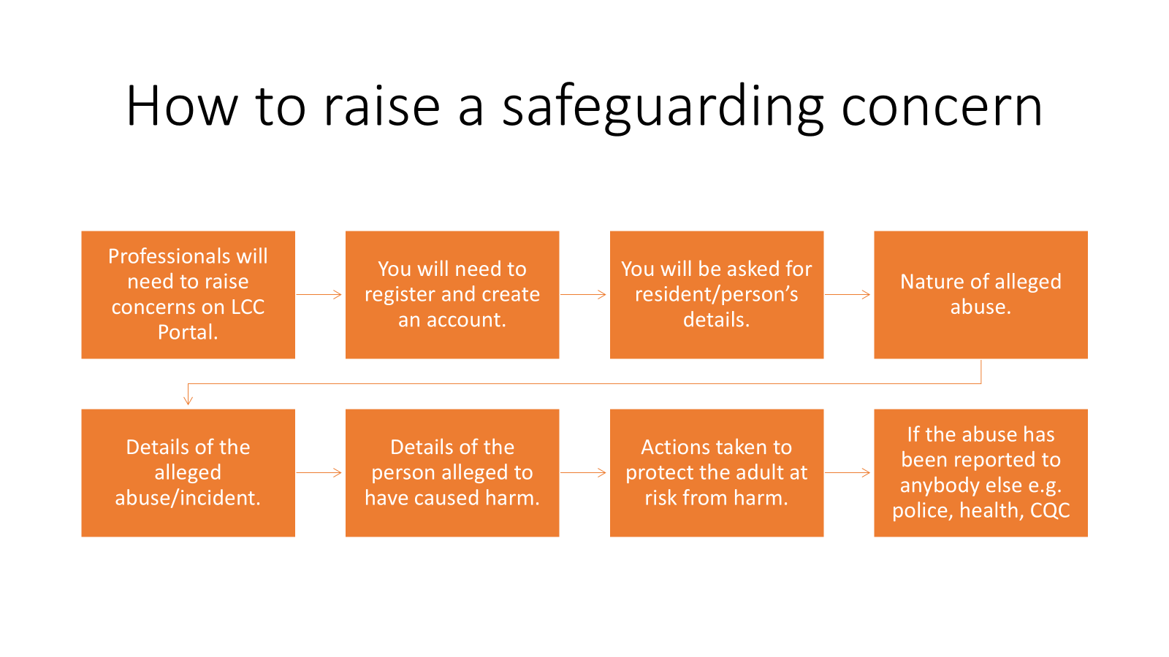

Slide 7
Lancashire Safeguarding Adults Board (LSAB) Toolkit
Reporting a Safeguarding concern and toolkit for providers and professionals

Slide 8
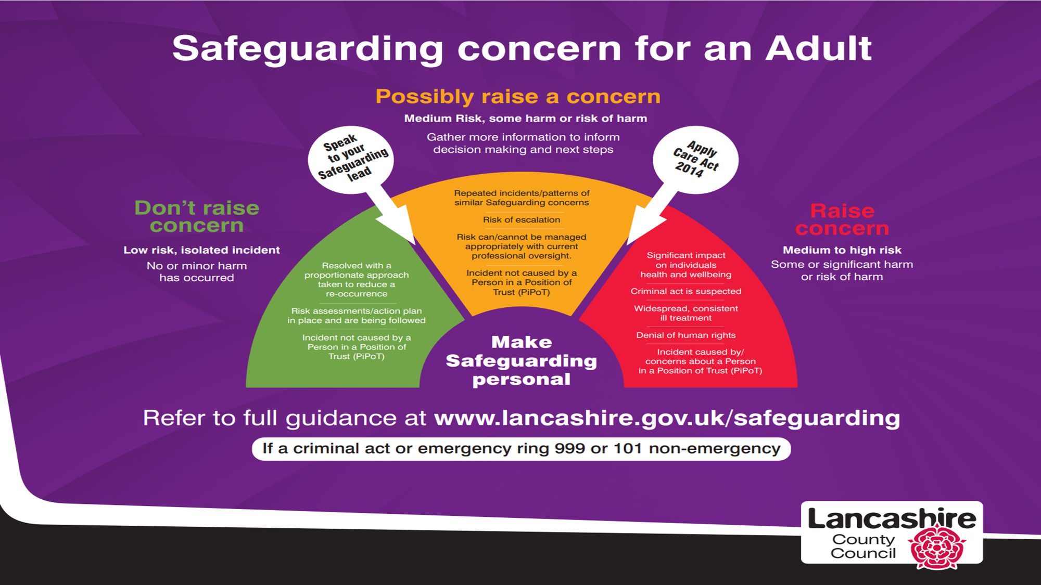

Slide 9
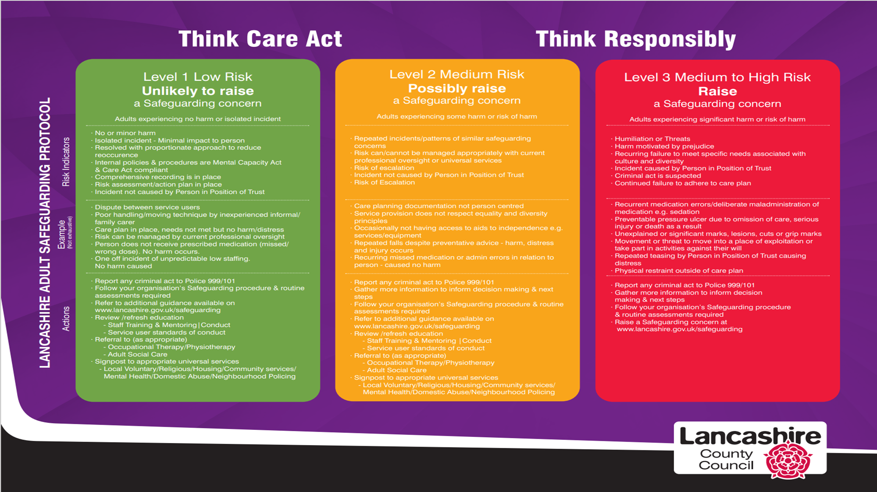

Slide 10
LCC Safeguarding Portal
When raising a safeguarding concern input all details and be guided by the portal outcome.
If the decision is green this means it does not need to be reported to LCC Safeguarding – it may be helpful to take a screenshot of the decision at this point for your records. It is your evidence that you have applied the guidance, and the concern does not need to be reported to LCC.
If the decision is green please do not amend details of your concern to change the outcome to amber so that it can be raised on the portal. Ensure you have documented the decision in your incident file/safeguarding file.
If the decision is amber it possibly needs to be raised to LCC Safeguarding and it is indicating that more information is required.
If the decision is red – it does need to be raised to LCC Safeguarding.
Our IT team are working on updates to the portal for ease of reporting and recording but they have not yet been rolled out.

Slide 11
Provider responsibility if concern does not meet Care Act (2014) for safeguarding
What happens next – what outcomes have been taken to mitigate risk for the future?
Doesn’t meet guidance for reporting to safeguarding, but actions still need to be taken – e.g. reporting to CQC may be required and/or other referrals.
Providers should record and demonstrate that guidance for reporting a safeguarding concern has been considered – there is a LSAB Safeguarding Concerns Checklist that you may find useful to complete during your information gathering.
Document your decision making and rationale for not reporting to LCC Safeguarding – the completed checklist can be used as part of this decision making.

Slide 12
Scenario - Falls
Mrs Smith had an unwitnessed fall in the lounge and was found by care staff on the floor.
Mrs Smith has capacity and was able to tell staff that she had slipped getting out of the chair, she had not hurt herself but could not get up from the floor.
Mrs Smith was assisted up, checked over and no injuries were found.
Medical advice sought from GP.
Increased observations on Mrs Smith for the next 24 hours and fall recorded on incident form and care notes.
- Does a safeguarding need to be raised?

Slide 13
Outcome
Does not meet LSAB Criteria –
Minor/no injury
Not as a result of omissions of care
Provider took appropriate action at the time of the fall by contacting GP and increasing observations.
Incident appropriately documented.
Good practice to record that Care Act (2014)/LSAB guidance has been applied but the incident did not meet criteria.

Slide 14
Scenario – Pressure Sores
- Mrs Taylor has a grade 3 pressure sore.
Tissue Viability Nurses have put a wound care plan in place and have placed Mrs Taylor on 2-hour repositioning.
On their second visit the pressure sore has deteriorated. Nurses can see the dressings have been changed in line with their plan, but the positional changes are not being carried out 2 hourly as advised.
- Does a safeguarding need to be raised?

Slide 15
Outcome
This does meet Care Act (2014)/LSAB criteria and should be reported to LCC Safeguarding team
There has been omissions of care as the repositioning has not been carried out in line with the care plan and this is likely to have contributed to the deterioration in the wound.

Slide 16
Scenario - Medication error
Mr Jackson was given another residents medication which resulted in him suffering a seizure and needing to be treated at hospital.
- Does a safeguarding need to be raised?

Slide 17
Outcome
This does meet Care Act (2014)/LSAB criteria -
There has been an omission of care.
Mr Jackson became unwell as a result and required medical attention at hospital.

Slide 18
Scenario - Falls
- Mr Jones has fallen and suffered a fractured hip.
- He was in the lounge and was walking to the dining table to have his lunch. He mobilises using a zimmer frame. The fall was witnessed but staff could not prevent the fall. This is the first fall Mr Jones has had since being in the care home. Staff called an ambulance.
- Does a safeguarding need to be raised ?

Slide 19
Outcome
Doesn’t meet Care Act (2014)/LSAB Criteria –
- One off fall.
- Witnessed (if not witnessed would need to consider raising).
- No third party.
- Not as a result of omissions of care.
- Provider took appropriate action.

Slide 20
Things to remember when considering raising a safeguarding alert.
We are not looking at incidents in isolation - Is this the first incident for this resident?
Has the person suffered any harm?
Is the care plan up to date and being followed – has there been any omissions of care?
Is there a person who has caused the harm?
What actions have been implemented to reduce risk in the future?
High standard of recording and documenting – are needs increasing? Good recording helps to evidence changing needs, does the person need a review of care/medication etc?

Slide 21


