Slide 1
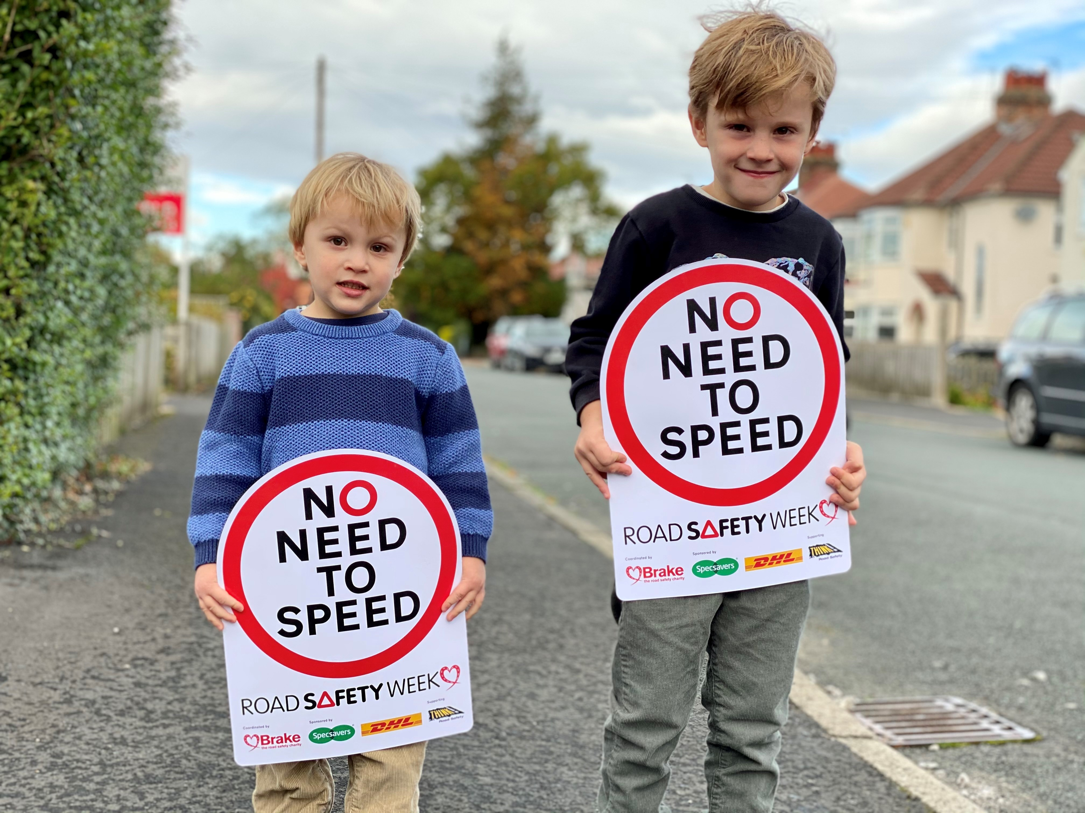


Notes:
Slide 1
Introduce Road Safety Week 2020
Explain that Road Safety Week is the UK’s biggest road safety event and it happens every year.
Explain that Road Safety Week 2020 is taking place this week (16-22 November) and that we are talking about why speed matters for people to be able to make safe healthy journeys. We are also reminding grown ups that there is NO NEED TO SPEED when they are driving.
Move to next slide

Slide 2

Notes:
Slide 2
When is speed a good thing?
Ask the children for examples of when it’s a good thing to be fast.
Suggestions could include:
Running fast when you want to win a race
Getting something to eat quickly when you’re feeling really hungry
Explain that these are really good examples of when speed is good but sometimes speed can be very dangerous. This is especially true when traffic moves too fast on roads.
Move to next slide

Slide 3
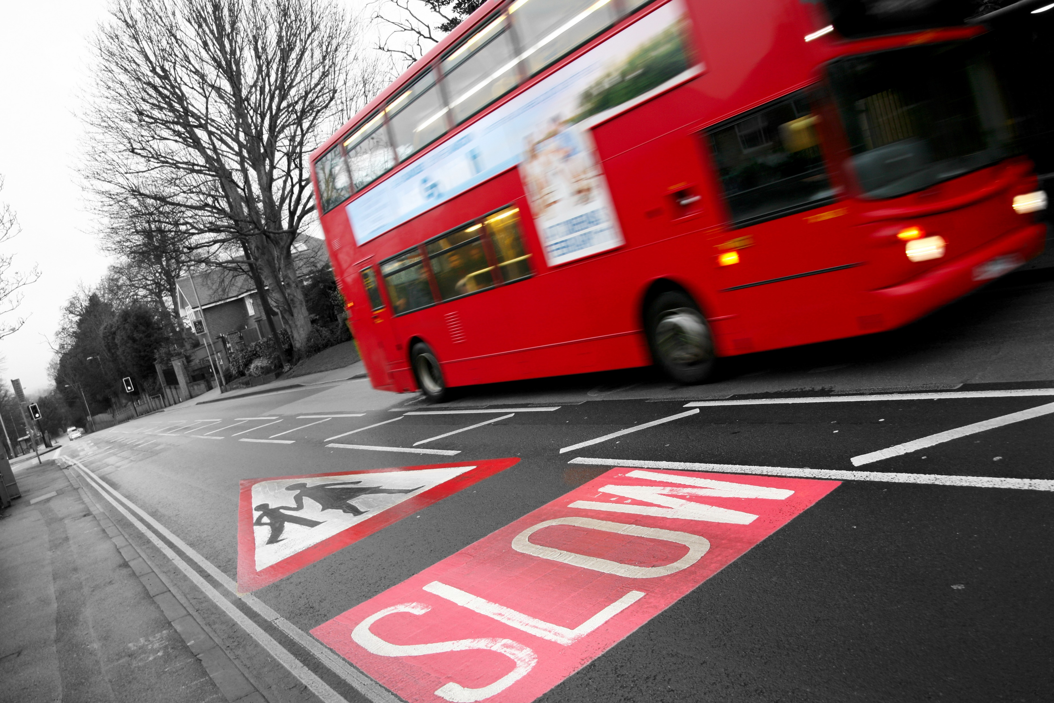
Notes:
Slide 3
Talk about why fast traffic is dangerous.
Most of the time, people move about without being hurt by traffic. But sometimes traffic hurts people. This is called a road crash. Traffic is so fast it’s difficult to see it coming… and difficult to get out of its way.
When a vehicle crashes into people walking or cycling, it hits people very hard, or runs them over and squashes them. This is because traffic is fast and heavy and made of metal.
Sometimes their legs or arms are hurt and don’t work anymore. Sometimes people die. This can sometimes happen if their brain or heart has been badly hurt.
If a car hits another car, it can hurt the people inside the cars.
Say that this isn’t a very nice fact to hear but that every day a lot of people are killed and badly inured in road crashes, including children.
You can share some of the following statistics if appropriate:
Around the world, more than 1.3 million people are killed on roads every year
Road crashes are the single biggest killer of young people aged 5-29, worldwide
39 children aged 15 or under were killed on roads in Britain in 2019
2,218 children aged 15 or under were killed or seriously injured on roads in Britain in 2019
That means that more than six children aged 15 or under are killed or seriously injured EVERY DAY on roads in Britain
One reason that people get hurt on roads is because cars and other vehicles often travel too fast.
The faster a driver is going, the more time they need to stop if something happens in front of them, and the harder they will hit if a crash occurs.
Move to next slide

Slide 4
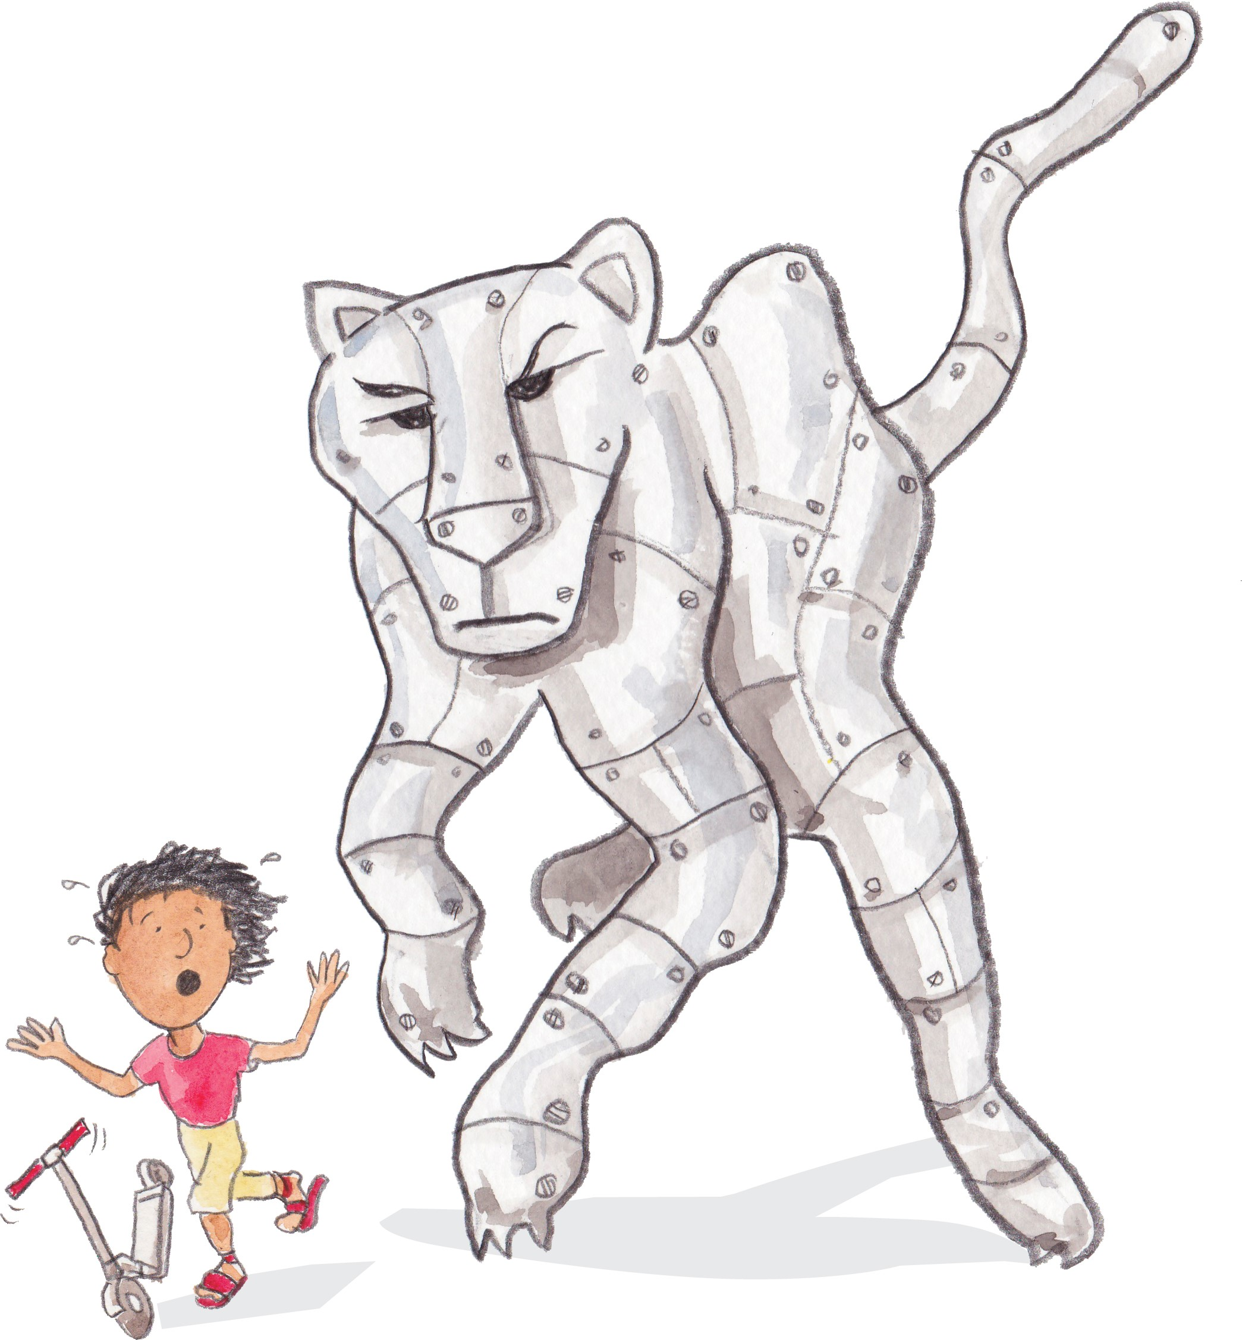
Notes:
Slide 4
An elephant cheetah made of metal
Ask children to think about an elephant. An elephant weighs about the same amount as a car (about two tonnes or more). So it’s no surprise that a car can squash a child under its weight. (Trucks and buses weigh much more.)
You can also imagine 100 children. All these children put together weigh about the same as a car. A car is about 100 times heavier than a child.
Now think about a cheetah. A cheetah is the fastest animal on land, and can run at about 68 miles per hour. Cars can travel faster than this.
Now imagine an animal that is as large as an elephant, and made out of hard metal, moving as fast as a cheetah, hurtling towards you. It’s not a nice thought is it? But this is what it can be like to be hit by a car.
Even when cars move very slowly, they can easily crush a person under the weight.
Ask the children for ideas about what they might call this animal.
Move to next slide

Slide 5
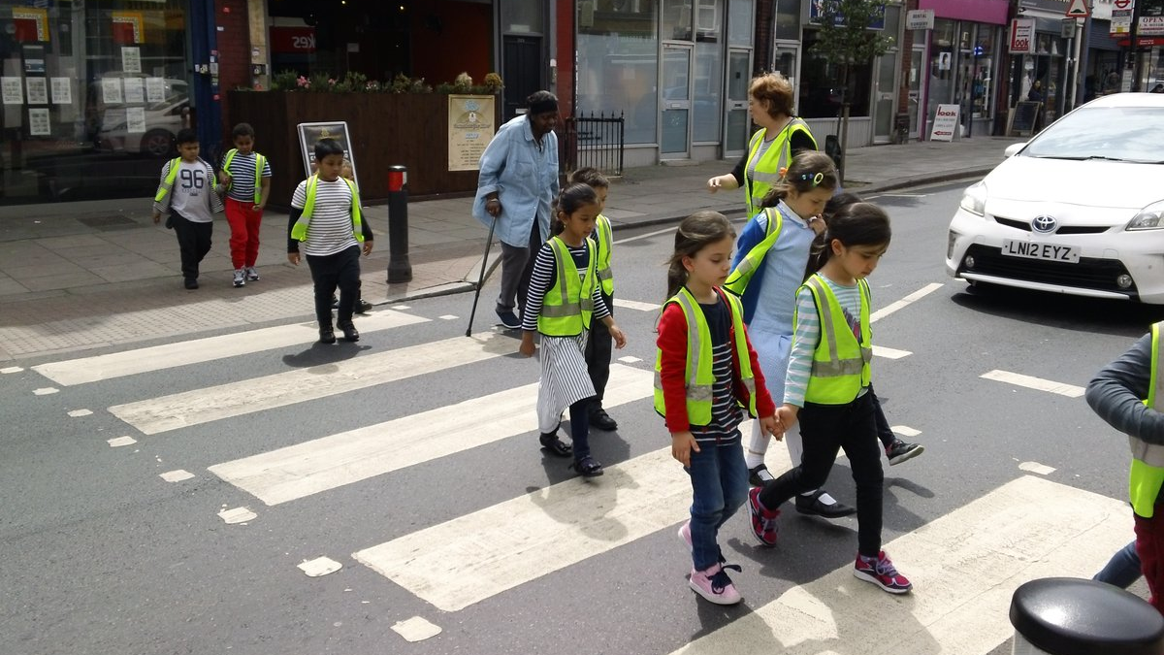
Notes:
Slide 5
How safe do you feel near roads?
Talk to the children about the traffic around your school or around where they live.
DO they think it travels fast?
Do they feel safe walking or cycling near school/where they live?
Does fast traffic make them feel frightened or worried?
Talk about how fast traffic is noisy, and smelly, and how it makes it dangerous for people to walk and cycle.
Ask how many of them walk or cycle to school. Ask them what would need to change for them to walk or cycle more for short journeys?
Ask for a show of hands for how many children know the speed limit on the road outside their school. Do they think this is a safe speed for cars to travel near a school?
Ask the teachers the same questions.
Move to next slide

Slide 6
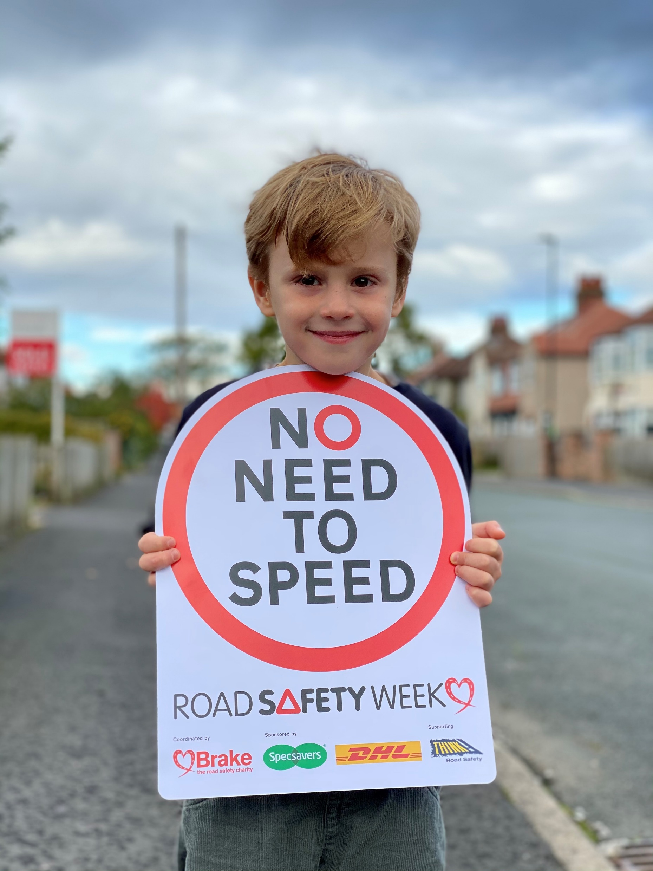
Notes:
Slide 6
Why do we need to shout out that there is No Need to Speed?
Say that this isn’t a very nice fact to hear but that every day a lot of people are killed and badly inured in road crashes, including children.
Share some of the following statistics if appropriate:
Around the world, more than 1.3 million people are killed on roads every year
Road crashes are the single biggest killer of young people aged 5-29, worldwide
39 children aged 15 or under were killed on roads in Britain in 2019
2,218 children aged 15 or under were killed or seriously injured on roads in Britain in 2019
That means that more than six children aged 15 or under are killed or seriously injured EVERY DAY on roads in Britain
One reason that people get hurt on roads is because cars and other vehicles often travel too fast.
The faster a driver is going, the more time they need to stop if something happens in front of them, and the harder they will hit if a crash occurs.
Move to next slide

Slide 7
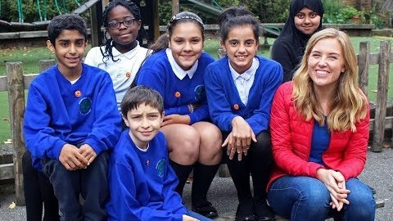
Notes:
Slide 7
Speed Matters with Maddie Moate
Explain that you are going to watch a short film about speed.
Play the ‘Speed Matters with Maddie Moate’ film (5 minutes 3 seconds)
About Speed Matters with Maddie Moate
This short film is aimed at helping children explain how and why they view roads differently and why it is so important for drivers to keep their speed down in places where people live. It gives a simple introduction to kinetic energy and stopping distances, and ends with the children talking about what they would like grown-ups to do to help keep them safe near roads.
The film can be viewed at: https://www.youtube.com/watch?v=ZKrejuEtP5w
You can also embed the film using the following code: <iframe width="560" height="315" src="https://www.youtube.com/embed/ZKrejuEtP5w" frameborder="0" allow="accelerometer; autoplay; clipboard-write; encrypted-media; gyroscope; picture-in-picture" allowfullscreen></iframe>
Move to next slide

Slide 8
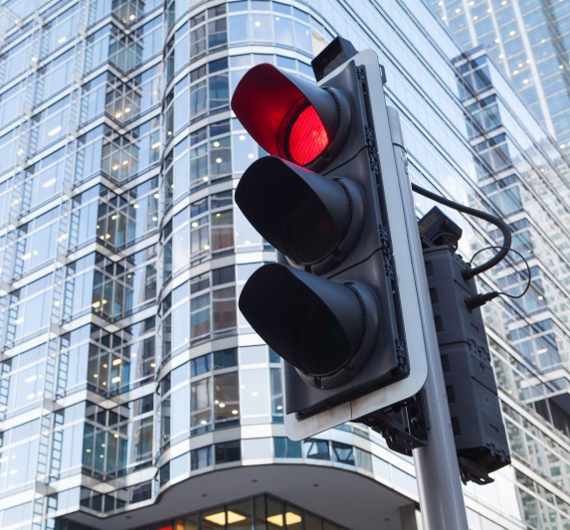
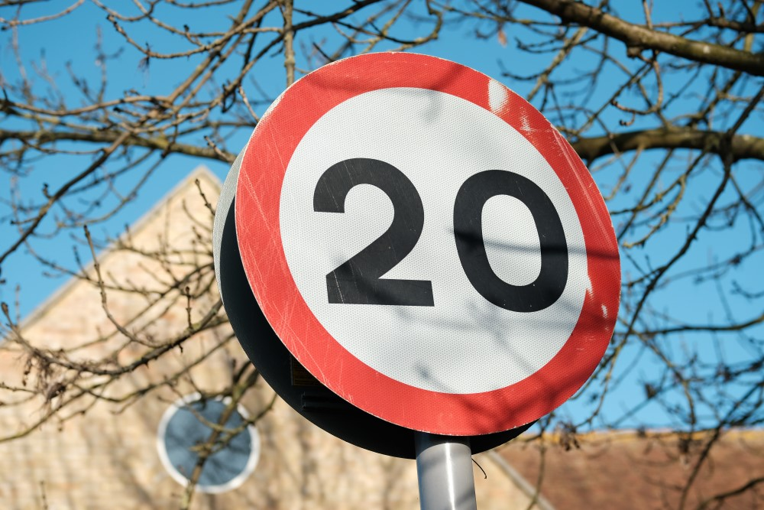
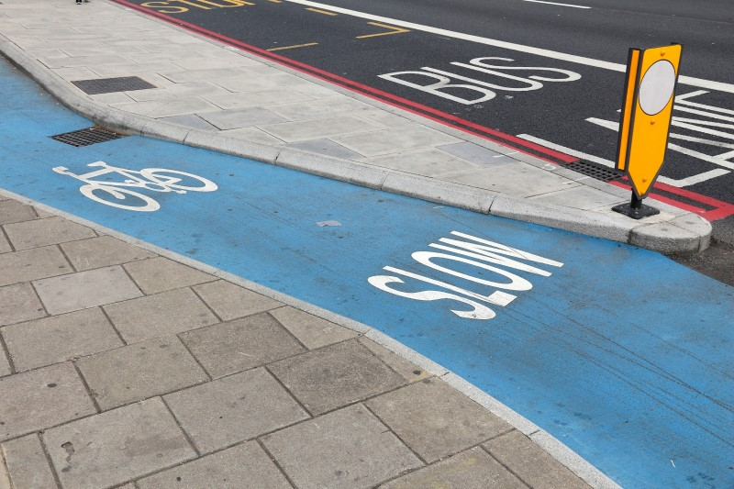
Notes:
Slide 8
What do kids need to enable them to make safe and heathy journeys?
Ask the children for suggestions about what they need to make safe and healthy journeys. Encourage them to think about how the speed of traffic affects their journeys and about how streets that are designed for people instead of traffic might look.
Suggestions might include
Slow speed limits
Roads designed to slow down traffic (speed bumps and chicanes)
Safe spaces for people to walk and cycle away from traffic
Safe places to cross roads
Remind children that in the film the children talk about how they want footpaths, cycle paths, safe places to cross roads, slow traffic and clean air to breathe to make safe and healthy journeys.
Explain that there is a lot that grown ups can do to help make their journeys safer as well and that roads can be designed to put people first instead of traffic.
Say to younger children that they should always hold hands with a grown-up when walking near roads. They should use safe footpaths away from traffic and always cross roads at safe places with a grown up.
Remind older children that we all share a responsibility to use roads safely, and this includes people who walk, scoot and ride, as well as people who drive. Explain that children can talk to their parents or carers and remind them to drive at safe speeds, especially in areas where people live, work and play.
Move to next slide

Slide 9
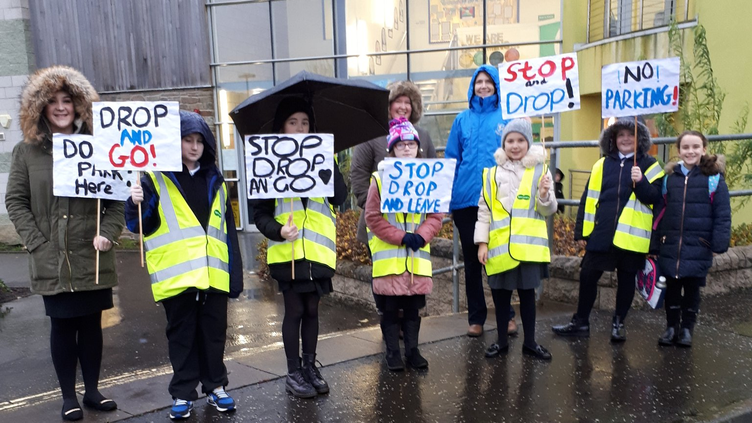
Notes:
Slide 9
Shouting out for safer streets?
Remind the children that you are taking part in Road Safety Week and talking about why speed matters for people to be able to make safe healthy journeys.
We are also reminding grown ups that there is NO NEED TO SPEED when they are driving.
Tell them that everyone can be a leader for road safety.
Talk about any Road Safety Week activities that your school will be doing. There are resources to support all these activities in your Road Safety Week action pack
For example, you might be:
- Talking about road safety in lessons or group activities
- Using the colouring sheets, activity sheets or postcards and taking them home to talk to their parents/carers about important road safety messages.
- Making a display at school out of the artwork they have made during Road Safety Week.
- Taking photos using Road Safety Week selfie props (if you have ordered these) and sharing them to raise awareness that speed matters for safe journeys.
- Taking part in a Wear Your Stripes Day.
Wear Your Stripes for Brake
A Wear Your Stripes Day is a fantastic dress-down day where children and staff donate £1 to Brake and swap their school uniform for fun, bright, stripy clothes in support of Brake’s mascot Zak the Zebra. There is more information about Wear Your Stripes Days and other fundraising activities in your Road Safety Week action pack.
Fundraising for Brake helps our vital work supporting families affected by road crashes and campaigning for safer roads for everyone. All efforts to fundraise for Brake during Road Safety Week are greatly appreciated.
Explain that the children will be learning a lot more about road safety throughout the week
Move to next slide

Slide 10

Notes:
Slide 10
Thank you and summary
Thank your pupils for listening. Remind them that it is Road Safety week and that they can all make a difference to road safety in their communities. They can be good role models, and use roads safely, remind grown ups that there is No Need to Speed and ask grown ups to help keep them safe near roads.
Remind them that they might be talking about road safety in other lessons this week.
If you have a school council ask their representatives to discuss the issues raised in this assembly at their next meeting and to suggest ideas for how they could get more involved in road safety.
END

