Slide 1
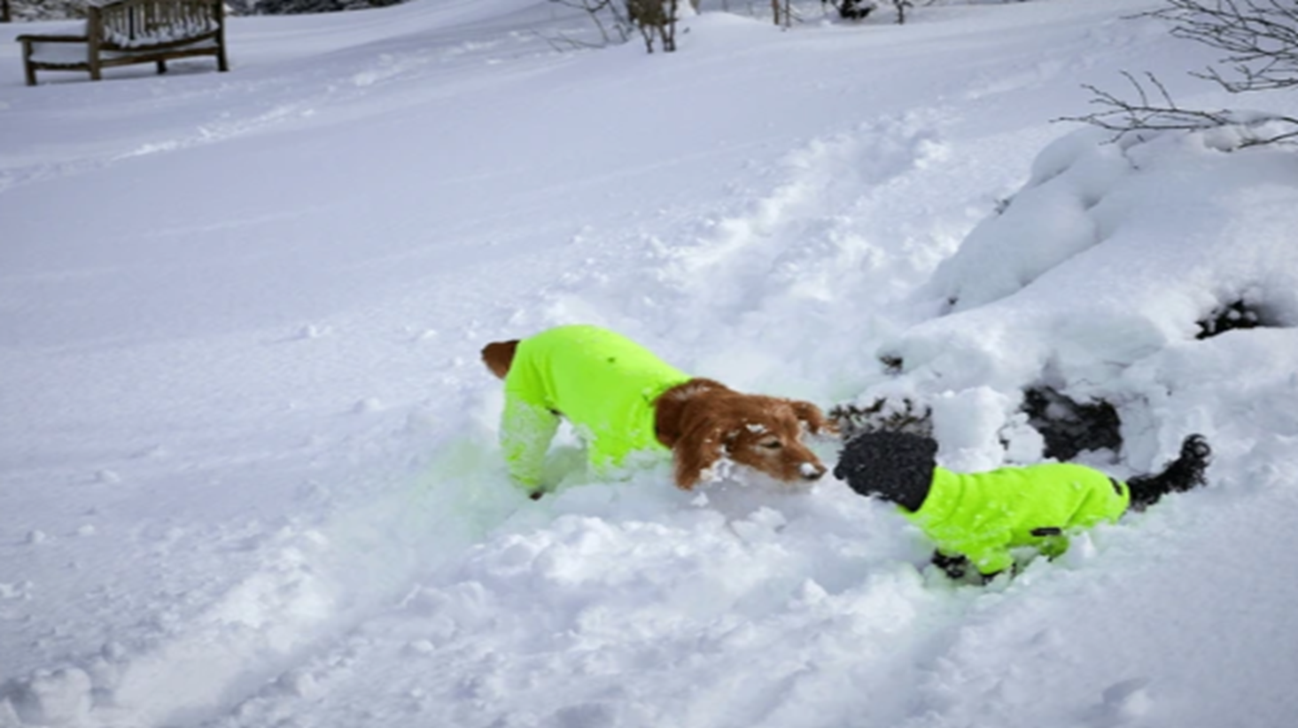

Be Bright Be Seen
Lancashire County Council Road Safety Team

Slide 2
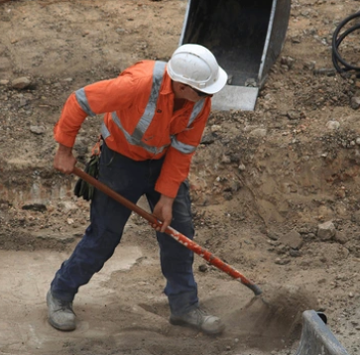
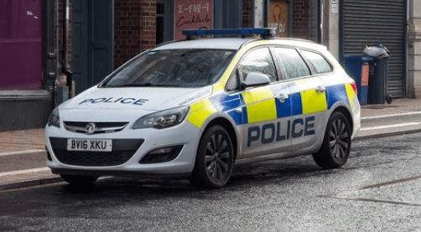
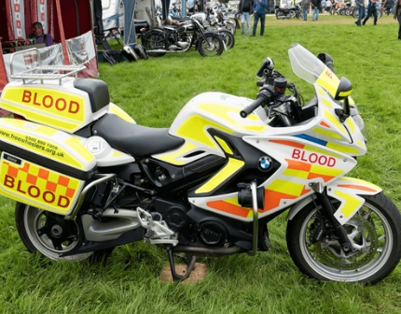
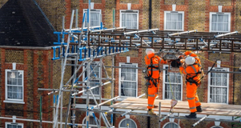
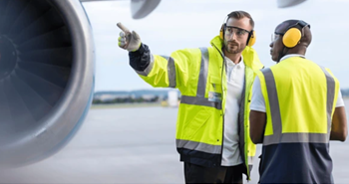

Why do these people/vehicles utilize bright colours?
Notes:
Take answers and remind pupils that to help keep them safe, many people need to wear bright clothing in their workplace

Slide 3
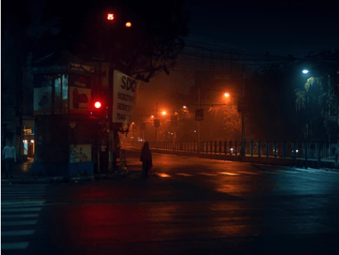
With darker mornings and evenings approaching, why do we need to make sure that we wear bright/reflective clothing when out and about?
Notes:
Can anybody tell me what happens with the light outside at this time of year?
- It is getting darker a lot earlier in the evenings and lighter a lot later in the mornings

Slide 4
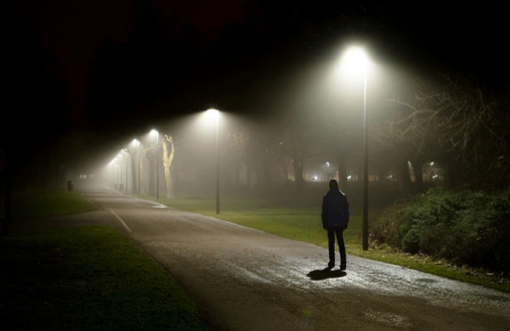

This person is very difficult for drivers to see

Slide 5
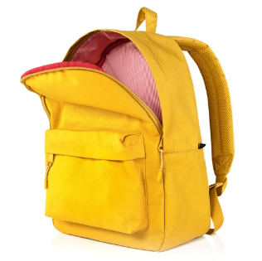



Ways to become more visible at the roadside
Wear brightly coloured clothing to help drivers to see you when you are near the roadside.
Using a torch can help you to see and can also help drivers to see you (never shine a torch towards a vehicle).
Reflective accessories such as bags, wristbands and sashes can help you to be seen in dark or gloomy conditions
When cycling, always use front and rear lights, reflectors and high visibility clothing in dark conditions.
Notes:
Explain that if they shine a torch towards a vehicle, they may dazzle the driver, which is extremely dangerous.
Focus the pupil’s attention on how hard it is to see dark clothing at night or when the weather
is bad e.g. torrential rain/fog/snow. Have any pupils seen people travelling with special
clothing or equipment that make sure they are seen in the dark or when it’s raining hard
and difficult to see?

Slide 6
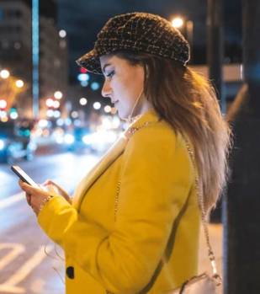
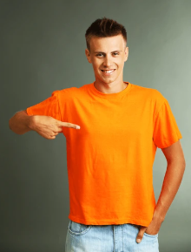

Wearing bright clothing will make you much more visible, helping to keep you safe
Notes:
Reflective materials reflect light and are therefore better in low light conditions
Fluorescent materials are bright coloured and can be used either the day or night

Slide 7


Remember…
Be Alert
Stay alert to traffic, including in car parks
Be Bright
Wear bright or reflective clothing, particularly in dark or gloomy weather
Use Caution
ALWAYS Stop, Look Listen and Think before crossing a road
Notes:
Be Alert​
Be Bright​
Use Caution before crossing ( use the Green Cross Code)

Slide 8

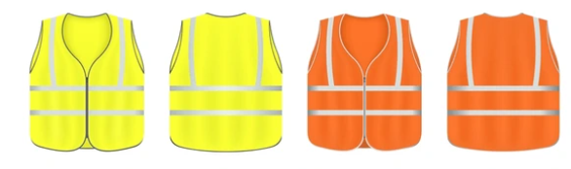
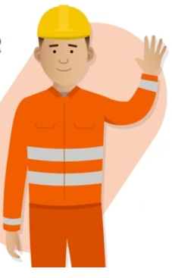
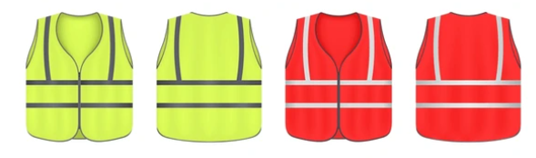
Be Bright Be Seen
Lancashire County Council Road Safety (Education & Engagement) Team

