Slide 1
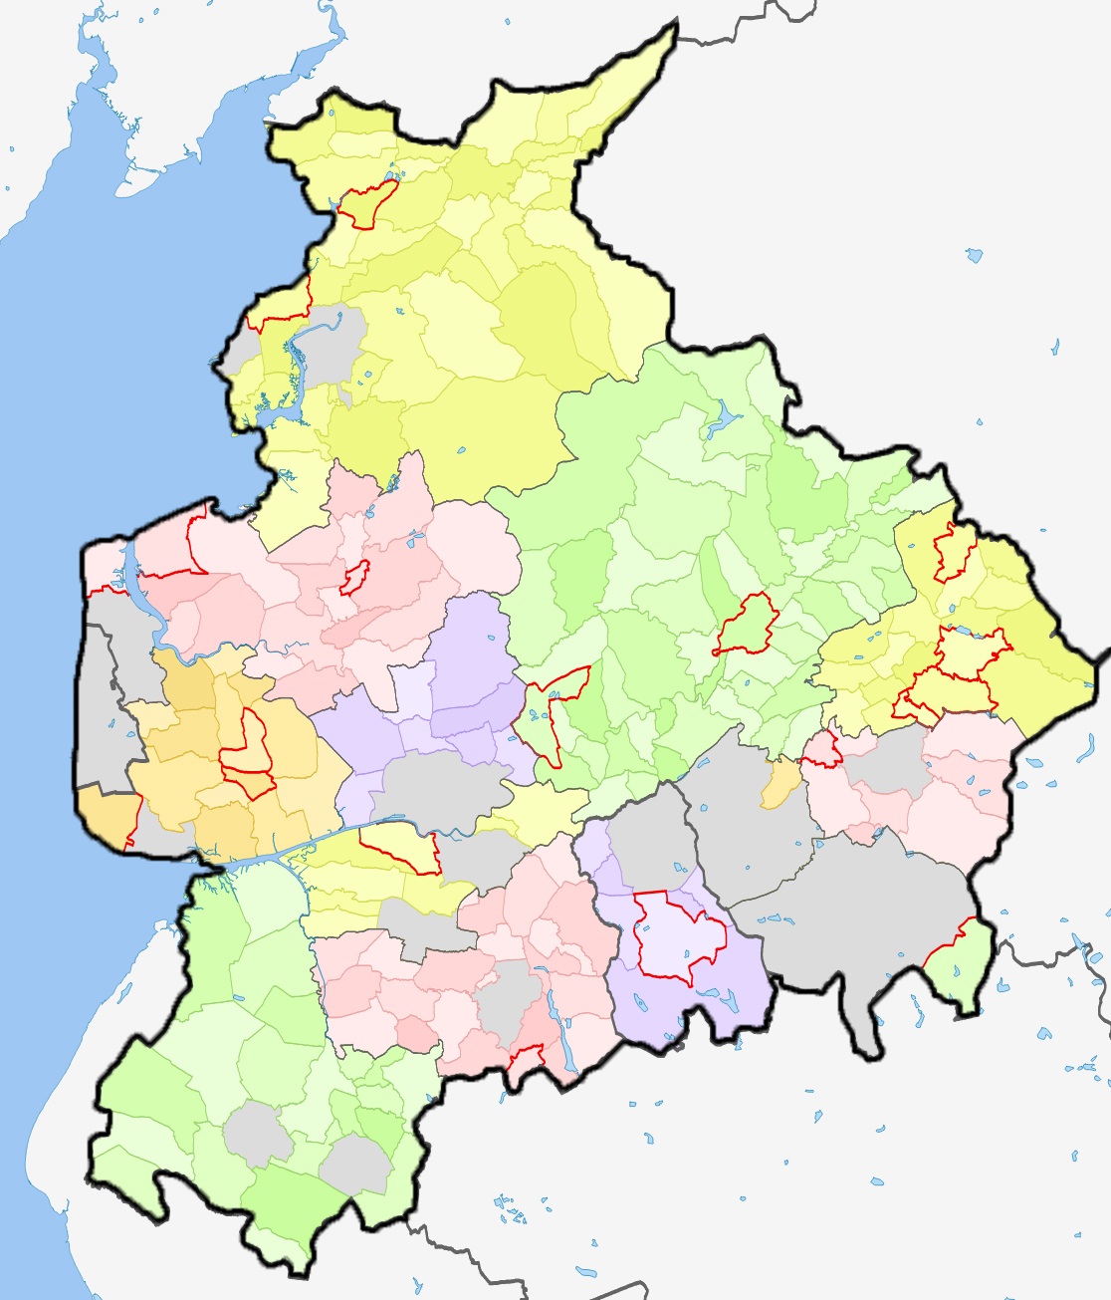
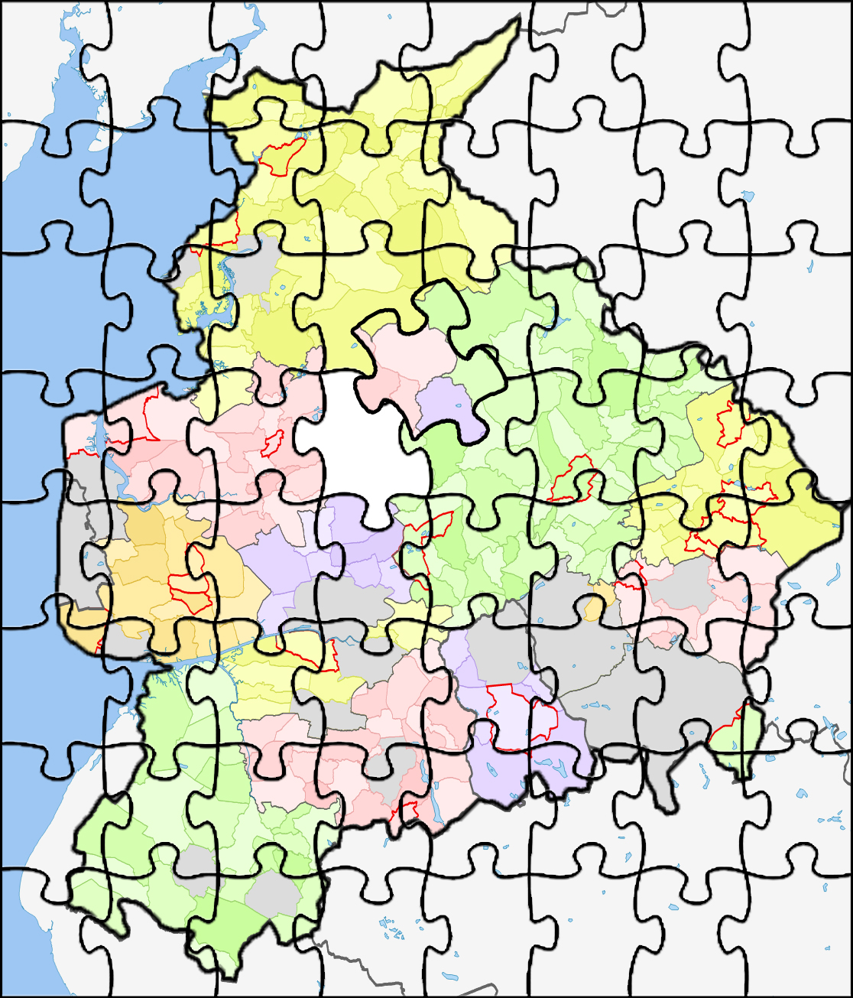
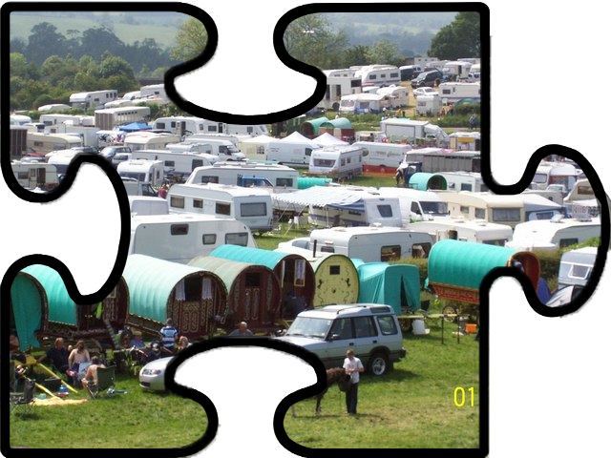
Lancashire is like a big beautiful picture
Notes:
This slide acts as an introduction to the entire assembly, and sets the tone for the rest of the presentation.
AIM: - The aim of this slide is to introduce the pupils to the idea that Lancashire is like a big puzzle, where there are hundreds of different communities and types of people, and that each of these communities might look a bit different, but that they all fit together perfectly to make Lancashire into the big, beautiful jigsaw puzzle that it is.
SCRIPT: This is a map of Lancashire. You can see how big Lancashire is! It stretches all the way up to Lancaster and Carnforth in the North, across to Burnley and Colne in the East, right down to Skelmersdale and Ormskirk in the South and across to Blackpool and Fleetwood in the West. It’s a big, beautiful, proud County with a long history and you can see how many towns and communities make it what it is.
CLICK TO ADVANCE ANIMATION
We can think of Lancashire a bit like a big jigsaw puzzle! We’ve all done jigsaw puzzles, and we know how all those different pieces look a bit different to each other. They all have different pasts of the big picture on them, and they all fit together perfectly to make a lovely picture. Every piece of our jigsaw is really important, and with any of the pieces missing the jigsaw isn’t complete.
CLICK TO ADVANCE ANIMATION
Some of the pieces of the Lancashire Jigsaw puzzle might be the African Caribbean Community, or Jewish People, or the Muslim Community. Some might be the LGBTQIA+ community, or Women, or Men. There are so many different people who help us to complete the Lancashire Jigsaw Puzzle that it’s hard to count them all, but today we are going to be having a look at one of those communities who help us complete the Lancashire jigsaw in a bit more detail, the Gypsy, Roma and Traveller Community.
NOTE: You can use whichever communities you want in the above section, and it might be useful to ask the pupils if they can think of any communities that they have been looking at who we might also include.

Slide 2
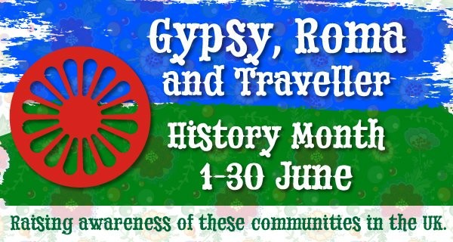
June is GRT History Month!
Notes:
AIM: This slide is really just there to let the pupils know that in June we celebrate Gypsy, Roma and Traveller History Month.
SCRIPT: Every year we have lots of different days or weeks or months when we try our best to focus on a particular group of people. In June we celebrate Gypsy, Roma and Traveller History Month, a whole month when we try our best to learn new things about the Gypsy, Roma and Travellre people, and about the history of their community and culture!

Slide 3
Who are Travellers?
Travellers is a word which we can use to talk about a few different groups of people.
We can use the word Traveller if we don’t know if somebody is a Gypsy, an Irish Traveller, a Showperson or from another Traveller group.
Notes:
AIM: This slide aims to give the pupils confidence over use of the word Traveller and when it is best to use it.
SCRIPT: One of the things that we all sometimes get a bit worried about is all the different words that we hear used to describe the Gypsy, Roma and Traveller people. Everybody is different, and everybody has different words that they like to hear used to describe them. You will find that some Gypsy, Roma and Traveller people like to be called Gypsies, for example, some like Romany Gypsy, some like Irish traveller or Showman or any number of other different words. If we know that somebody prefers to be referred to using any of these words, then of course it’s really kind of us to make sure that we make them feel welcome by using the words that they like most, but if you DON’T know what word somebody from a Gypsy, Roma or Traveller background prefers then we always use the word Traveller, since most people are happy to be called a Traveller whatever background they are from.

Slide 4
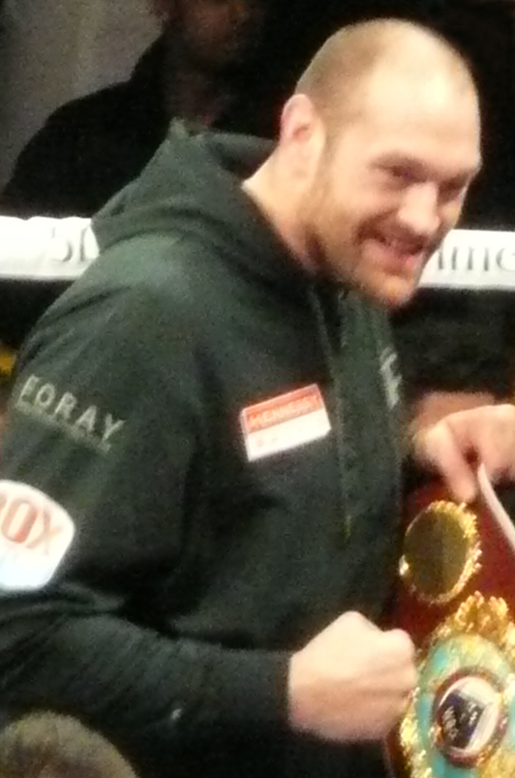
Gypsies
Gypsies have lived in Britain for over five hundred years.
Gypsies might sometimes speak another language called ‘Romanus’
  Kushti means Good
  Mush means Man
  Rakhli means Woman
Notes:
AIM: This slide aims to introduce the pupils to the Gypsy people, who are probably the best known of the Traveller people and to let them know that Gypsy people have a history in the UK going back 500 years and a language which they speak amongst themselves.
SCRIPT: Sometimes you will hear Gypsies referred to as ‘Romany Gypsies’ or as ‘English Gypsies’ or even just as Gypsies. All of these words mean the same thing, and they are used to talk about a group of Traveller people who arrived in the UK just over 500 years ago.
The Gypsy people were originally from Northern India from an area called The Punjab, where they travelled around – We call this being ‘nomadic’. About a thousand years ago The Gypsy People left Northern India and travelled all the way across Europe. Some of them stopped in other countries like France or Germany, but some arrived in Britain in the early 1500s.
When they first arrived, people thought that they were from Egypt, and called them the “Travelling Egyptians”, but over time and as we realised that they weren’t actually from Egypt, and the name developed from ‘Egyptians’ to ‘Gypsies’ which is where the word comes from.
Gypsies actually have their own language, which they speak among themselves, and you might recognise a few of the words that they use! Probably most of us have heard the word ‘Kushti’ which means good.
Some of you might also recognise the person in this photo! Would anybody like to tell us who he is? That’s right, this is Tyson Fury who is a proud Romany Gypsy from Lancaster in the north of Lancashire.

Slide 5
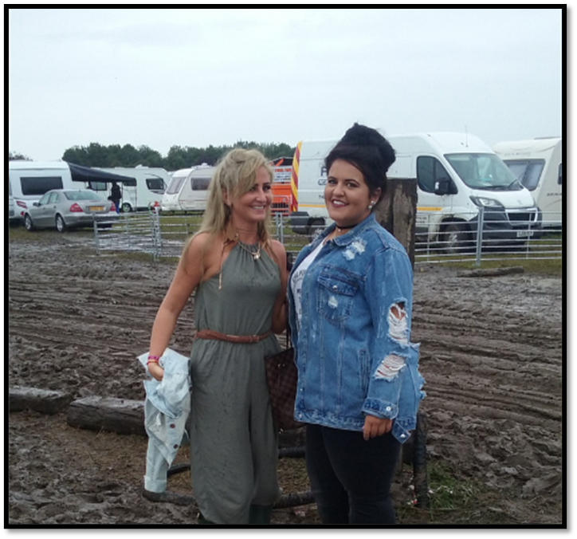
Irish Travellers
Irish Travellers were originally from Ireland, but now live all over Britain.
Just like Gypsies, many Irish Travellers keep horses.
Just like Gypsies, Irish Travellers might live in
houses but might also live in a trailer and travel
around the country for some of the year.
Notes:
AIM: This slide introduces the Irish Traveller people, who people often think are the same as Gypsies, but actually share a separate history, language and heritage. It’s really important to highlight that Gypsies and Irish Traveller people are different.
SCRIPT: One other large group who we talk about when we are talking about Gypsy, Roma and Traveller people is the Irish Traveller people. Some people don’t realise that the Gypsy people and the Irish Traveller people are two different communities, who have a different history and different backgrounds. We learned about how the Gypsy people were originally from Northern India, but the Irish Traveller people are from Ireland, which is very close to The United Kingdom.
The Irish Traveller people have some things in common with the Gypsy people, which is why some people don’t realise that they are different. Just like the Gypsy people, the Irish Travellers often love horses, and many but certainly not all enjoy racing and caring for their horses. Irish Travellers can also live in caravans (which most Irish travellers would call a trailer) for some or all of the year, although many also live in houses or chalets.
The biggest difference between Irish Travellers and Gypsies is their history. The Irish Traveller people have probably lived in the British Isles for thousands of years, travelling around, working and carrying news between towns. Hundreds of years ago in a time before we had televisions and the internet to tell us what was happening in the world, the Irish Travellers moving from place to place were a really valuable source of news from far away for local villages towns and communities.

Slide 6
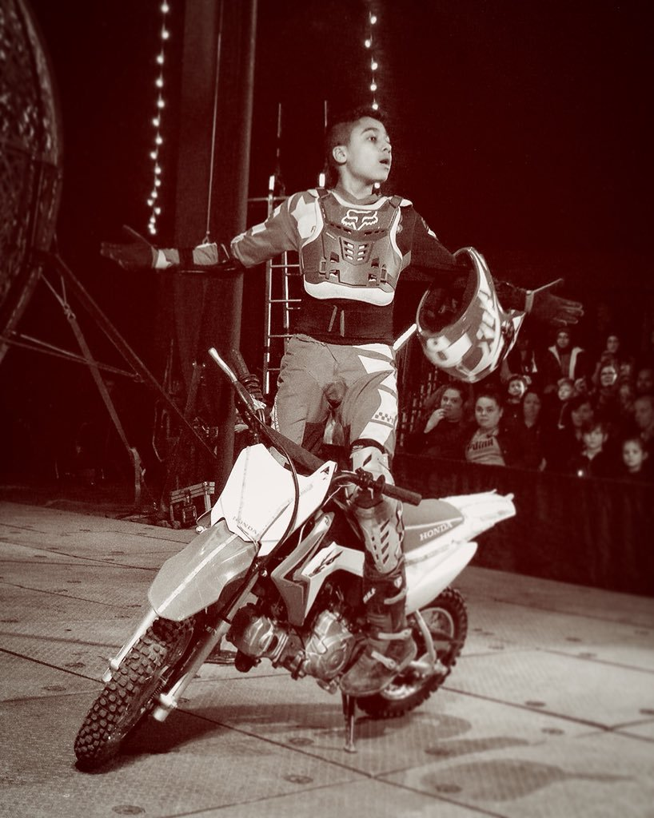
Show People
Show people are people who live and work in circuses or on fairgrounds.
Show people travel for all or part of the year
putting on shows in the circus and setting up
rides, food stalls and other equipment at fairs.
Many circus people perform in the circus as
well as selling food and helping set up the big
top.
Notes:
AIM: This slide introduces Show People, also often referred to as ‘Showmen’, ‘Circus Families’ or ‘Fairground Families’. It’s really important to highlight that Show People are different from either the Gypsies or The Irish Travellers, because generally they see their mobility and way of life as part of their business, not a part of their culture.
SCRIPT: If you have ever been to the circus, or to a fair with lots of fun rides, then you’ll have met some of the Travellers who run these two big travelling businesses! Show People are the third big group of Travellers who we will be looking at today, and the Show People are different again to either the Gypsies or The Irish Traveller people.
Travelling Circuses and Fairs have been a tradition in Europe and across the world for at least three hundred years. Circuses travel with performers who often do amazing tricks like juggling or making people laugh or walking on big tight ropes many metres above the ground. Fairs travel with lots of different rides and games and different food vans which you can buy food from.
Both Fairground and Circus families can be described as Show People, and unlike the Gypsies and Travellers who see their way of life and community as part of their culture and heritage, the Show People often see their way of life and community as part of their business. They need to move around and travel for some or all of the year so that they can bring the Circus or the Fair to lots of different towns, cities and communities so that as many people as possible can enjoy them.

Slide 7
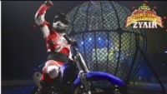
Notes:
This video shows Zyair, a young person who rides a motorcycle in Circus Zyair. Zyair went through both primary and secondary school, travelling from place to place every week and attending a new school in every place the circus visited. He even went to several schools in Lancashire, including one in Lancaster and two in Preston. He loves riding his motorcycle, and the freedom that living with a circus brings him.
[You can show the pupils as much or as little of the video as you want, and discuss it a bit if you like. What would life have been like for Zyair when he was younger and going to a different school every week? Zyair actually really enjoyed making lots of new friends as he travelled around, and he really enjoyed sharing his performances in the evenings with the friends he made at the schools he went to!]

Slide 8
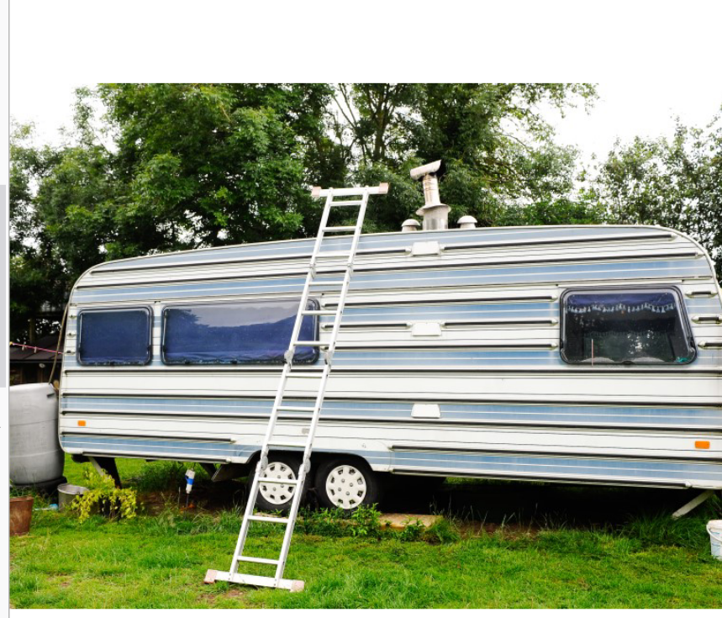
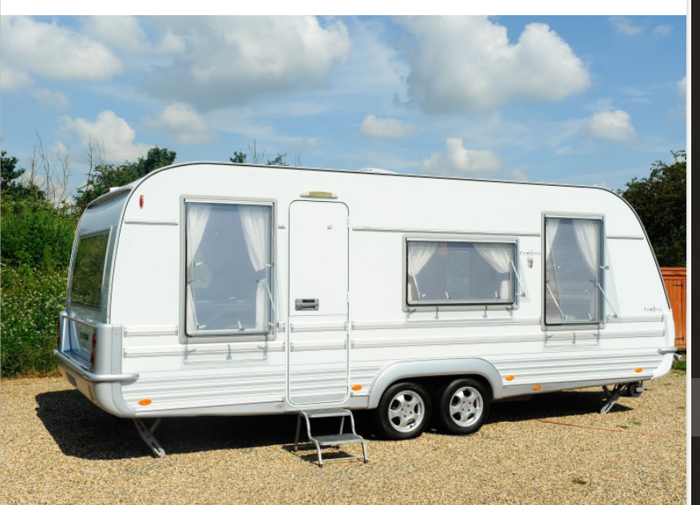
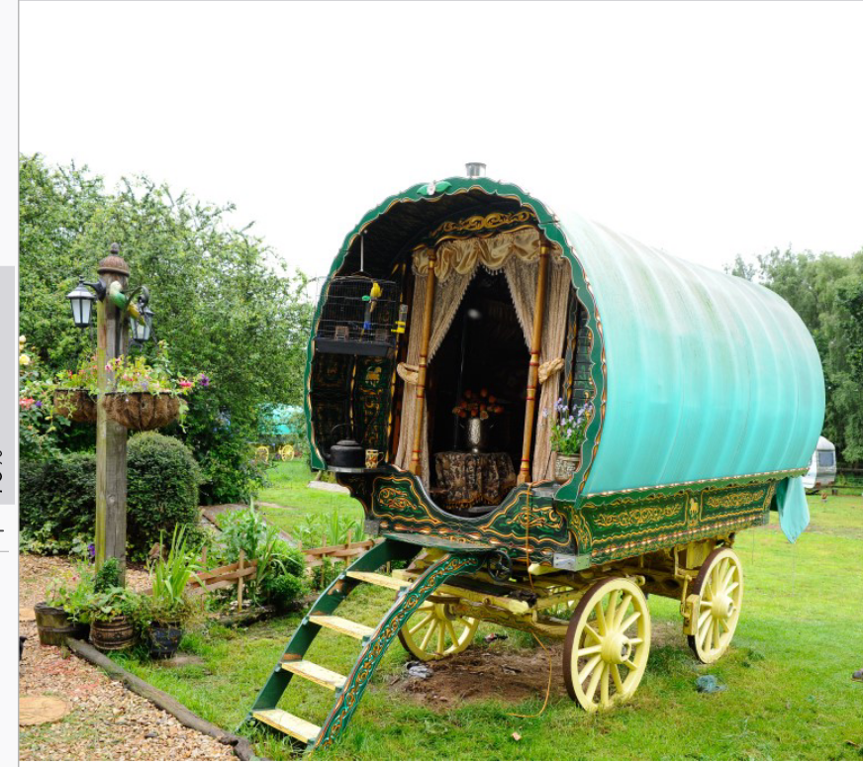
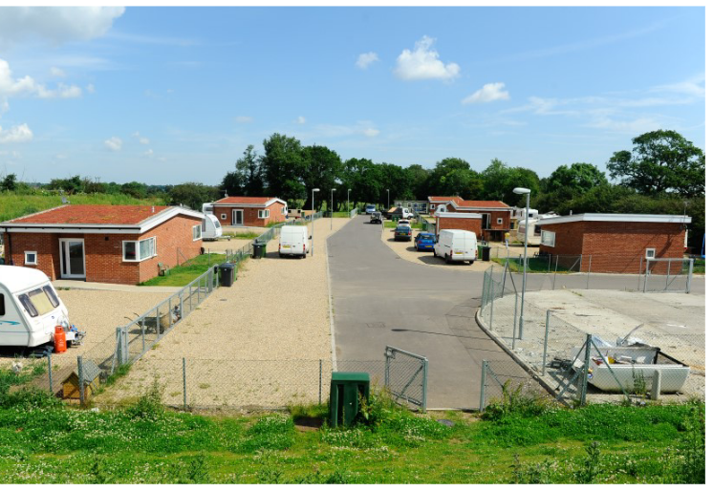
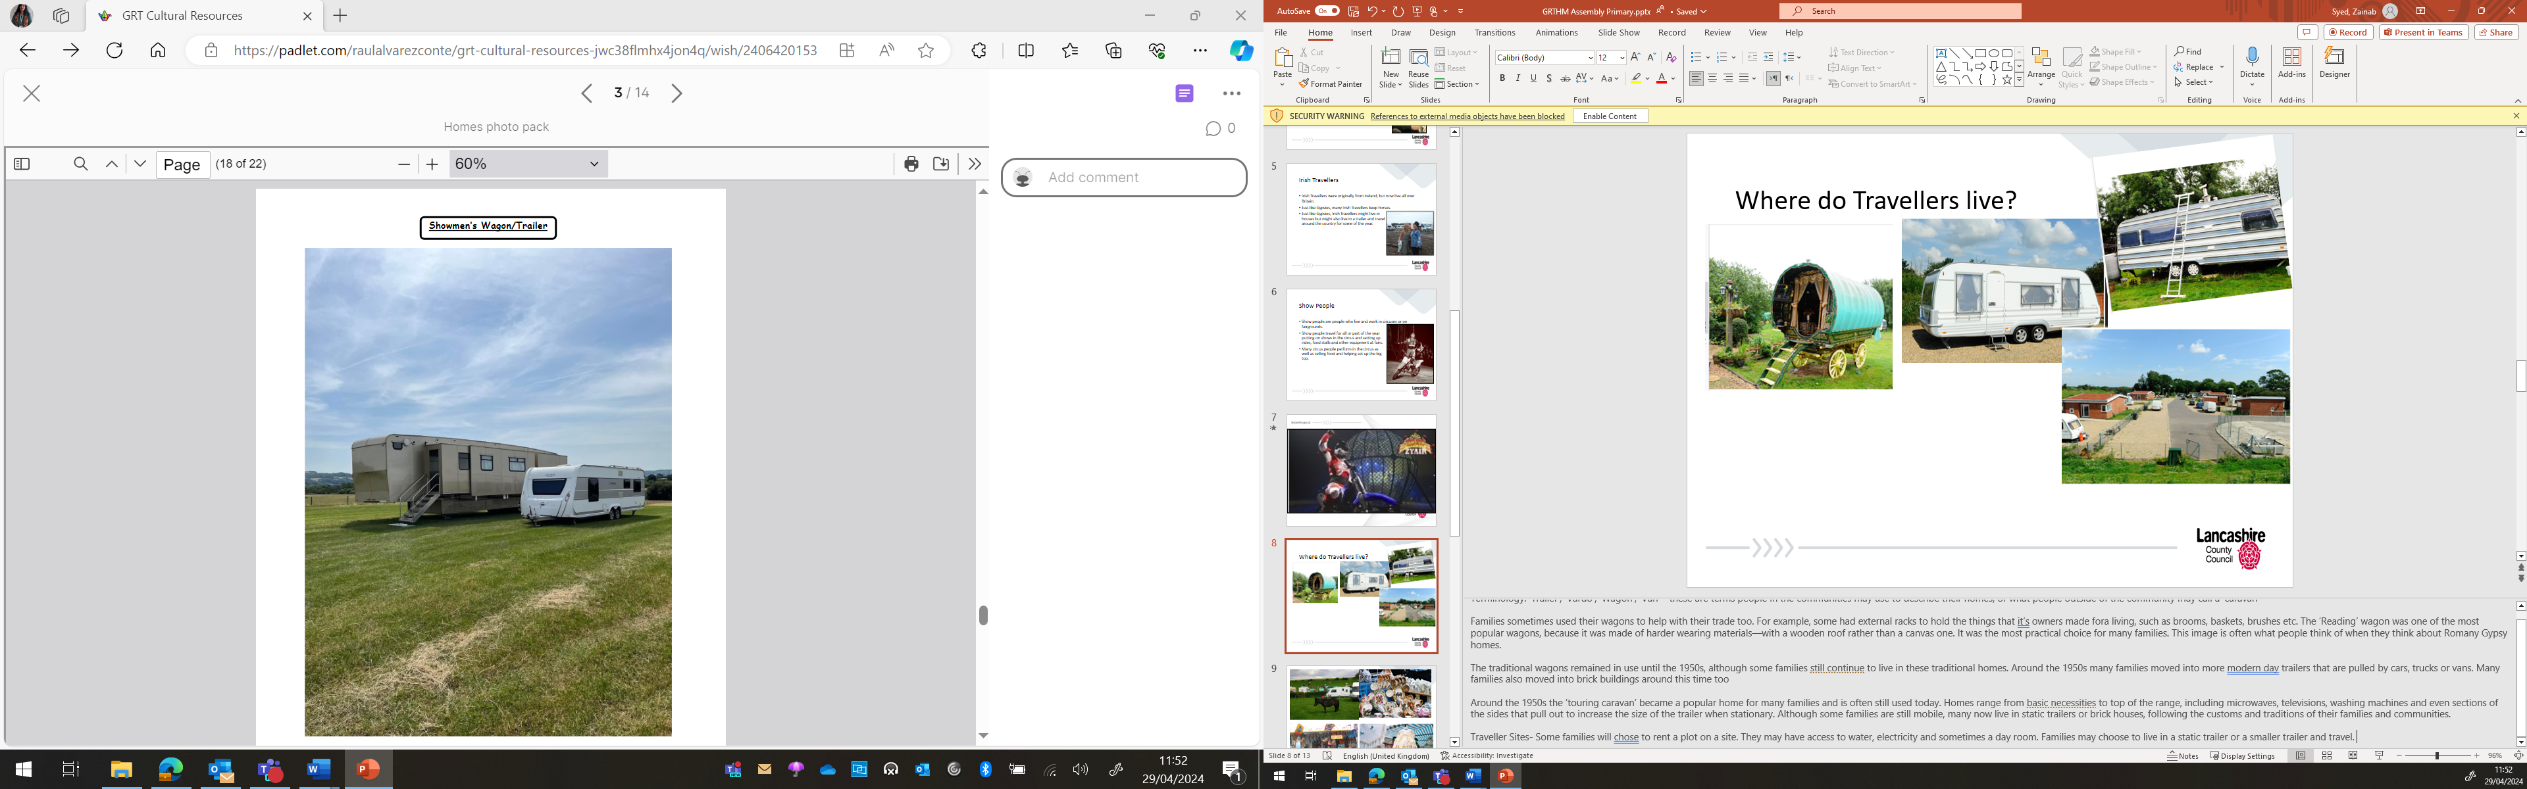
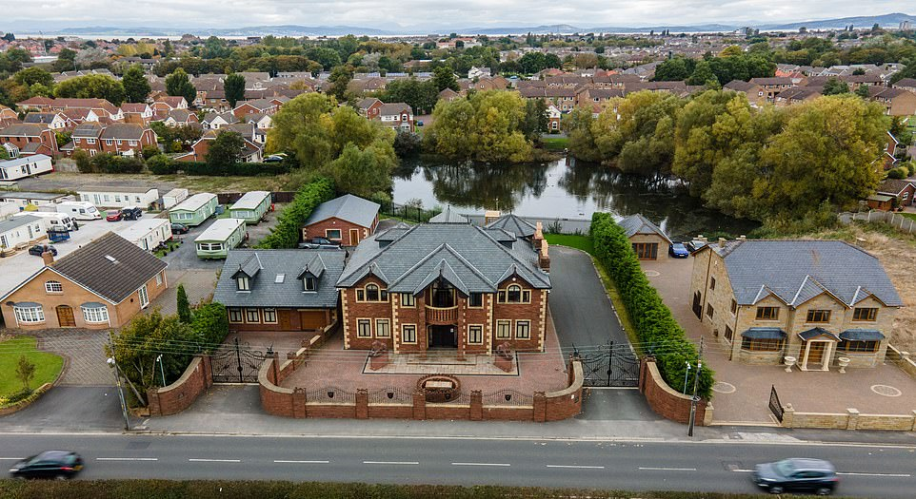
Where do Travellers live?
Notes:
Terminology: ‘Trailer’, ’Vardo’, ‘Wagon’, ‘Van’ - these are terms people in the communities may use to describe their homes, or what people outside of the community may call a ‘caravan
Families sometimes used their wagons to help with their trade too. For example, some had external racks to hold the things that it’s owners made fora living, such as brooms, baskets, brushes etc. The ‘Reading’ wagon was one of the most popular wagons, because it was made of harder wearing materials—with a wooden roof rather than a canvas one. It was the most practical choice for many families. This image is often what people think of when they think about Romany Gypsy homes.
The traditional wagons remained in use until the 1950s, although some families still continue to live in these traditional homes. Around the 1950s many families moved into more modern day trailers that are pulled by cars, trucks or vans. Many families also moved into brick buildings around this time too
Around the 1950s the ‘touring caravan’ became a popular home for many families and is often still used today. Homes range from basic necessities to top of the range, including microwaves, televisions, washing machines and even sections of the sides that pull out to increase the size of the trailer when stationary. Although some families are still mobile, many now live in static trailers or brick houses, following the customs and traditions of their families and communities.
Traveller Sites- Some families will chose to rent a plot on a site. They may have access to water, electricity and sometimes a day room. Families may choose to live in a static trailer or a smaller trailer and travel.

Slide 9
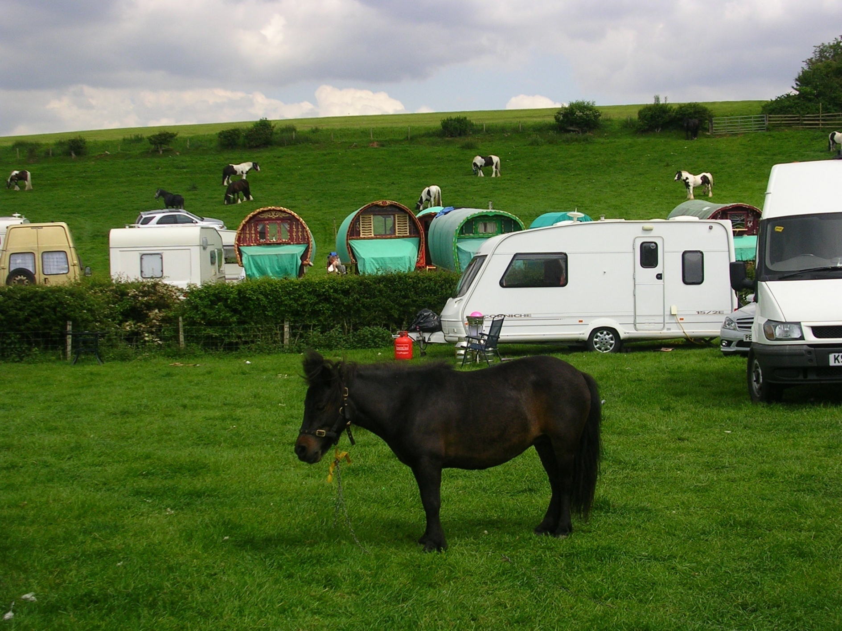
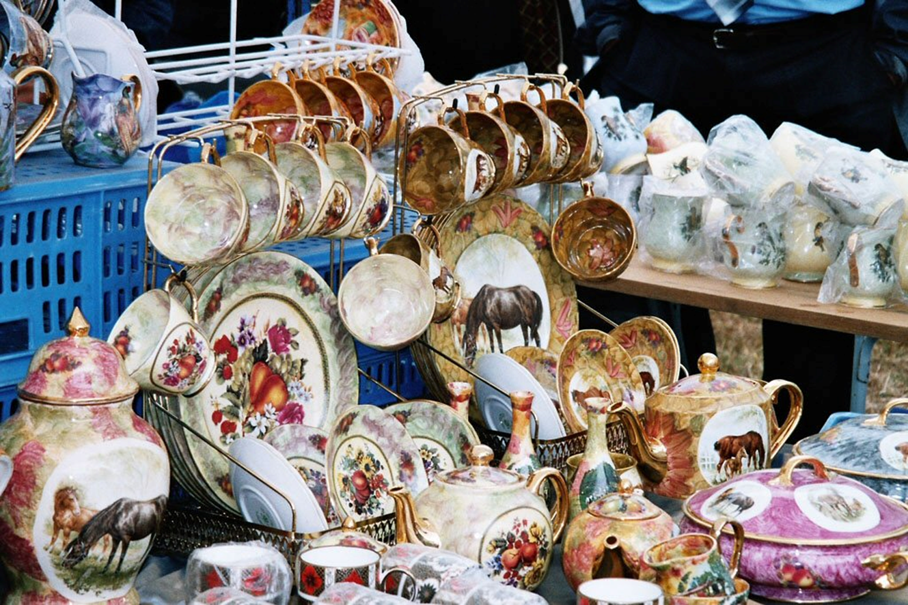
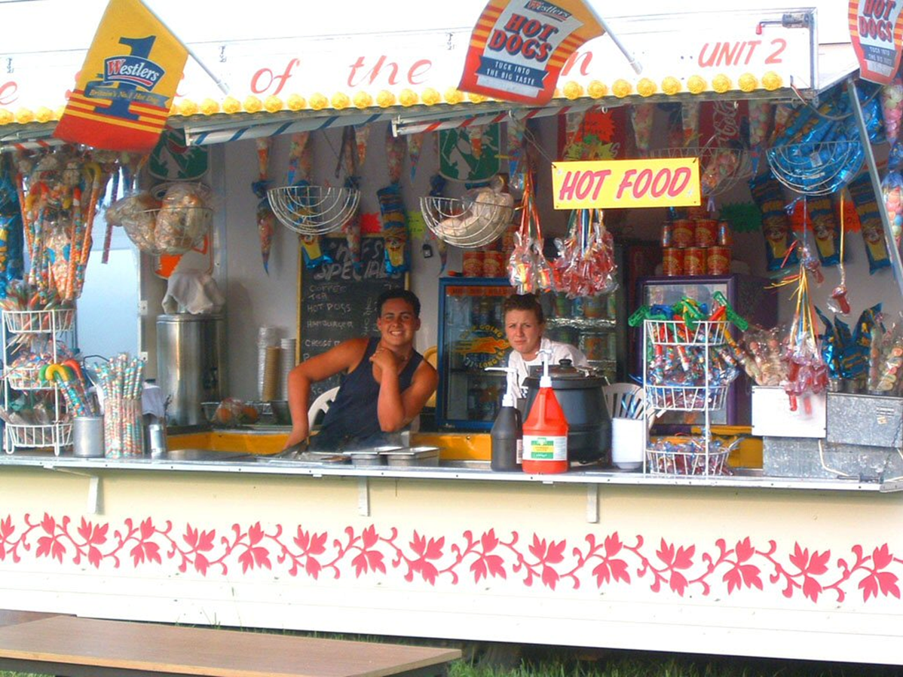
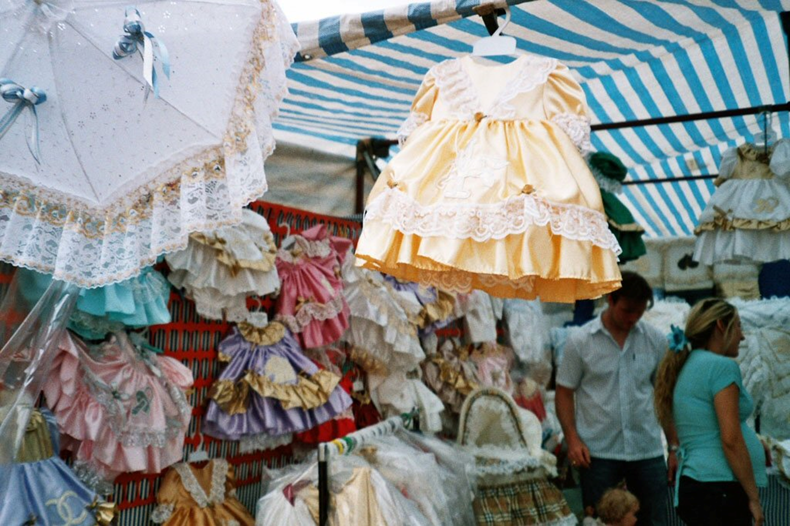
Notes:
These are images from Appleby Horse Fair.
Appleby Horse Fair is an annual gathering of Gypsies and Travellers in the town of Appleby in Westmorland and Furness, which takes place over a week in early June, from a Thursday to the following Wednesday, but this is essentially a weekend event, the main days being the Friday, Saturday and Sunday.
This event has been happening for more than 500 years and even has a Royal charter in place issued to the borough of Appleby from King James II of England in 1685.
The Fair is billed as the biggest traditional Gypsy Fair in Europe, and is commonly likened to a large family gathering. The horses are washed in the River Eden and trotted up and down the 'flashing lane' most main days.
There is a market on Jimmy Winter's Field selling a variety of goods, some traditional to the Gypsy travelling community, and a range other horse-related products.

Slide 10
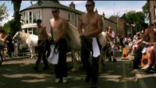
Notes:
This video will show you what the town of Appleby looks like during the horse fair – it is very busy, full of horses and people
Horses are paraded as they are there to be sold.
Many young people ride and was the horses in the River Eden
The video is 2 minutes 17 seconds long

Slide 11
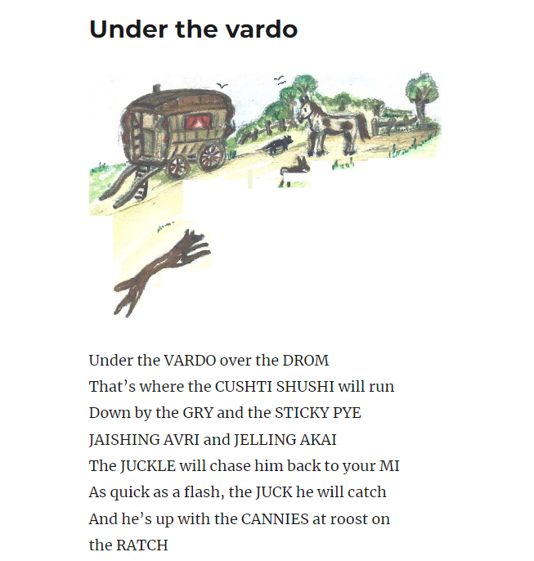
Under the vardo – ACERT
Notes:
This poem / song was written by a Gypsy woman called Kathleen Cunningham (the book is on the next slide)
Kathleen wrote these poems for her grandchildren. They include some Romani words
The link will take you to the website where you will be able to play the song.
Play the song and ask the children what the song is about. What do they notice? Do they know all of the words?
Which words don't they know
The link also has a glossary of the Romany words so you can tell the pupils what the word means.
Once they know what the song is about, sing again.

Slide 12
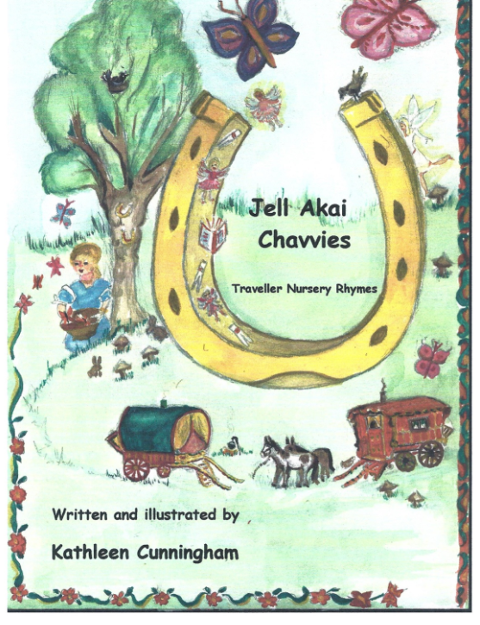
acert.org.uk/jell-akai-chavvies/
Notes:
This is the book that Kathleen wrote – it is full of nursery rhymes with Romani words.
The link will take you to the online version of the book.
Jell Akai Chavvies – means come to me / come here children
Classes could explore and learn other nursery rhymes, and perform them in assemblies

Slide 13
Summing up of what we have learned
Many Traveller families visit Appleby Horse Fair, as a holiday or to buy and sell horses
Travellers can live anywhere
Travellers is a word which we can use if we don’t know if somebody is a Gypsy, an Irish Traveller, a Showperson or from another Traveller group.
  Kushti
Notes:
Ask children what they can remember about Travellers, then reveal the point summary
Can they share a characteristic of a Gypsy? Speak Romanus – Kushti – good
Can they share a characteristic of an Irish Traveller? Horses, Ireland, travel
Can they share a characteristic of a Shoe person? Circus or Fairground
Where do Travellers live? Houses, caravans / trailers, mobile homes, anywhere
What do you remember about Appleby Horse Fair? Takes place in June, buying and selling horses
Have a look at our website for some resources and ideas GRT History Month - Lancashire Professional Development Service

