Slide 1
Last 1000 Days Improvement Collaborative
@BTHQIHub

Slide 2
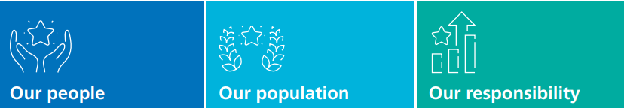

Our Mission
To deliver safe, effective, sustainable care for everyone, every day.

Slide 3


Our Aim
Reducing unnecessary time care home residents spend in emergency healthcare settings in their last 1000 days of life by October 2024
Notes:
So this is my ask, that we work together and share in the learning to reduce unnecessary attendances to ED, and work together to reduce deterioration associated harm by improving the prevention, escalation, and response to residents deteriorating, through working together to look at better ways of working together co-ordination and as part of safe and reliable pathways of care.

Slide 6
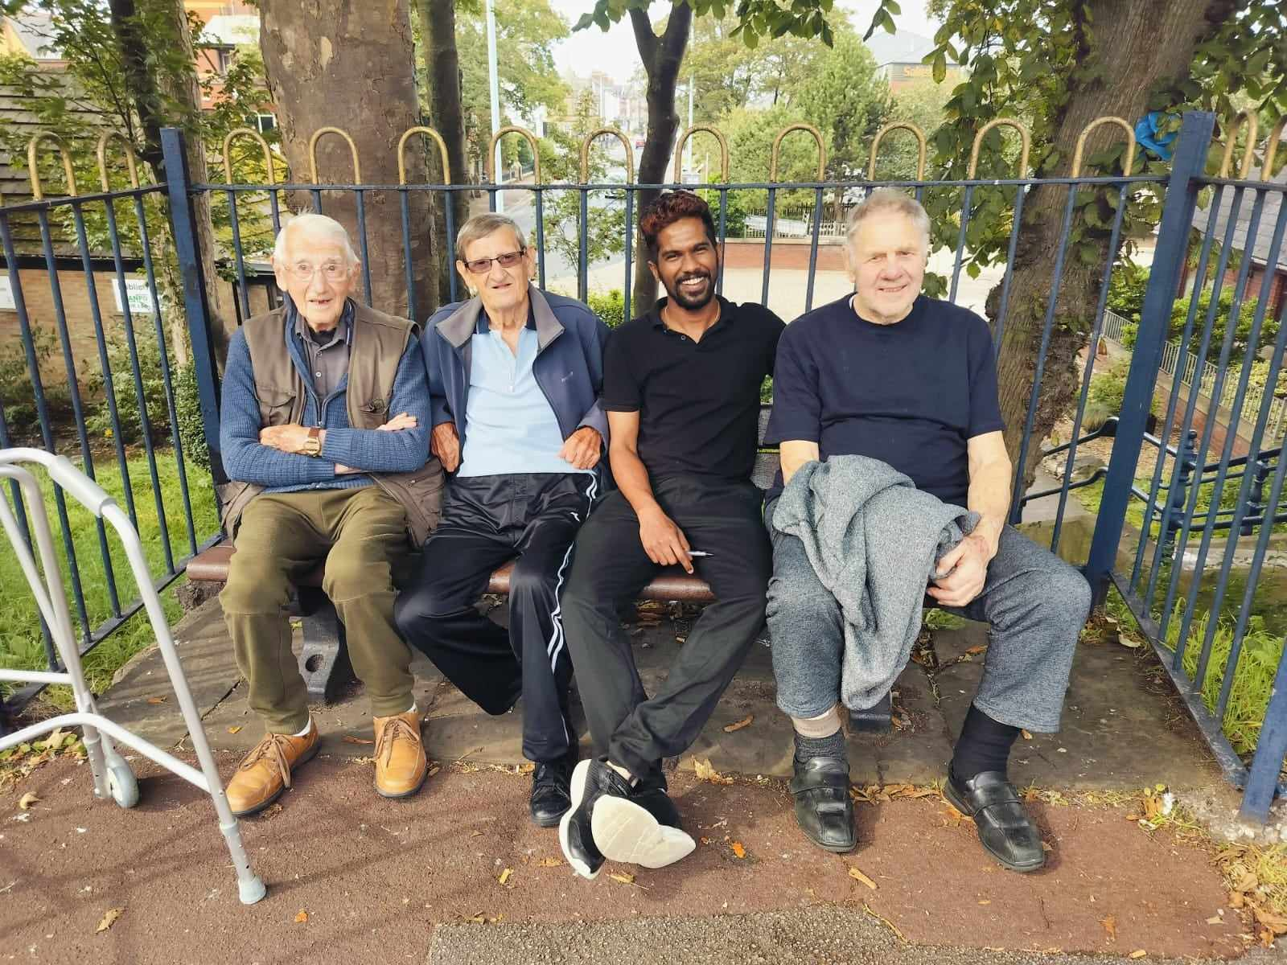
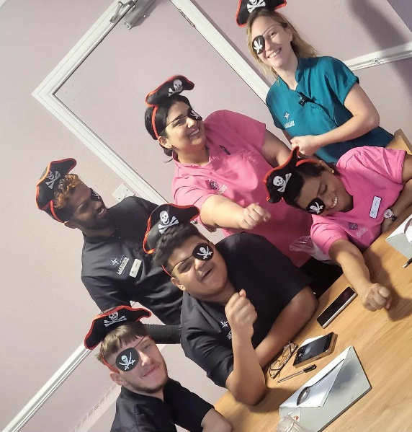
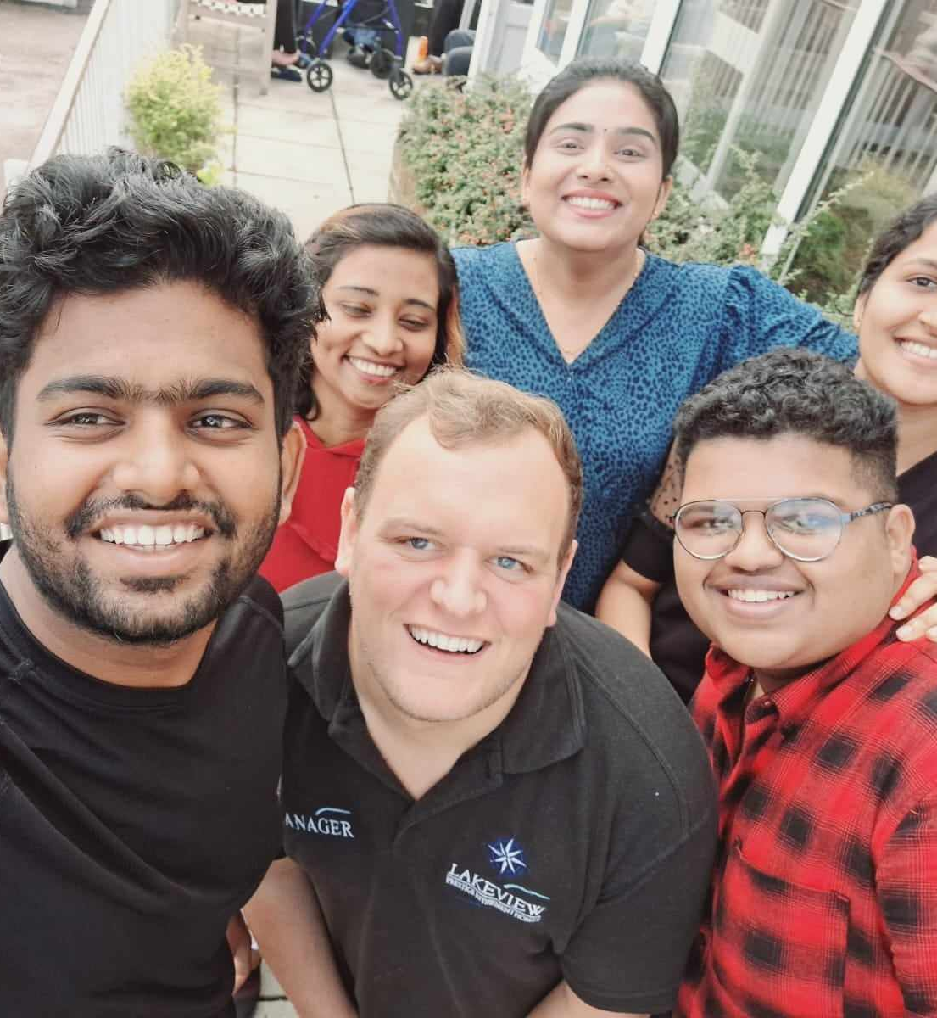
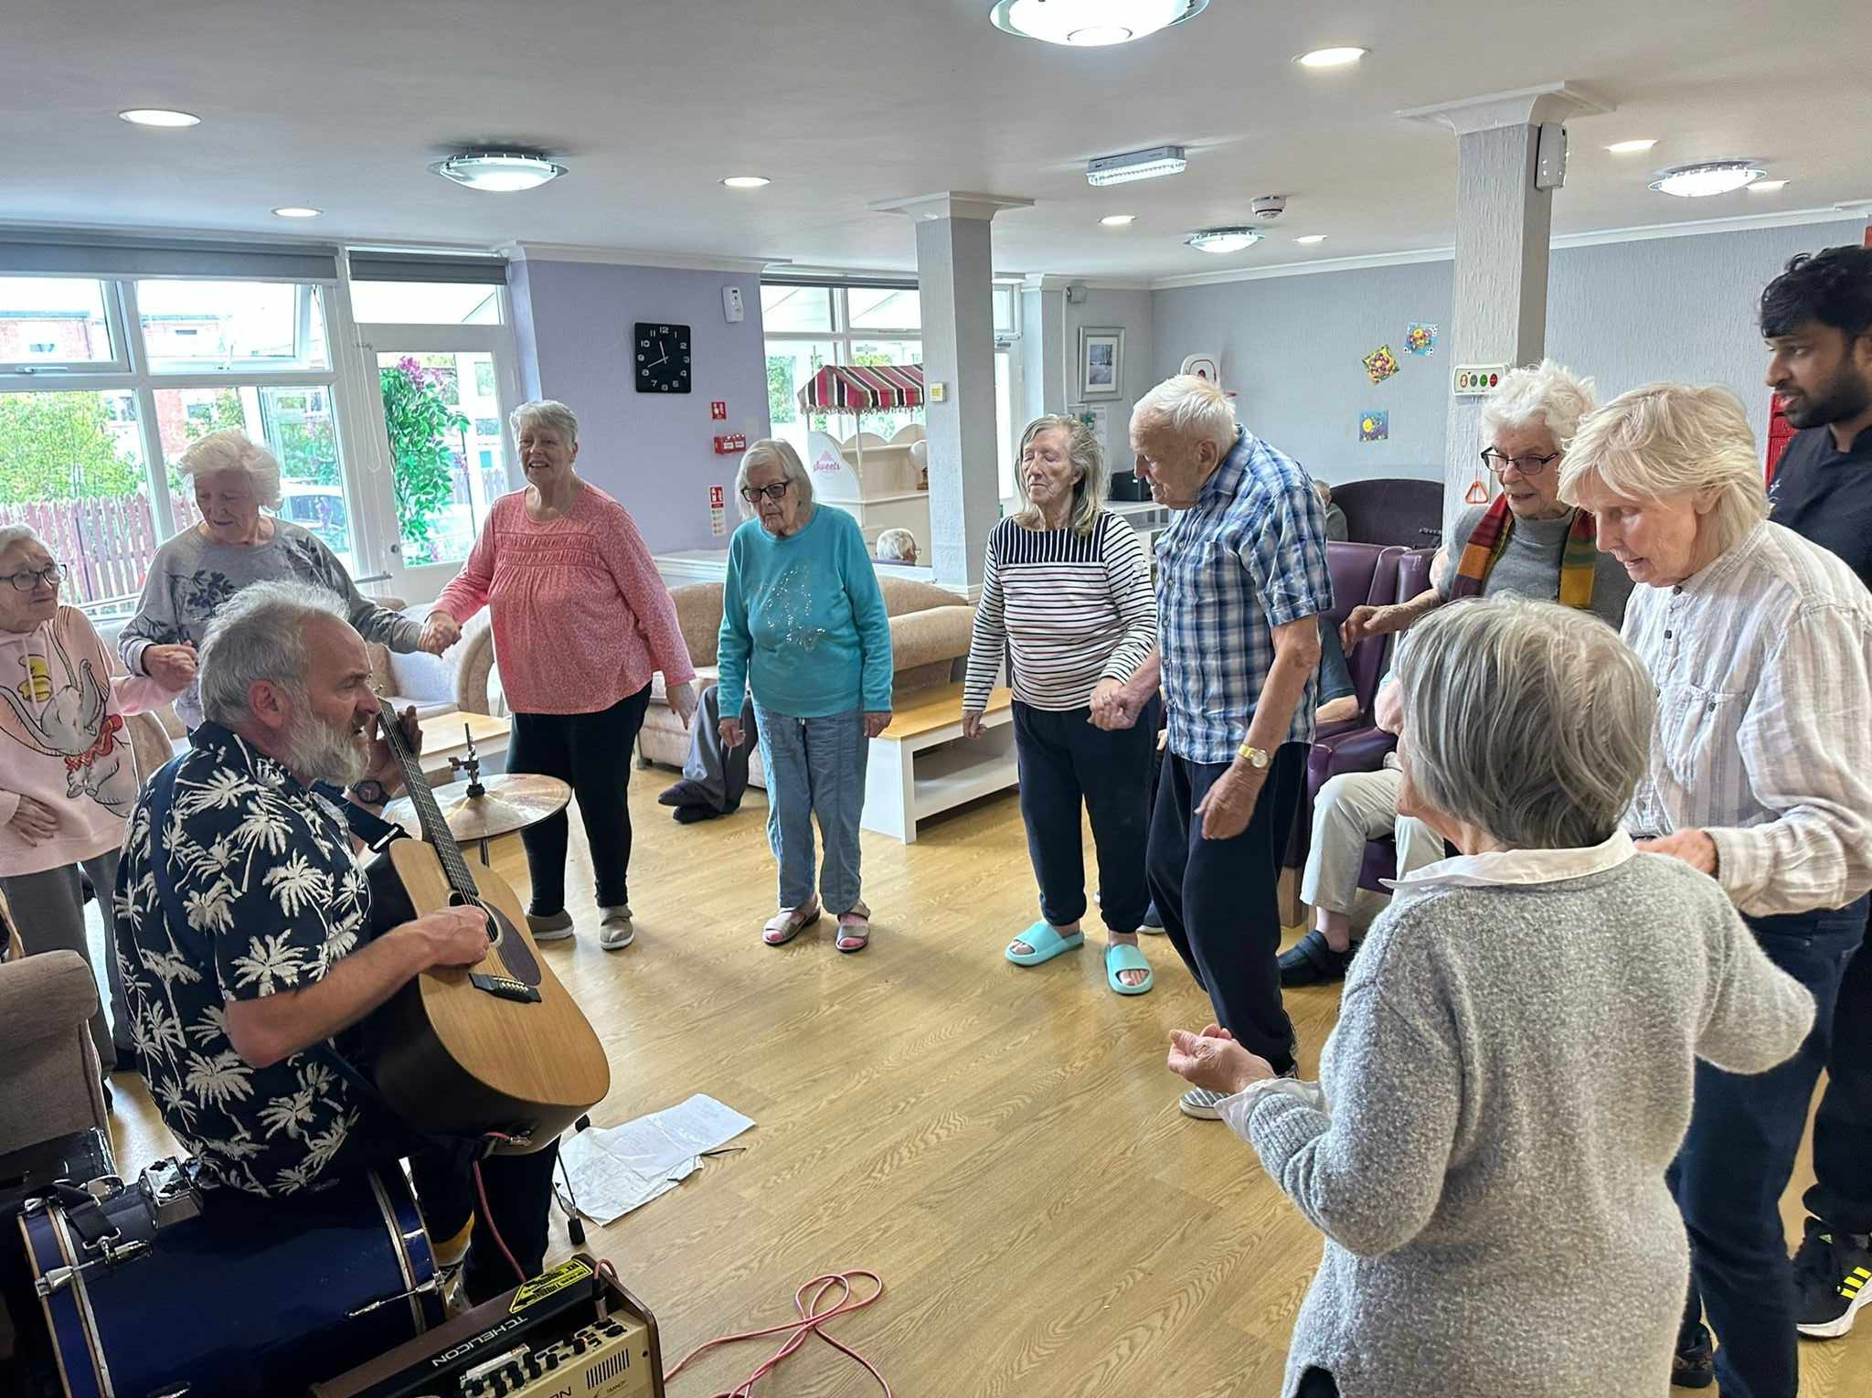
Newfield Lodge Last 1000 days QI Collaborative
Notes:
Intro – Mark Ratcliff, Been in adult social care for 11 years and my main drive is to work with dementia and improve their daily lives.

Slide 7
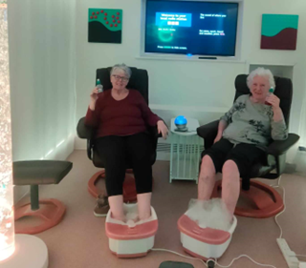
AIM: Reduce resident falls by 25% by October 2024

Slide 8
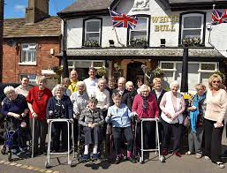
Northlands care home
Summit Presentation
Notes:
We are a 15 bedded care home in great Eccleston add anything else needed, local community, tight knitted, everyone knows everyone, Community feel.

Slide 9
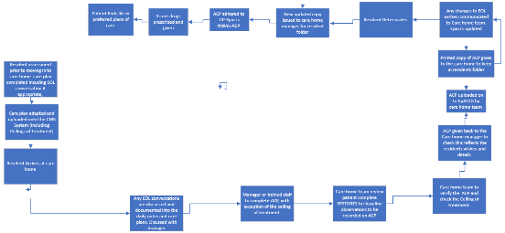
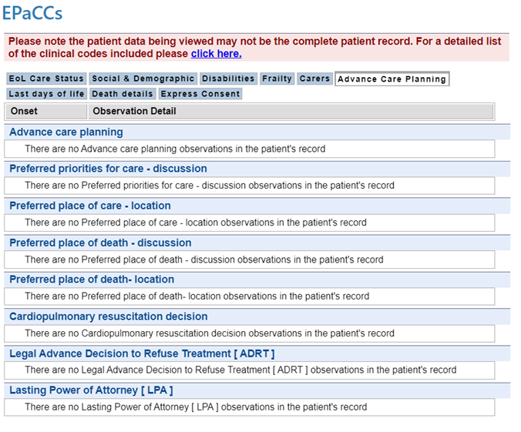

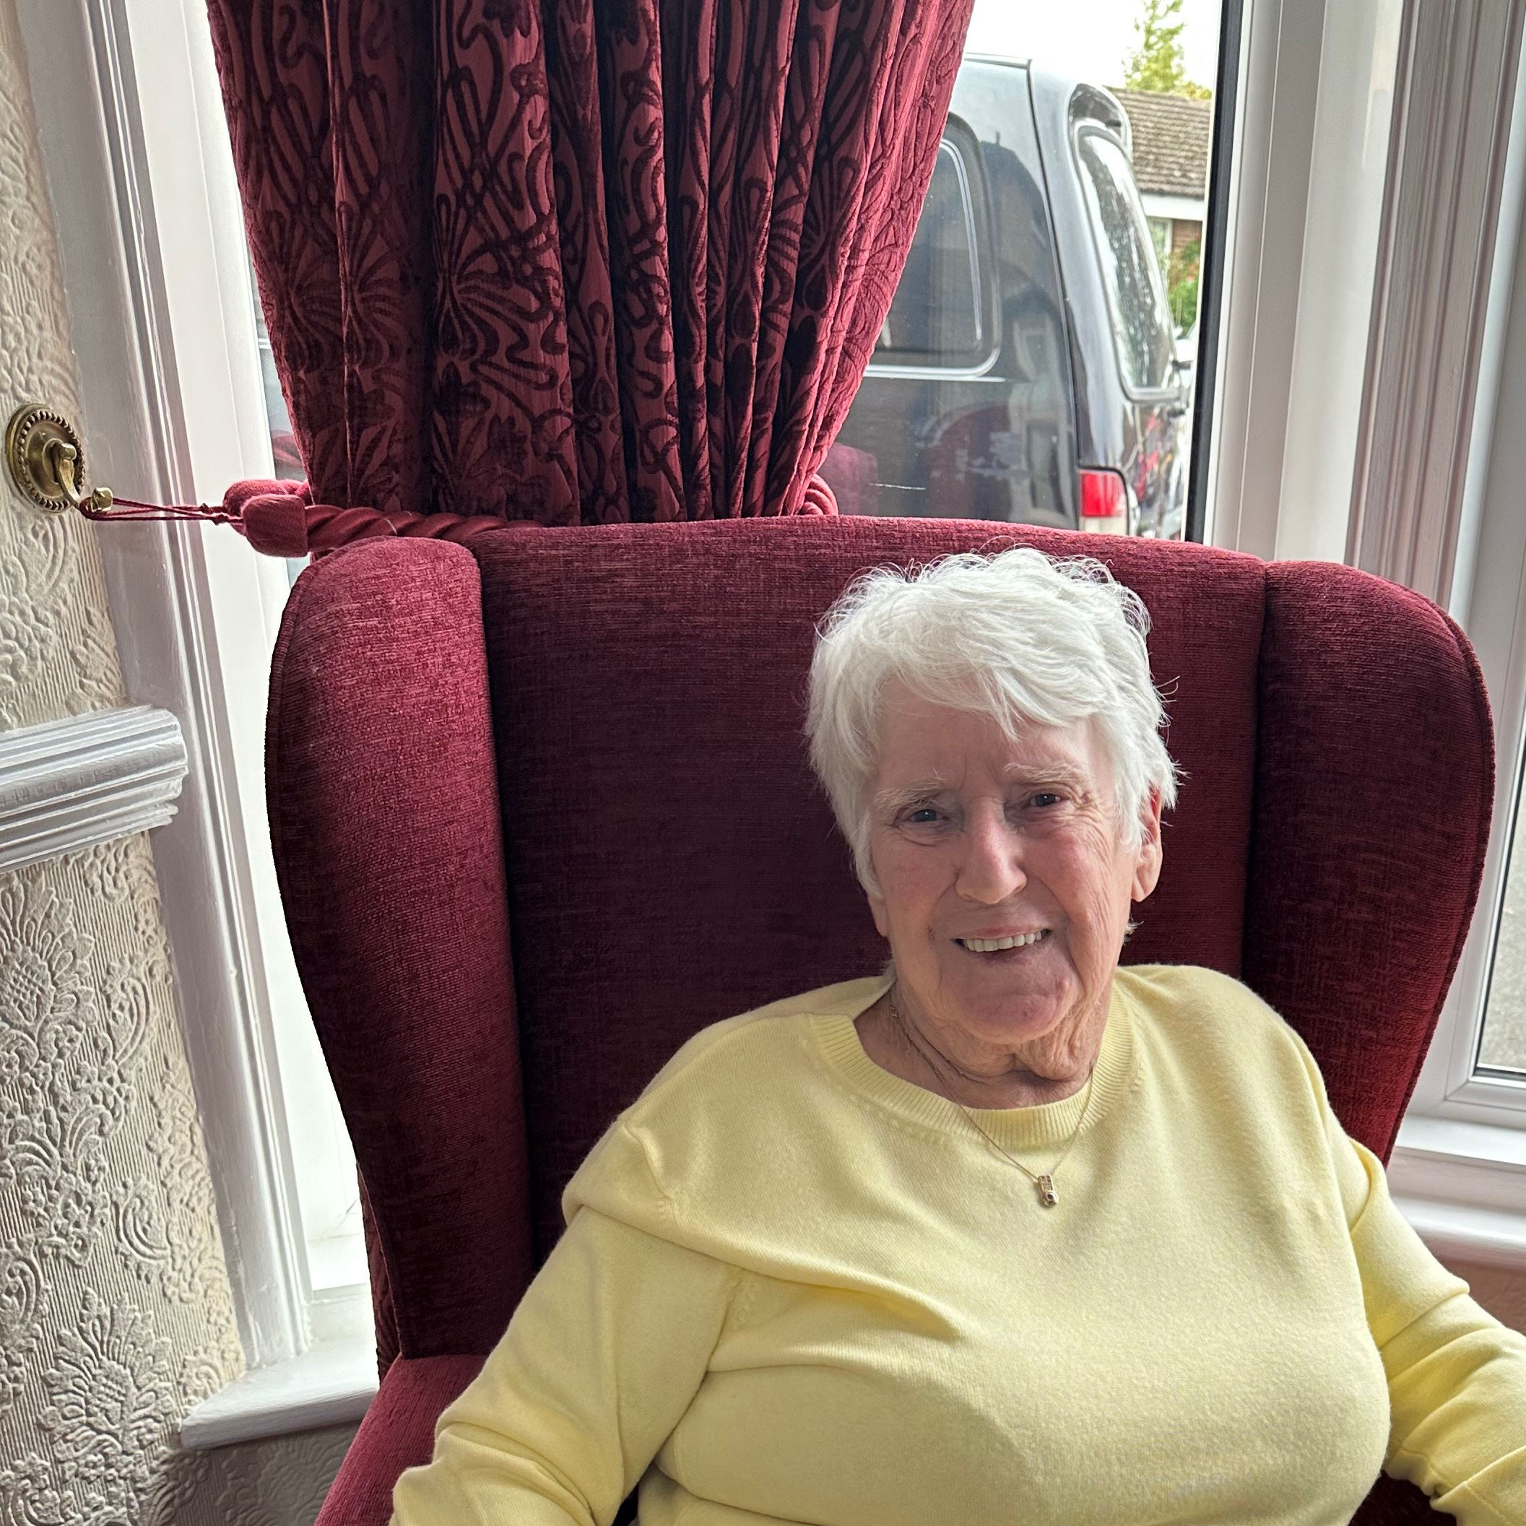
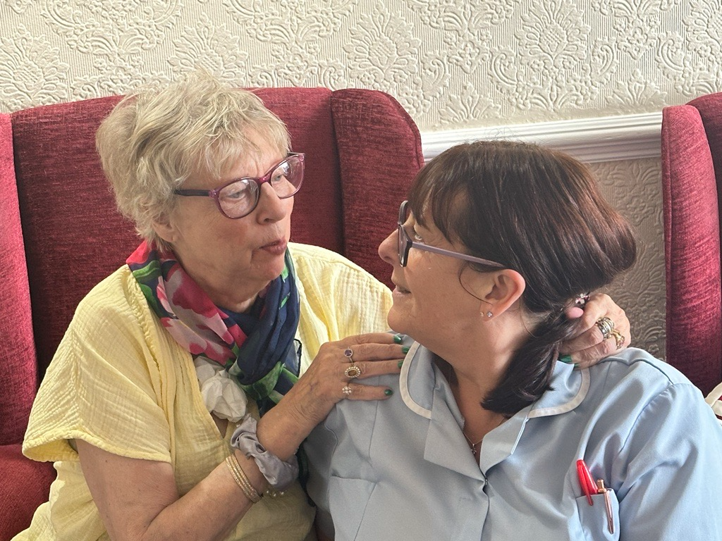
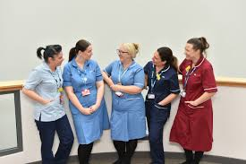
Notes:
We created a process map and then an improved process map to establish a slick and easy way to complete advanced care planning.
As a team we developed a positive culture around advance care plan wishes and now we are confident as a team to initiate the conversations.
Essentially, we create the information with residents, families, carers (this is not always a one off conversation this could be over a period of time depending on how comfortable the resident is)and then pass on to your care home team who upload to EPaCCs and then the health centre, NWAS are aware as needed.
As we know things change…….residents have different needs all the time, we change and update as needed. No ACP is set in stone.

Slide 10
Notes:
We didn’t just want to measure our ED attendance, since October 2023 we have had 8 admissions. We know this was required and appropriate.

Slide 11
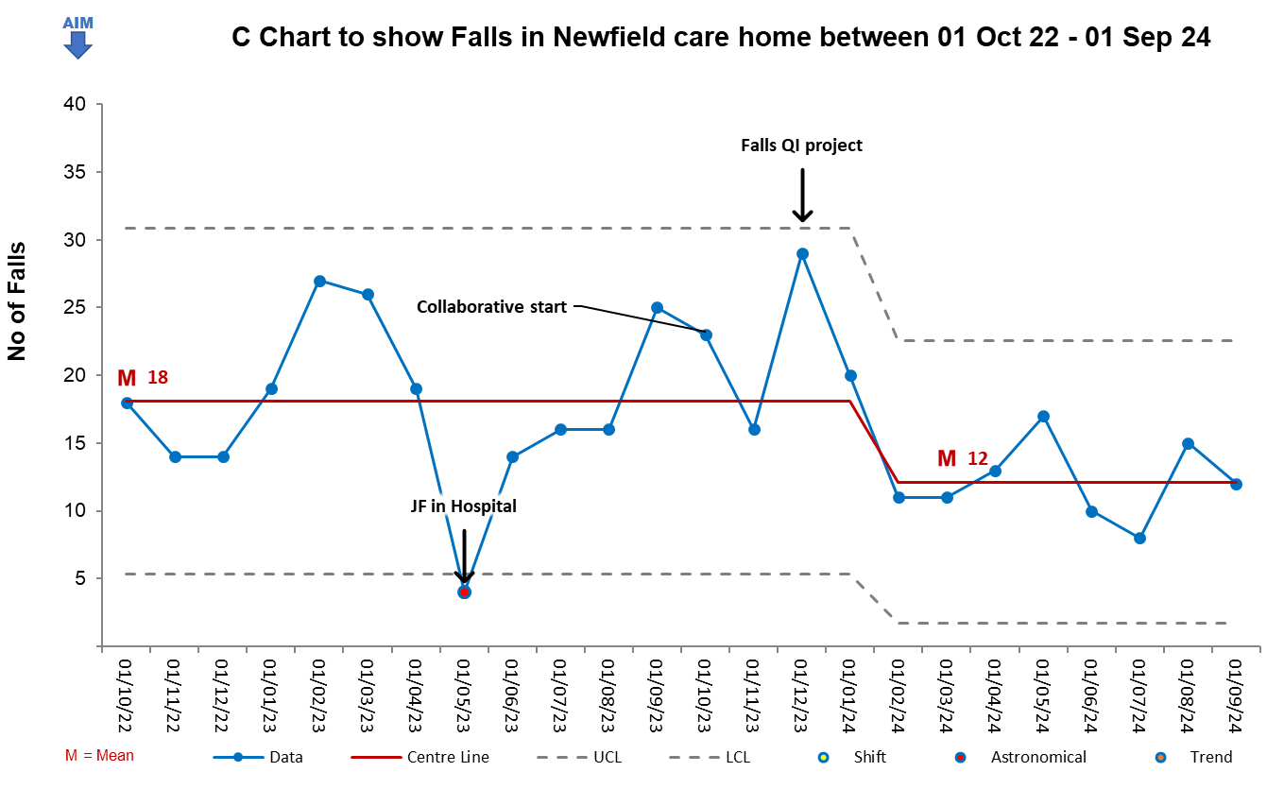
Notes:
This is having an impact overall on falls. Our monthly data shows a reduction in falls over all in the last 2 months.

Slide 12

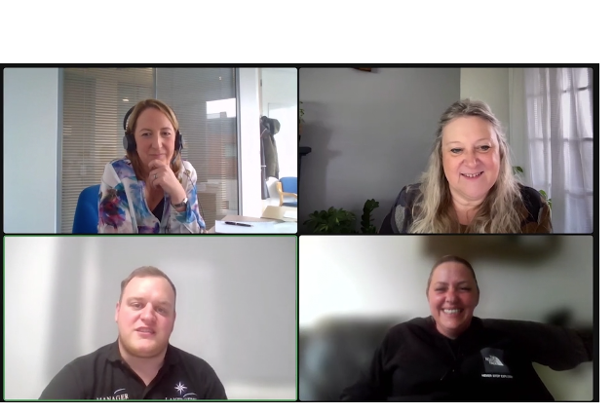
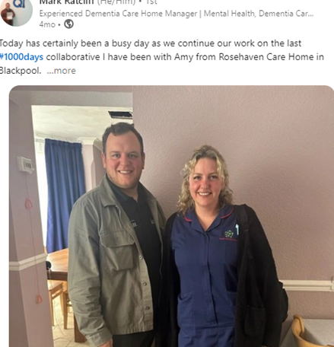

Slide 13

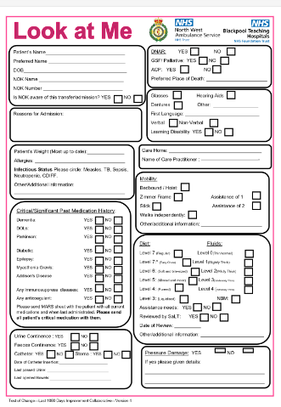
“Look at me”
A Care Home SBAR communication tool & ED Discharge

Slide 14
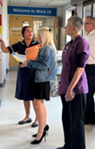
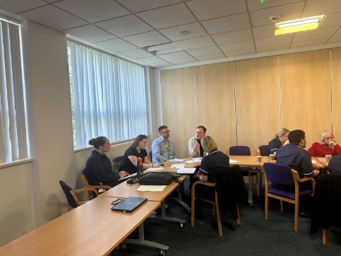
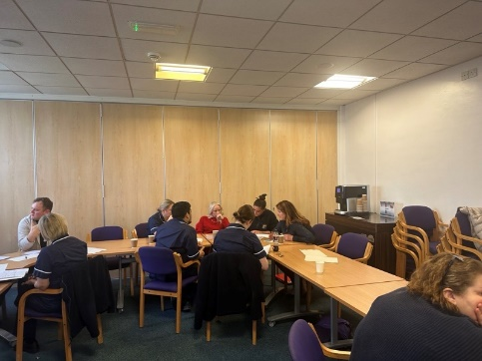
Co design Safe Discharge
Care Home Champions
Care Practitioner Discharge Document

Slide 15


We’re delighted to announce as part of the last 1000 days collaborative we now have a symbol on Nexus Patient Record (NPR) Tracker system to alert staff when care home and nursing home residents are cared for on our wards. This can be updated through the Social & Lifestyle tab on NPR and selecting Nursing Home or Care Home from the drop down menu for Social Circumstances on Admission.

Slide 16
16th October 2024 9.30-1pm
Last 1000 days Phase 2
Trinity Hospice
To book a space please email
anna.dallow@nhs.net
Phase 3, are you interested?
anna.dallow@nhs.net

Slide 17
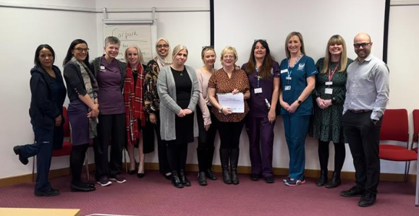
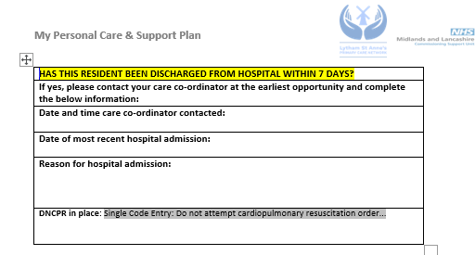

Personalised Care and Support Plans and Advance Care Plans
Lucy Cardwell, Frailty ACP at Trinity Hospice
- Aimed at supporting Care Homes and PCN’s to reduce avoidable admissions into ED for frail and palliative patients
- Working closely with the Lytham St Anne’s PCN Care Home Team and Care Home’s in LSA
- Re-design of the current care plan and advance care plan document to focus on clinical risks for high-risk residents recently discharged from hospital
- Currently on Version 3 of PCSP
Education for care home staff

Slide 18
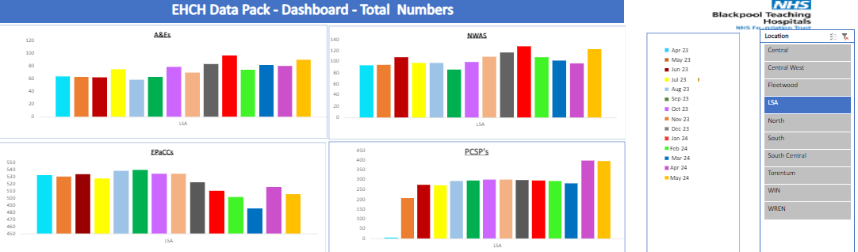
Advance Care Planning
Since the launch of version 1 there has been a 196% increase on PCSP's in April 2024 compared to April 2023
This means that more residents have a comprehensive care plan which includes identified clinical risks for those at risk of hospital admission- giving the carers information on these risks will empower them to recognise the soft signs of deterioration and prompt them to escalate to the care home teams earlier. It also includes advance care planning conversations - meaning carers are talking to residents about what they wish for the future and where they wish to be cared for.
April 2023 = 6 PCSP's completed
April 2024 = 400 PCSP's completed
May 2023 = 207 PCSP's completed
May 2024 = 397 PCSP's completed

Slide 19
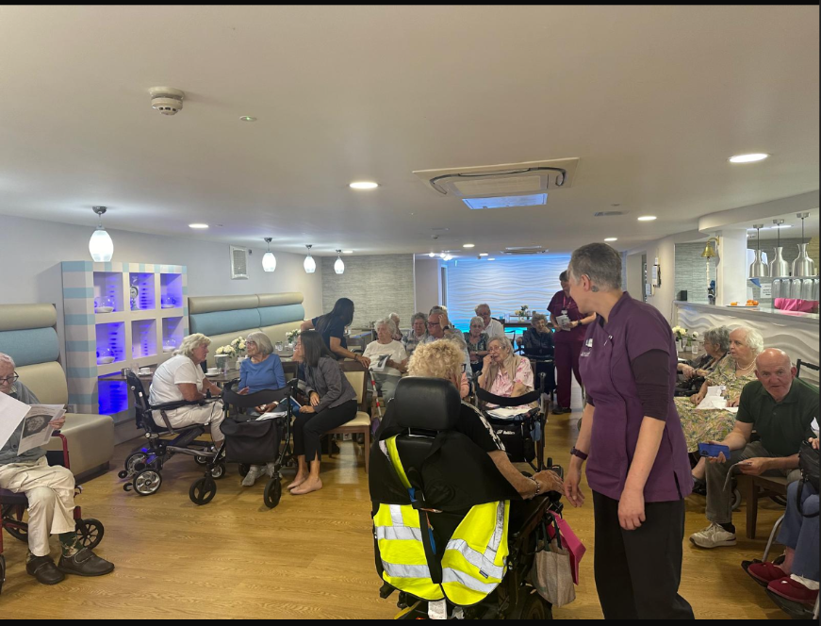
ACP Resident, family and carer workshop

Slide 20
Advance Care Planning
PCN Care Home Team have changed their practice on discharge reviews
Process mapping with the teams
Share the learning with other PCN's and Care Homes
Lucy.cardwell1@nhs.net

