Slide 1
Least restrictive practice project with care homes.
Oct 2024

Slide 2
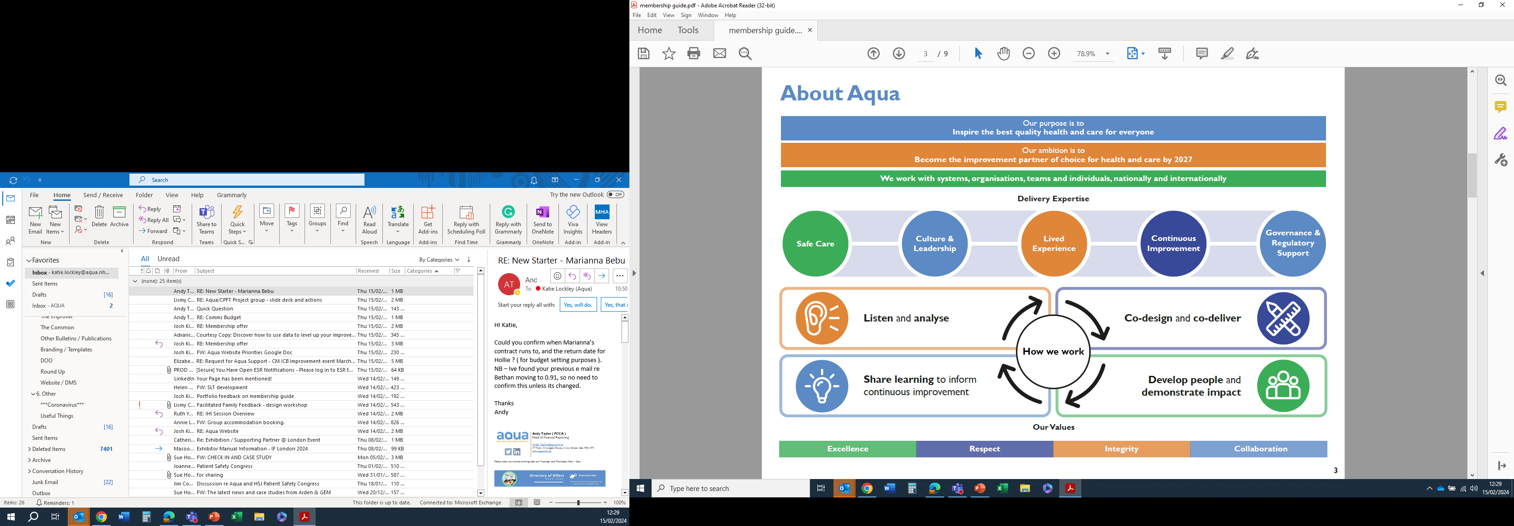
About Aqua

Slide 3
Least restrictive
The ask
The offer
To offer support into care homes that had been impacted by CQC inspection.
To offer support to homes who have started work on improving their service and want to build on it
To draw on expertise on least restrictive practice work done by Aqua over the past 10 years in the region across a range of settings.
Data collection and analysis
Soft QI methodology approach
Learning events
Least restrictive practice
Trauma informed care
Personalised care
Coaching sessions

Slide 4
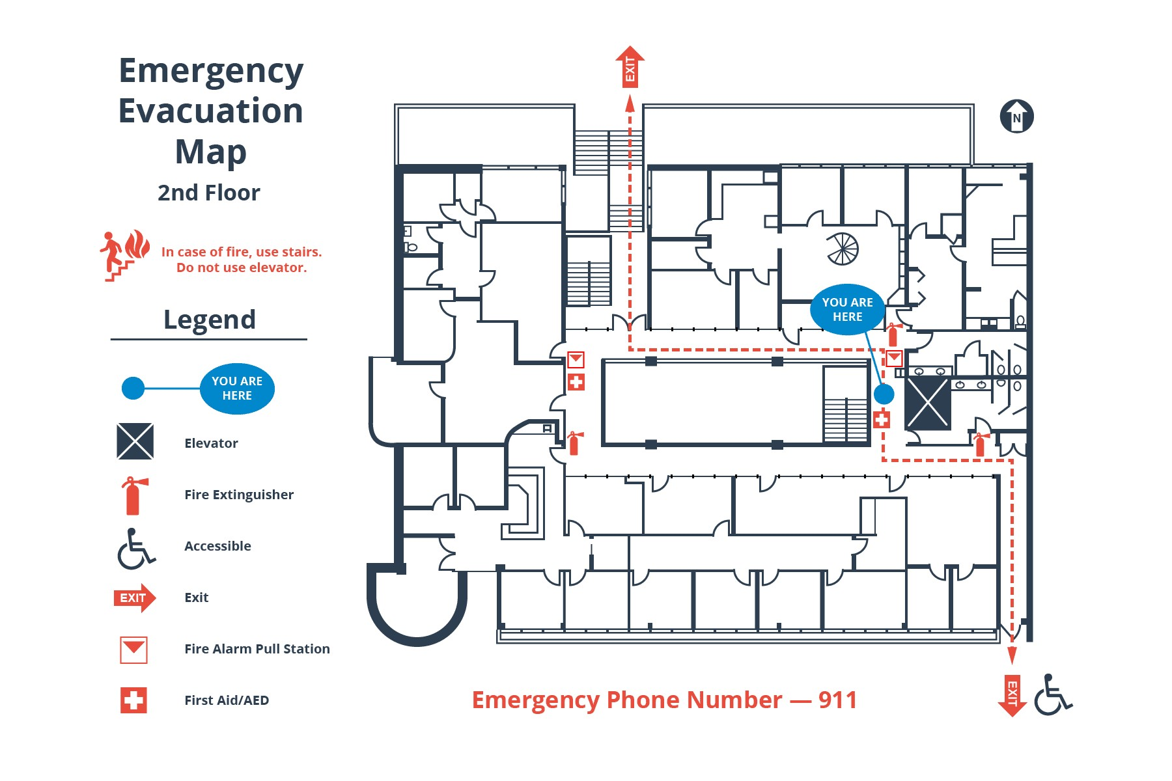
Data collection
Heat map

Slide 5
Data

Slide 6
Data
The data hasn’t run long enough to give
A precise average as you need 12 months
Data to be definite on the reduction.
Dovehaven
Around a 40% reduction within the 6 months across both areas
The Lodge
Reductions in 2 areas particularly the male unit but overall no change. The data is skewed as in the first few months the data was inconsistent.
Hulton house
Saw around a 30-40% reduction over the 6 months of the project.

Slide 7
Focus of least restrictive work
Personal care
Mealtimes
Observations
New admissions
Individual residents
Environment

Slide 8
Care home experience and impact

Slide 9
The challenges and opportunities Homes view
‘Prior to starting I felt there was avoidable incidents and little insight to triggers. I think staff were stuck in a rut on managing the residents who display with distressed behaviours. we were strong at being reactive in situations or incidents but needed to invest further into being proactive and reducing potential avoidable incidents/safeguarding
Feeling of powerlessness by staff
Staff afraid to ‘speak up’ in case they were ‘wrong’.
Want to Increase staff engagement and observation
To reduce boredom and improve quality of life for residents.’
Dovehaven manager

Slide 10
Case studies
Dovehaven
The lodge
Change the approach of waking a resident in the morning.
This was very positive for a handful of residents and did go to show that the whole individual and their histories needed to be considered and to understand their individual needs. It doesn’t work for all.
New admission and staff on shift new his name and said hello and his name on his arrival including one member of staff to greet them in the car park. This is a small change but made a big difference to him, his wife and the ambulance crew. He settled in well over the coming days.
All male complex nursing community. Staff noticed that residents were walking with purpose along the long corridor, becoming tired and hungry with no place to sit. This would lead to residents becoming distressed and annoyed with other residents and / or staff.
Decorated the corridor in ‘seaside’ colours, added ‘pier’ type garden furniture with colourful cushions so residents can rest when walking with purpose.
Incidents of resident-on-resident aggression reduced, and residents appear to be less tired

Slide 11
Impact
At Dovehaven the Champion set up an Improvement board where information is displayed (the charts/graphs) where information from sessions is shared. The champion would share with the team in huddles each day.
We have used new tools and reviewed Planned Care Day and included senior staff in Flash meetings to pass on shared information and those which have worked and those which have not.
encouraged a ‘thinking outside of the box’ approach and to consider the individual
more aware of how we do daily tasks, breaking things down into steps instead of the task as a whole.
Looking at things from the resident’s point of view
At The Lodge as a team, we trust each other to a greater extent and staff are no longer reluctant to share ideas which might be seen as ‘wacky’. This has brought us together as a team
Staff team appear happier and more relaxed and we have noticed increased staff retention.
Residents appear to be more engaged with what is going on, more wellbeing practitioners appointed to ensure availability of activities for residents to engage with.
we see this as an ongoing project and developments to the service and provision of care are still occurring.

Slide 12
Staff feedback
Really enjoyed the face to face discussions, and the support from Paul in developing and completing the Test of Change. This gave us all some ownership of change and that our ideas were listened to
Greater engagement from whole staff team in development and improvement of service
The simplicity in the project …..encourages you to explore different options, encourages you to think beyond the day to day.
this project has been very effective in creating change driven by staff on the floor, which has been a positive teambuilding experience. This has worked well in identifying both environmental and behavioural factors

Slide 13
Impact
Data driving practice.
Reduction in safeguarding incidents.
Reduction in resident-on-resident incidents
Personalised approach to least restrictive
Focus on quality intervention rather than task
Observations being meaningful
Focus on what drives the behaviour rather than the behaviour itself. ‘What is the resident communicating and why?’
Better understanding of trauma.
The importance of structure in a day –activities, meaningful environments that define a space.
Individual approach to those residents expressing higher levels of distress and agitation.
That Tech is fantastic but it can reinforce the task and erase the person.
Celebrate improvements.
High risk residents stepping down from observation following personalised interventions. 60% of incidents in one area relate to one resident and a month later no incidents which continued month after month.
Understanding the environment and how staff and residents engage with the spaces plays an important part in reducing incidents.

Slide 14
Overall system impact
Step down in acuity – less observations
Financial benefit of less incidents
Increase in least restrictive, personalised practice
Environmental changes – corridors refreshed to support those who walk with purpose alongside quieter spaces/furniture moved to create smaller more defined spaces.
Increase in activities to reduce boredom
Meaningful observations
Staff retention increased
Incidents reduced including safeguarding incidents with only one in November 2023 at The Lodge that fell under moderate or above harm and was a resident-on-resident assault. (Sept 2023-March 2024)

Slide 15
Learning
Virtual working – it was difficult to build a relationship with staff as an outsider when working virtually. Face to face enabled trust to build much quicker.
Histories – The impact of previous safeguarding incidents, CQC visits, safeguarding visits, press attention, post covid trauma on the staff and the culture. The importance of appreciating and celebrating staff in this field can go a long way to improving care as too often oversight/assurance can feel punitive and assumptions made about the homes which can be untrue and unfair.
Workforce when there is a lead and champions in the homes this works well but any changes to staffing it can lead to an immediate slow down in the engagement. Having that one link makes all the difference.

Slide 16
How could we sustain this work?

Slide 17
Phase 2
Exec leading steering group.
6 month follow up – visit homes and evaluate what has sustained, what hasn’t and why.
Develop care bundle package for training.
Link into trauma informed care/PSIRF approach.
Share learning.
Seek further opportunities to deliver project.

Slide 18
Opportunities
Promote sensory resources including training champions in sensory modulation
Promote trauma informed approach aligned to personalised care/Kitwood
Promote walkarounds (15 step challenge approach) including safeguarding leads- see through an appreciative lens.
Visual data and all staff seeing themselves as improvers.
Celebrate improvement
Promote what safety looks like to families and visitors when it comes to their engagement with their loved one and other residents.
Staff wellbeing and safety huddles that are safe spaces to bring ideas.

Slide 19
Paul Greenwood
Programme manager mental health
Paul.greenwood@aqua.nhs.uk
X @PaulG_AQuA

