Slide 1
Skills for Care – Lancs forum October 2024

Slide 2


A workforce strategy for
adult social care
Name and Date
Notes:
Please find this slide deck - strictly confidential and embargoed until 18th July 2024 - please do not share on any further until then.
Introductions.
Today I’m going to walk you through the new Workforce Strategy for adult social care in England – along with our latest data on the Size and Structure of the workforce.​
Why do we need this Strategy? Well, to put it quite simply, social care is important for all of us.​
​We all want to live in the place we call home, with the people and things that we love, in communities where we look out for one another, doing the things that matter to us. That’s the vision of Social Care Future – they represent people who draw on care and support, and they’ve helped to develop this Strategy.​
​Social care is important for people, communities and the economy. It enables people to live well and contributes 60 billion pounds to the country’s economy each year.​ So the skilled professionals who work in social care are vital. We want people to want to come and work in care. Once they’re in, we want them to be able to feel valued and to develop, grow and progress in their careers, so they stay in the sector and learn new skills.​
This strategy has the potential to be a real turning point for adult social care. We know the sector faces many challenges – but now we have a Strategy that will help us tackle them.​
One of the reasons we need this is because there’s no single entity with all the levers for change in adult social care. It is a complex system with influence spread across several groups.​ These include national government local government and Integrated Care Systems (ICSs), care providers, the Care Quality Commission (CQC) and workforce support bodies like Skills for Care.​
​Skills for Care has been leading the development of this Workforce Strategy – but it’s been a real collaborative effort with many organisations and people with a stake in the future of social care.
​
We announced our plans to do this work back in October. So, in just 10 months, we’ve brought together a very wide range of people and worked together to develop a comprehensive, long-term Strategy to make sure we have enough of the right people with the right skills to provide the best possible care and support to the people who draw on it.

Slide 3


The context: in 2023-24…
A workforce of 1.59 million
4.2% more filled posts (70,000) than in 2022-23
131,000 vacancies on any given day (8.3%)
26% of staff in the independent sector left their jobs
105,000 international recruits – up 25,000 on 2022-23
Notes:
To give you some context about the shape of the adult social care workforce and the challenges facing it, I’m going to start by sharing the headlines from our latest annual Size and Structure of the Adult Social Care Sector and Workforce in England report which we published on the 18th July alongside the strategy.
These statistics come from our Adult Social Care Workforce Data Set, which has records on more than 650,000 staff in 20,000 care providing locations. They cover April 2023 until March 2024.
The overall workforce grew for the second year running, and there were 1.59 million people working in care. That’s a 4.2% increase in filled posts – or 70,000 more filled posts than the previous year.
The number of vacancies was down from 153,000 to 131,000. That’s a significant drop, but still a lot of vacancies – and the new vacancy rate of 8.3% is still around 3 times the vacancy rate in the wider economy.
In terms of turnover, 26% of staff working for independent providers left their job over the course of the year.
And while it’s good to see the workforce growing, it’s important to note that a lot of this growth was driven by international recruitment. 105,000 people were recruited from overseas, which is 25,000 more than the previous year.
It’s worth remembering that the rules on care workers bringing dependents with them to the UK changed in the very last month that these statistics cover – so we’re yet to know the impact of those changes on international recruitment.

Slide 4

The recommendations
and commitments
Notes:
I’ll now walk you through some of the recommendations and commitments.
Where a recommendation states ‘should’ this is to be agreed. If it states ‘will’ this is a commitment and will be taken forward by the respective organisation/s.

Slide 5









Attract and retain
Pay and T&Cs
International recruitment
Regulator actions
10-year attraction plan
Individual employers
Attracting leaders
Regulated professionals
Wellbeing & EDI
Notes:
Attract and retain
Joined-up, consistent action on pay. Central government (lead) with local government, unions and employers. (2024)
Consider the modelling in this Strategy in the Fair Cost of Care exercise. (2025, ongoing). Central Government, DHSC and Local Government. We have modelled and costed three options for improving pay in the Areas of focus, recommendations and commitments section.
A transition plan to increase domestic recruitment and reduce international recruitment. Government departments/bodies and the sector. (Ongoing)
Continued funding to support ethical international recruitment. Department of Health and Social Care (DHSC). (Ongoing)
Review the application of ethical recruitment. DHSC and Home Office. (By March 2025)
Regulator encouraging recruitment and retention plans. Commitment – Care Quality Commission (CQC).
A 10-year attraction plan focusing on men, younger people and people with technical skills. Cross-sector partnership, sponsored by Department for Work and Pensions (DWP) and DHSC. (By summer 2025)
Support for individual employers. The Local Government Association (LGA). (Start 2024)
A national programme to attract graduates and career changers. DHSC. (From 2025)
Attract more social workers and occupational therapists with a clearer pathway and financial support for students. DHSC; DfE; Social Work England (SWE); the British Association of Social Workers (BASW); the Royal College of Occupational Therapists (RCOT) and Skills for Care.
Attract more registered nurses and nursing associates to working in social care and offer them attractive career pathways to retain them. DHSC; Council of Deans of Health; Universities; ICSs. (From 2025)
A People Promise for Social Care. Skills for Care, commissioned by DHSC. (Scoping 2025, launch 2026)
Scope retention pilots in five ICS areas. DHSC; Skills for Care and stakeholders. (2026/27)
Regulator support for workforce wellbeing and equality, diversity and inclusion. CQC.
Create Workforce Strategy employer champions. Commitment - Skills for Care and provider representatives.
Retain more internationally educated registered nurses working in social care through pathways, support and regulation. Nursing and Midwifery Council (NMC); CQC; DHSC.
Implement the Social Care Workforce Race Equality Standard (SC-WRES). Skills for Care and partners (commitment); DHSC; Department of Levelling Up, Housing and Communities (DLUHC); Department for Education (DfE), CQC. (From 2024)
Improve wellbeing through guidance, training, NHS Health Checks, regulation and awareness-raising. Sector and health organisations (2024, 2025, ongoing); DHSC (2025); CQC (From 2025)
By implementing these recommendations with clear ownership, we can create a more attractive and supportive environment for social care staff, ultimately leading to a stronger and more diverse workforce.

Slide 6







Train
Career development
Competency
Regulator actions
Apprenticeships
High-quality training
Training
funding
Registered managers
Notes:
Train
Regulator to signpost to what good looks like in learning development. Commitment - CQC and Skills for Care. (2024, ongoing)
Expand Skills through the Care Workforce Pathway: DHSC and Skills for Care. (Starting 2024)
Continue funding to support delegated health tasks: DHSC with the sector. (From 2024)
Continue funding for new skills: DHSC. (Annual)
Develop Leaders through a framework for Directors of Adult Social Services (commitment - Skills for Care and Association of Directors of Adult Social Services (ADASS) and partners) and continue investment in the leadership programme for regulated professionals (DHSC). (2025)
Streamline and communicate mandatory training requirements. Commitment - Skills for Care and CQC. (2025)
Continue the Care Certificate and support uptake. DHSC. (From 2024)
Ensure level three competence for direct care staff. DHSC and Skills for Care. (2025, ongoing)
Overhaul social care Apprenticeships: Expert partners, commissioned by DfE. (2025)
Ensure high-quality training in functional skills, digital, data and technology and AI. Skills for Care, CQC, Care Provider Alliance (CPA) (commitment, 2024); Association of Colleges (AoC), Association of Employment and Learning Providers (AELP) (2025).
A three-year funding plan for training: DHSC. (From 2024)
Invest in training and developing social workers. DHSC/DfE with sector partners and local authorities. (2025)
Invest in training and developing occupational therapists. DHSC with sector partners, local authorities.
Invest in training and developing registered nurses working in social care. DHSC; sector partners; Council of the Deans of Health (CoDH); National Institute for Health and Care Research (NICE); NMC; CQC. (From 2025)
Develop managers through support, education and potential registration. DHSC; Skills for Care; CQC. (From 2025)
By investing in getting development and training right, we can give people working in social care the skills, knowledge and development they need to come into social care and to stay in social care, delivering exceptional care and support in a rapidly evolving environment.

Slide 7




Transform
Workforce planning
Training infrastructure
10-yr transformation
Coastal & rural
New roles
Digital skills
Care technologist
Registration
Notes:
Transform
Mandate workforce planning and strategy. Central government. (2024)
Create a responsibility for a central workforce body for the development and implementation of this and future workforce plans. Central government. (2024)
Investigate workforce registration. Commitment - Adult Social Care Workforce Strategy Implementation Board. (Scope in 2025)
Attract workers to social care in coastal and rural areas. ICSs and local partners. (Scope in 2025)
Support ICS workforce planning. Skills for Care; local government; NHS Employers and partners. (Scope in 2025)
Research on new roles for social care. Think Tanks, National Institute for Health and Care Research (NIHR) or DHSC. (2026)
Expand digital skills training. Digitising Social Care and partners (DiSC). (2025)
Pilot a new care technologist role. Skills for Care and partners. (2025)
Evaluation of current research priorities and funding in adult social care. DHSC. (From 2025)
Adult Social Care to be prioritised by NICE. NICE. (From 2025)

Slide 8
Who’s been involved
Logos, each one fading in separately for effect
What could good look like?
Notes:
The launch of this Workforce Strategy is really just the beginning. So what happens next and what could good look like?​​
In social care, where no one body owns all the levers we need to pull to make change happen, coalescing around a shared vision and strategy becomes even more crucial. We all have a role to play – government, regulators, providers, people drawing on social care and all of us who care about quality care. ​​
​​We have firm commitments from the Steering Group to evolve into the Adult Social Care Workforce Strategy Delivery Board, moving from development and into implementation. Organisations with system leadership roles and levers to pull are ready to play their part and want to do that in partnership with government.​​ The CQC has agreed to support the strategy by using its role and remit to influence key changes.​​
​​But by far the most powerful single action is for government to work in partnership with the sector and mandate this Strategy. That bold act would lead to long-lasting transformation in the adult social care sector, the likes of which have been talked about for many years. ​​The adult social care sector has galvanised around this Strategy – and that presents an opportunity to reboot the sector’s relationship with the Government if we can all work together in partnership to deliver the Strategy and transform social care.​​
​By working together, we can build a future where social care offers fulfilling careers, attracts talented individuals, and empowers its workforce to deliver exceptional care. ​​
​​

Slide 9
What next?
Autumn will see Skills for Care and partners kick off the delivery and implementation phase
There will be several virtual events, regional or themed, for all to attend
Skills for Care will launch some supporting resources
The Steering Group will become Workforce Strategy Delivery Board and continue to meet and will plan in regular strategy review points.
Focused work with new Government and DHSC officials to get a formal mandate for the Strategy
Notes:
Over the summer we will keep communication about the strategy alive via blogs and social media working with all partners.
In Autumn we will be working with stakeholders and partners across the sector to kick off delivery and implementation of the strategy. This will start with a series of virtual events, one for each region and some that are national themed events.
At Skills for Care we are developing some resources to support people with implementing the strategy recommendations, including revising the Core and Mandatory Training list which will be simplified. As the strategy will be launched as a website, this won't be static and will be owned by the whole sector, so a place for sharing all related resources and case studies.
Crucially the Steering Group will stay together and continue to meet, and as I mentioned before they will evolve into the Workforce Strategy Delivery Board (WSDB).
We all have a role to play in implementation, monitoring and influencing – so will need to continue to work with the new Government and officials to push to mandate the strategy together. We want Government and political support for the Strategy – but we will press ahead with implementation regardless, as the sector needs this Strategy.

Slide 10
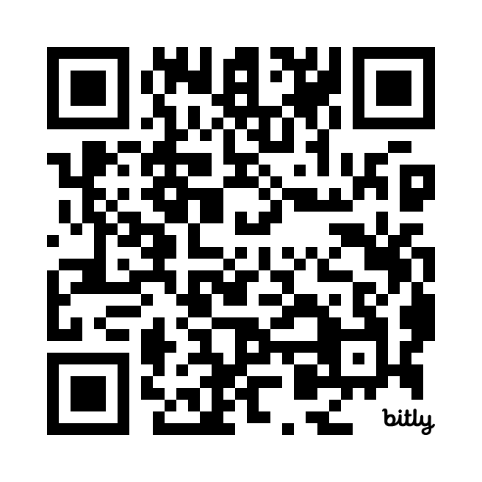
Read the Strategy
ascworkforcestrategy.co.uk
Notes:
So that’s a summary of what’s in this historic new Workforce Strategy for adult social care.
We’ve only really scratched the surface, so I hope you’ll want to read the whole Strategy. You can find it by scanning the QR code that’s on the screen right now – or you can go straight to A S C workforce strategy dot co dot UK.
Thank you.

Slide 11
Adult Social Care Learning and Development Support Scheme (LDSS)
The DHSC has launched the learning and development support programme for the financial year 2024 to 2025.
Information on the scheme includes:
guidance on eligibility and the process which includes completing an expression of interest to gain access to the online claims service
FAQs
Eligible training courses and qualifications list can be found on the DHSC web page
Notes:
https://www.gov.uk/government/publications/adult-social-care-learning-and-development-support-scheme
For any queries in relation to this statement please email ASCreimbursement@dhsc.gov.uk
WDF 2024-25
The WDF will be scaled down in 2024-25. It will only be possible to claim WDF for learning which is already in progress. This means that qualifications and apprenticeships which start on or before 31 March 2024 will be eligible for the WDF as long as the learner completes, and the certificate is issued by 31 March 2025.
This is to ensure that employers who have already paid for learning and development are not left out of pocket. Courses and qualifications which start on or after 1 April 2024 will not be eligible for funding through the WDF.

Slide 12
Introductory modules for managers
11 eLearning modules to develop skills in leadership, succession planning and developing future talent
Leading and managing in adult social care
Supporting and developing teams
Regulation and governance
Effective communication
Working with partners
Leading a person-centred service
Safeguarding and mental capacity
Making decisions
Managing resources
Learning and innovating
Personal development and wellbeing
www.skillsforcare.org.uk/IntroductoryModulesForManagers
Notes:
Our new and improved Introductory modules for managers support the development of aspiring and new managers.
The modules offer engaging introductions to key topic areas to peak learners’ interest and provide opportunities to reflect, ideas to improve practices, and motivation to learn more. Based on the Manager Induction Standards, the re-developed modules now feature up to date content and increased accessibility for learners.
Module duration:
The modules will take between 40 to 60 minutes to complete and this can be done at a time and a pace to suit the learner. They’re simple and engaging to follow and are relevant across different services and settings.
Cost:
Price per single module: £15
Package deal price (full module suite): £130 (saving £35)
Each module (or the full bundle) is purchased on a 2-year renewable license, with enrolment access to the module for a period of 2 years from date of purchase.

Slide 13
Developing the care workforce
The Department of Health and Social Care (DHSC) has outlined plans to improve the career prospects of the domestic care workforce through training, qualifications and a clearer, care career path.
Launch of the first part of the Care Workforce Pathway
Introduction of the Care Certificate qualification
A new digital leadership qualification
£20 million for apprenticeships
Notes:
This announcement from DHSC about their plans for a workforce reform package is welcome as it includes the first version of the Care Workforce Pathway and the introduction of the Care Certificate Qualification, which are both projects which Skills for Care has consulted and supported on with the sector.
Launch of the first part of the Care Workforce Pathway –Skills for Care has worked in partnership with DHSC and consulted with the sector to develop a national career structure for the adult social care workforce The initial phase of this work focusses on articulating the knowledge, skills and behaviours associated with roles providing direct care.
Introduction of the Care Certificate Qualification –Again, Skills for Care consulted and supported the Care Certificate’s qualification development with the sector. This reform will transform the existing standards into a recognised qualification aiming to improve portability. It reflects the existing Care Certificate standards with updates on emerging themes such as personal wellbeing, digital skills and equality and diversity.
A new digital leadership qualification –Skills for Care, in partnership with NHS-TD has developed a specification for a digital leadership qualification. This qualification aims to help equip social care leaders and managers with the confidence and capability to lead the implementation and use of technology in the delivery of care. Timescales for the development and launch of the qualification are yet to be finalised.
£20 million for apprenticeships - Local authorities and adult social care providers will be able to use the money towards training and supervising new social work and nurse apprentices.
Further additional information current from 25 May 24: The pre-election period started at 00:01 on Saturday 25 May, during which time there will be restrictions on the conduct of government business. This arises from the special character of government business during an election campaign, and from the need to maintain, and be seen to maintain, the impartiality of the Civil Service, and to avoid any criticism of an inappropriate use of official resources.
The pre-election period of sensitivity is affecting some of the developments. Due to the restrictions placed on the Civil Service during the pre-election period, no further information, or communications, can be provided by the DHSC during this time. We’ll cover the specifics in relation to the new L2 Adult Social Care Certificate qualification later in the slides.

Slide 14
Care Workforce Pathway
This first part focuses on direct care and support roles at four levels
Role category A: new to care
Role category B: care or support worker
Role category C: supervisor or leader
Role category D: practice leader
Each category has a set of behaviours, knowledge and skills expected of someone to work at that level.
Notes:
The first phase of the Care Workforce Pathway:
The role categories - This first part of the pathway focuses on direct care and support roles at four levels with each level relating to a role category, they are:
role category A: new to care
role category B: care or support worker
role category C: supervisor or leader
role category D: practice leader
Contained within each role category is a defined set of behaviours, knowledge and skills expected of someone to work at that level. The care workforce pathway also demonstrates how someone can develop within each category, building on their knowledge and skills to provide the best possible care to the people who receive their support.
Roles within each category may have different job titles but the roles will have a high degree of similarity across the sector. The pathway includes a number of suggested learning opportunities to help members of the workforce develop knowledge and skills within a role or within a specific area of practice.
Role category descriptions
Each of the four role categories outline the following:
What people do in their work
A brief persona for each role category to help contextualise the information included
The behaviours people must show (must do)
Knowledge and skills people need to have (should do)
Specific areas of practice (can do) and current suggested learning opportunities
Links to wider adult social care workforce reform
To support the implementation of the pathway, a training offer will include funding for:
A new Care Certificate Level 2 qualification – and over time DHSC want this new qualification to become the baseline standard for all new care and support workers to work towards when they join the profession
Learning and development, including training courses on:
healthcare interventions to support delegation
learning disabilities including autism
dementia care
leadership
digital skills training and development of a new digital leadership qualification

Slide 15
New Level 2 Care Certificate qualification
The Level 2 Adult Social Care qualification is an accredited qualification designed to provide a baseline standard to care, reduce the need for repeat training and give recognition to our care workforce.
It’s expected to take a new learner around 6-8 months to complete. An experienced care worker may complete this in a shorter period of time.
Eligible employers can claim funding for the Level 2 Adult Social Care Certificate on behalf of eligible care staff for up to £1500 per qualification through the Learning and Development Support Scheme (LDSS)
www.skillsforcare.org.uk/CareCertificateQual
Notes:
https://www.skillsforcare.org.uk/Developing-your-workforce/Care-Certificate/Level-2/Level-2-Adult-Social-Care-Certificate-qualification.aspx
https://www.gov.uk/government/publications/adult-social-care-learning-and-development-support-scheme/learning-and-development-support-scheme-for-the-adult-social-care-workforce-a-guide-for-employers
The qualification is available now to eligible non-regulated care staff, 19+ years.
Currently 54% of direct care workers do not have a level 2 or above qualification. The introduction of the Level 2 Adult Social Care Certificate qualification will provide people in care roles the most up-to-date knowledge and baseline skills required to support people well and succeed in their roles.
For thoese who have been in the sector for several years and deserve acknowledgement for the skilled care they provide, the qualification will also provide a route for them to gain a recognised qualification. Investing in training and support for staff will act as an incentive for staff recruitment, retention and development within the workforce.

Slide 16
Priorities – Raising Completion of ASC-WDS and improving data quality project
Notes:
Speak here about prior background and link worker roles.
Specialism in Recruitment and Retention support offer both from prior experience and as a link worker for the organisation in this area.

Slide 17
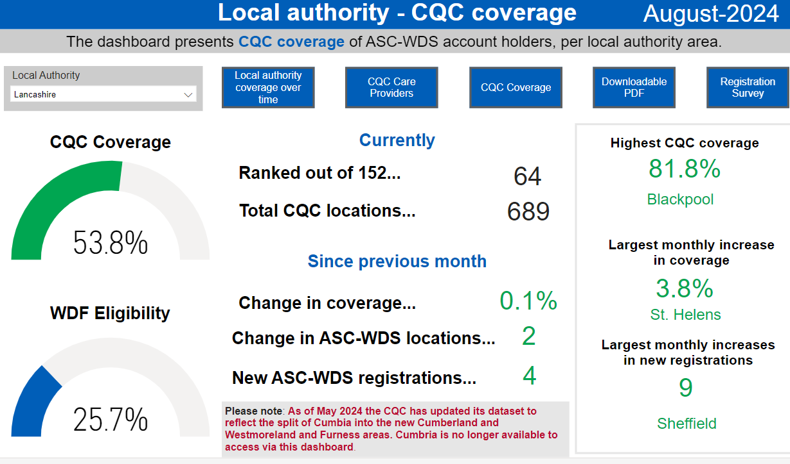
Lancashire coverage – ASC-WDS
Notes:
The Cheshire and Merseyside commissioned work spans 9 local authority areas.
For the purpose of this work, data was taken predominantly from the Skills for Care ASC-WDS system, completion of this isn’t mandated and varies by area.
There has been a growth in completion rates since the work was commissioned with an overall % increase of just shy of 3%. This is positive. We have a target to get completion nationally to 55%, so completion is consistent with the national average. However, there are particular areas to target to drive completion, Cheshire East, Cheshire West and Chester, Liverpool. The data is weighted, the more response we have the richer quality the data and the better opportunity we have to give a snapshot in time of an area if commissioned.
In advance of completing this work we asked for targeted work to increase completion of ASC-WDS and thus make the data for this piece of work richer in terms of real completion of data vs weighted data, as you can see significant improvements in take up rate, particularly in Knowsley and St Helens – Knowsley support from QA team to drive up improvements has really worked. All areas bar one had increased from initial completion by Jan 23.
Also link to WDF and funding for completion of quals which we know, investment in training results in lower turnover rates.
Everyone wins if we increase completion.
Opportunity to increase promotion in residential settings where completion Is generally lower than other provision types.

Slide 18
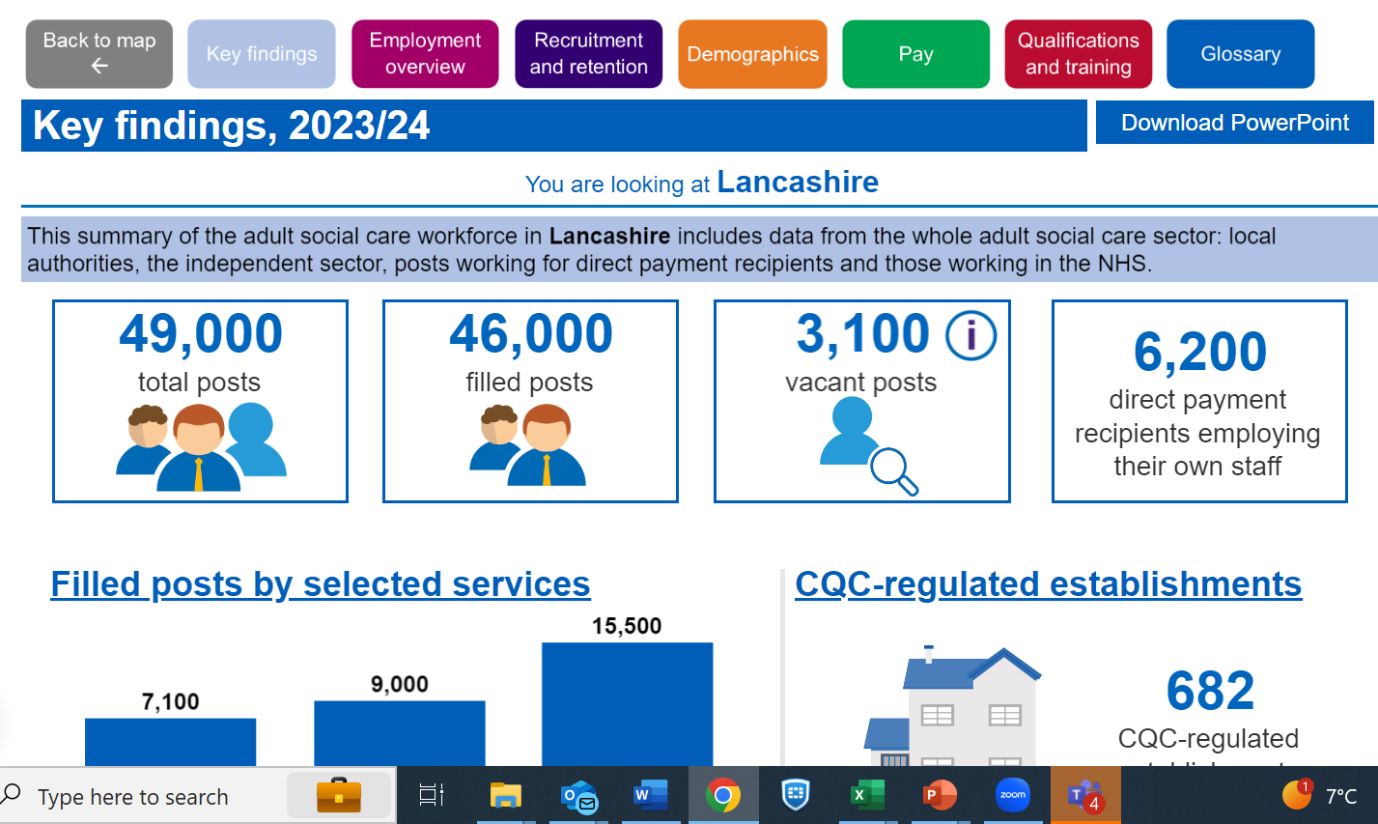
Data split to ICS Level / LA area level / Regional level
Freely published online with analysis report available too
Data drawn down from March each year and published in October

Slide 19

Good and outstanding care guide – Single Assessment Framework edition
Our updated Good and Outstanding care guide has been co-produced with The Outstanding Society and covers the new CQC inspection model
Aimed at frontline managers and those supporting regulated services, it helps regulated providers to prepare to evidence to meet the CQC’s 34 new Quality Statements.
An electronic version of this latest edition is available to all our registered manager members.
You can also purchase a hard copy now from our bookshop. A discounted rate is available for members.
Notes:
https://bookshop.skillsforcare.org.uk/Product/38

Slide 20
North West Roadshow
7th November 10-1.45
Preston click here to book
From attraction to belonging - supporting line managers to build better workplace relationships
Join us to explore how focusing on good workplace relationships during recruitment and induction can improve the motivation, performance and retention of new starters. Evidence from leavers surveys and workforce data clearly shows how important it is that new starters and those changing roles, experience good, supportive workplace relationships.
Using examples from the Skills for Care Induction Toolkit, sector insight and research, delegates will have an opportunity to share good practice and pick up top-tips to support their development.
Notes:
Speak here about prior background and link worker roles.
Specialism in Recruitment and Retention support offer both from prior experience and as a link worker for the organisation in this area.

Slide 21
Priorities – Increasing engagement
Notes:
Speak here about prior background and link worker roles.
Specialism in Recruitment and Retention support offer both from prior experience and as a link worker for the organisation in this area.

Slide 22
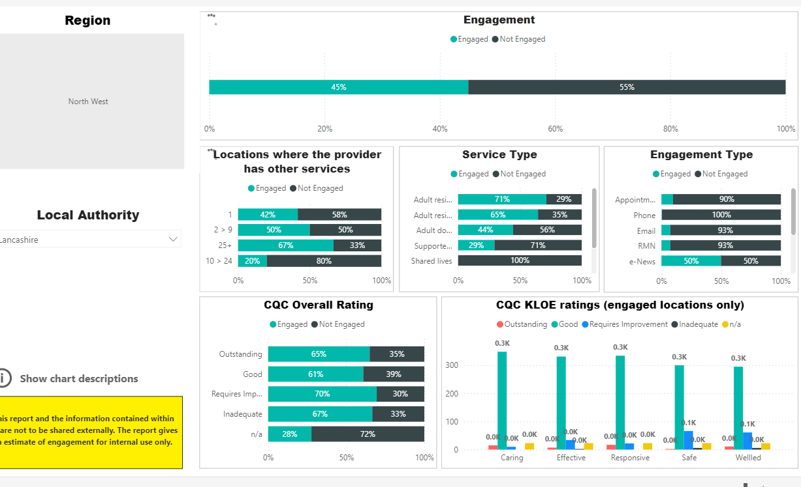
Notes:
Speak here about prior background and link worker roles.
Specialism in Recruitment and Retention support offer both from prior experience and as a link worker for the organisation in this area.

Slide 23
Priorities – CEOs
What do we want them to know?
Attendance / awareness of CEO core network
Promotion of outstanding care offer
Facilitate engagement with ICS’
Promote integration resources and support
Promotion of CQC product range
Promotion of culture toolkit and leadership offer
Promotion of broader SfC work programme
Notes:
Speak here about prior background and link worker roles.
Specialism in Recruitment and Retention support offer both from prior experience and as a link worker for the organisation in this area.

Slide 24
Priorities – Nominated Individuals
Nominated individuals network – meets quarterly
What do we want them to know?
Promotion of ASC-WDS / Data for understanding profile of workforce / Benchmarking
Promotion of training and development / WDF
Promotion of leadership offer for RMs by proxy
Digital transformation skills and development
Promotion of Health and wellbeing support / strategies
Promotion of Recruitment and retention offer
Revised Culture toolkit
Notes:
Speak here about prior background and link worker roles.
Specialism in Recruitment and Retention support offer both from prior experience and as a link worker for the organisation in this area.

Slide 25
Priorities – HR Directors
HR Directors network – meets quarterly
HR directors Whatsapp group
What do we want them to know?
Promotion of ASC-WDS / Data for understanding profile of workforce / Benchmarking
Promotion of training and development / WDF
Promotion of leadership offer
Digital transformation skills and development
Promotion of Health and wellbeing support / strategies
Promotion of Recruitment and retention offer
Revised Culture toolkit
Notes:
Speak here about prior background and link worker roles.
Specialism in Recruitment and Retention support offer both from prior experience and as a link worker for the organisation in this area.

Slide 26
Priorities – Employer L&D leads
Regional L&D leads network – meets quarterly
L&D leads Whatsapp group
What do we want them to know?
Promotion of ASC-WDS
Promotion of training and development / WDF
Promotion of leadership offer particularly L&M related WDF training
Digital transformation skills and development
VLE for CQC inspections
Core and Mandatory training guidance
Care certificate
Updates on national policy / reform
Notes:
Speak here about prior background and link worker roles.
Specialism in Recruitment and Retention support offer both from prior experience and as a link worker for the organisation in this area.

Slide 27
Priorities – Employer QA Leads
What do we want them to know?
How to prepare for inspection and best practice
VLE CQC inspection WDF
CQC good and outstanding resources – toolkit
Updates on reform
Linking in to local improvement projects where applicable
Promotion of Leadership support offer
Updates and support on new CQC assessment framework
Promotion / awareness of broader SfC support offer
Notes:
Speak here about prior background and link worker roles.
Specialism in Recruitment and Retention support offer both from prior experience and as a link worker for the organisation in this area.

Slide 28
Priorities – Nurses
What do we want them to know?
Promotion / sign up to we are social care nursing
Sign up to nursing bulletin
Engagement with Social Care nursing council – SNACs – Jane Green
Engagement / promotion nursing community of practice – Adele Thornburn
Promotion delegated healthcare interventions
Focus on preceptorship
Promotion of Nurses workforce intelligence
International recruitment
Facilitated engagement with ICS colleagues
Notes:
Speak here about prior background and link worker roles.
Specialism in Recruitment and Retention support offer both from prior experience and as a link worker for the organisation in this area.

Slide 29
Other useful updates
https://www.skillsforcare.org.uk/Support-for-leaders-and-managers/Managing-a-service/Delegated-healthcare-activities/Delegated-healthcare-activities.aspx
https://www.skillsforcare.org.uk/Support-for-leaders-and-managers/Managing-a-service/Digital-technology-and-social-care/Digital-Skills-Framework.aspx
Notes:
https://www.skillsforcare.org.uk/Documents/Learning-and-development/Funding/Workforce-Development-Fund/2019-20/WDF-funded-qualifications-and-learning-programmes-2019-20.pdf

