Slide 1
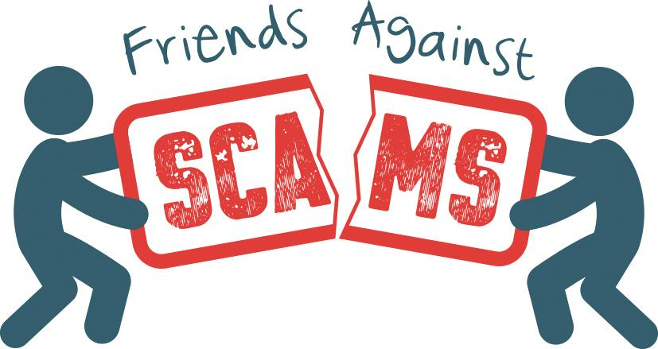
Young Friends Against Scams
Notes:
Start by making introductions. Explain to the students that you are going to talk to them about Friends Against Scams.
Explain that Friends Against Scams was created by the National Trading Standards Scams Team to protect and prevent people from becoming victims of scams by empowering people to take a stand against scams.
Explain that they will learn about the different types of scams and how to spot a victim. With increased knowledge and awareness, they can have conversations with their family and friends about scams to help protect themselves and others.

Slide 2
Let’s talk. What is a scam?
Notes:
Tell the students that you are now going to have a short quiz to see what they already know about scams. Ask for answers to encourage discussion.
Start by asking the students what they think a scam is?

Slide 3
Scams check…
Can you tell me about the different ways that people might get scammed?
1.
a
b
c
d
Telephone Scams
Online Scams
Postal Scams
Doorstep Scams
People might receive lots of phone calls every day. The people on the phone sometimes pretend they are policemen or from the bank. Sometimes the people on the phone pretend to be your friend so that they can steal your money.
  People might be receiving suspicious emails or visiting websites that are dodgy without even realising it! The criminals want to steal your personal information.
People will receive lots of letters that tell them they have won money or that they can read their fortune. They ask people for money in return for their winnings. The letters look very official and sometimes it is hard to tell if it is a scam!
Doorstep criminals visit people at home and might tell them that they need something “fixed”. They do poor quality work or work that doesn’t need to be done and charge really high prices/fees.
Notes:
Ask the students if they can tell you the four types of scam before revealing the four answers. Some answers will be known, offer them a label in your response - for example “person selling dodgy stuff at your door” this can be answered by identifying it with the label “Doorstep Scam”.
Talk to the students in more detail about the four types of scam as you bring them up on the powerpoint.

Slide 4
I wonder…
2.
Why might people get caught out by a scam? Anyone can be a scam victim…
Vulnerable
Lonely
Pressure
Vulnerable
Lonely
Pressure
Someone might have had a bad day and this makes them feel vulnerable or sad for a while. When you feel a bit vulnerable you sometimes make mistakes. They might even be poorly.
People might not have friends and family who are local or they might be too busy. Someone might live on their own and want someone to talk to and the criminals pretend to make friends.
The criminals put lots of pressure on people to respond to a scam. They are very sneaky! People might be too scared or embarrassed to talk to someone about what’s happening.
Notes:
Ask the students for their thoughts before revealing the answers.
Talk about some of the issues that people can face that make them more likely to fall victim to a scam.

Slide 5
Think…
3.
Do you think only old people get scammed?
No
Yes
No
Anybody can be a victim
Even young people get scammed!
Notes:
It is important to highlight the fact that anyone get caught out by a scam. Although many postal scams are targeted at older people, there are now scams that specifically target young people through text messaging and social media.

Slide 6
What do we know…
4.
How many people in the UK get tricked by scams?
Hundreds
Thousands
Millions
Notes:
With this question, you could ask for a show of hands for each answer.
Make it clear that this is problem does not just affect a few people – it affects the lives of millions of people. Some may only be scammed out of a few pounds, whilst others may lose their life savings.

Slide 7
Let's think…
5.
Most scam victims are rich…
False
True
False
Anybody can be a scam victim no matter how much money you have!
Notes:
Again, ask for a show of hands for each answer. Scammers will target anyone and they will then try to get all the money that person has available, regardless of how much it is.

Slide 8



Let's learn a
little bit
more about scams
Notes:
Tell the students that you are going to move on to look at 2 areas in more detail

Slide 9
Postal Scams – the signs
First name used
Too good to be true
Often tell you to “keep it secret”
Send you junk trinkets
Requests money for a prize
Dazzling
Stamps used to make the letter look genuine
Looks authentic
Notes:
Give a brief recap on postal scams and what they are. This information is available in the Young Friends Background Information document.
Ask the students about what could be a sign of a scam on a letter. Think about things like – making offers that are too good to be true, giving deadlines to try and rush people into responding.

Slide 10
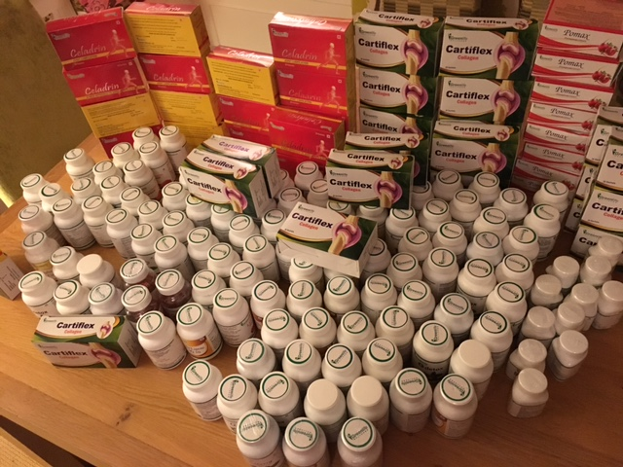
Lotions and potions in someone’s house!
Notes:
Sometimes postal scams will send you free gifts to encourage you to enter into a ‘fake’ prize draw.
Explain to the students that this a picture taken from a victim to show how many products they ended up with when they got into the cycle of being scammed. The more they spent, the more they needed to win money, so they kept entering and paying over and over. They never won the big case prize but ended up with lots of worthless and useless products.

Slide 11
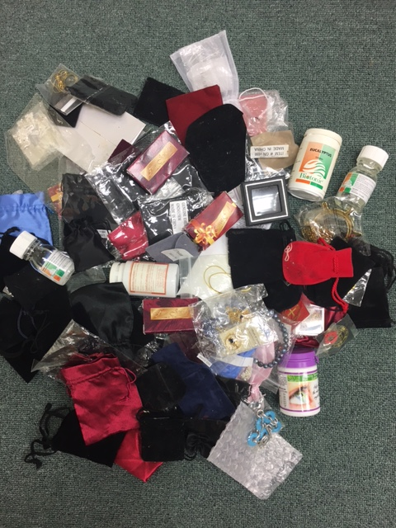
Good luck charms/trinkets
Notes:
This is another example – ask the students what they think they should do if they went into someone’s house and say lots of things like this?
Have a conversation with the class about the importance of telling someone they trust if they are worried someone else is the victim of a scam.

Slide 12
Online/email scams – the signs
Bad spelling!
Pressure to Respond
Lots of capital letters
Incorrect email address or website links
Not addressed to anyone
No subject
No signature
Requests for passwords or bank info
Notes:
Give a brief recap on online scams and what they are. This information is available in the Young Friends Background Information document.
Ask the students about what could be a sign of a scam online or sent via email. Think about things like – links that you are asked to click, request for password information, pressure to respond.

Slide 13
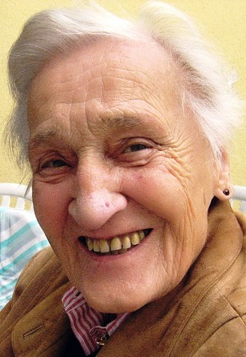
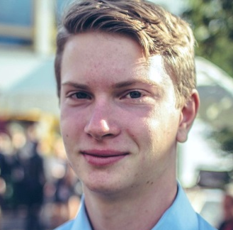
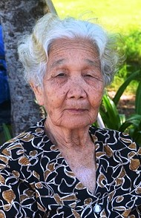
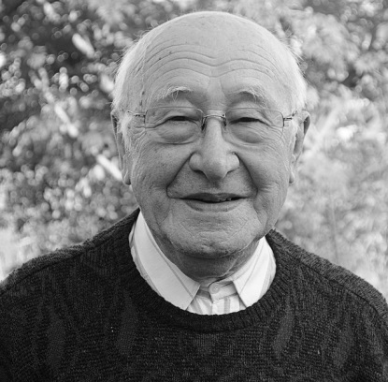
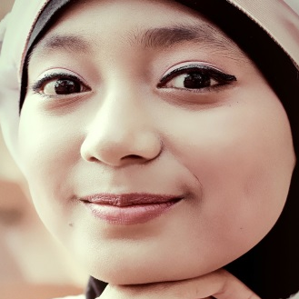
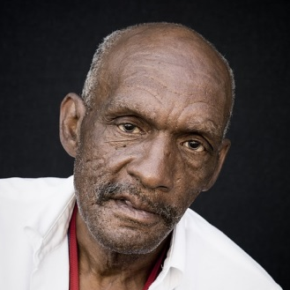

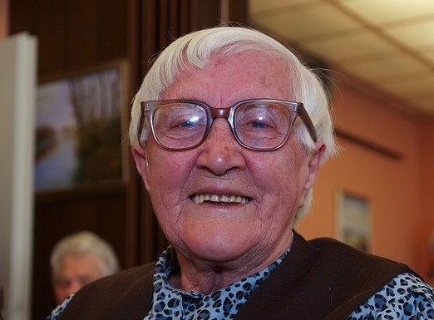

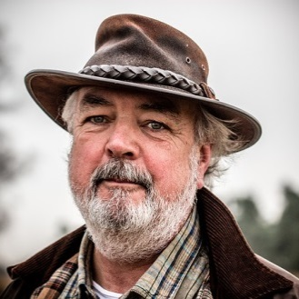


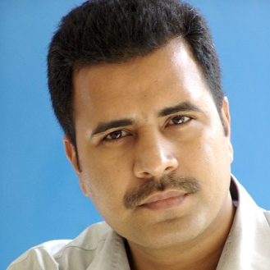
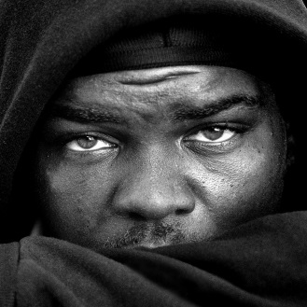
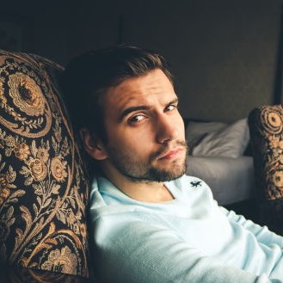
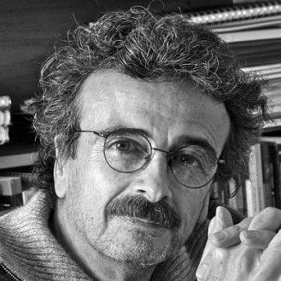

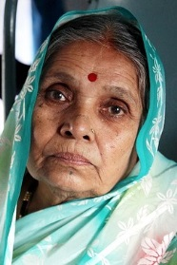
Anyone can be a scam victim.
Health issue
Dementia
Vulnerable
Socially isolated
Lonely
Pressure
Sense of purpose
Targeted by criminals
Trust easily

Slide 14

What can you
remember?
Notes:
The work undertake on this slide will depend on the time you have available. You can just talk to the students about some of the key messages they have learnt today.
Depending on the time you have available, then you may wish to make use of the games and activities in our files.

Slide 15

Top Tips - what can you do to protect yourself and/or others?
Never tell people your personal details.
1
2
Don’t assume everyone is genuine.
3
Don’t be rushed.
4
Listen to your instincts.
5
Stay in control.
Notes:
Explain to the students that Friends works alongside the Take Five campaign and they have 5 important messages that you can try to remember to keep you safe from scams:
Never tell people your personal details
Don’t assume everyone is genuine
Don’t be rushed
Listen to your instincts
Stay in control
NB – Please note that when you move on to the next slide, a short film with music will play automatically, so only move on when you are ready to complete the session
Before moving on to the final slide, you may wish to thank everyone for listening and participating in the session. Explain that you are now going to show them some final slides explaining how they can spread the word about scams and make a promise to share the friends messages with other people.

Slide 16

Congratulations
You are now a Young Friend
Against Scams.

Slide 17
What's next?

Slide 18
Make a promise and turn your knowledge into action.

Slide 19
Some example promises to get you thinking about what you can do.

Slide 20
1. Tell five people about scams and the Friends Against Scams idea.

Slide 21
2. Encourage someone you know to visit the Friends Against Scams website.

Slide 22
3. Look out for other people. Talk to your friends, your family, your neighbours about scams!

Slide 23
4. Could you write to your local Member of Parliament asking them to promote scams awareness?

Slide 24
How will YOU spread the word?

Slide 25
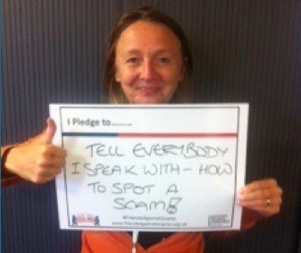
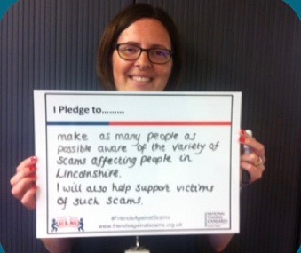
Eve and Gillian have promised to tell everyone they meet how to spot a scam and help to support them.

Slide 26
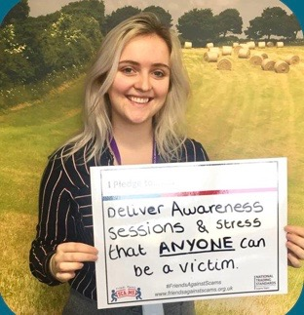
Candice has promised to become a SCAMchampion to raise awareness with people of ALL ages.

Slide 27
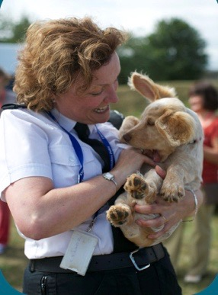
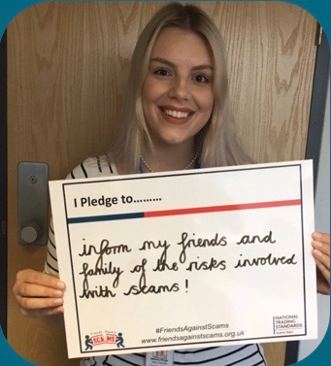
Bethany and Caroline
have promised to
speak to family and friends
about the risks including
“everyman and his dog.”

Slide 28
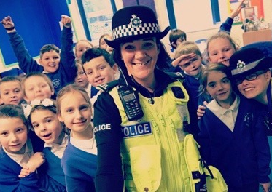
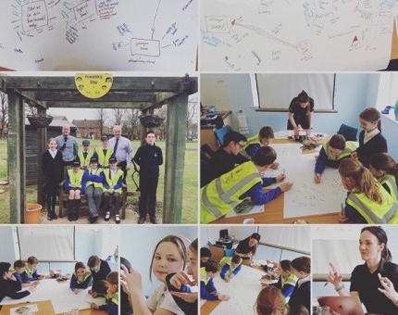
Mel has promised to help
spread the word through
schools and education.
She had a little help
from the children
at Spilsby and Cranwell
primary schools.

Slide 29
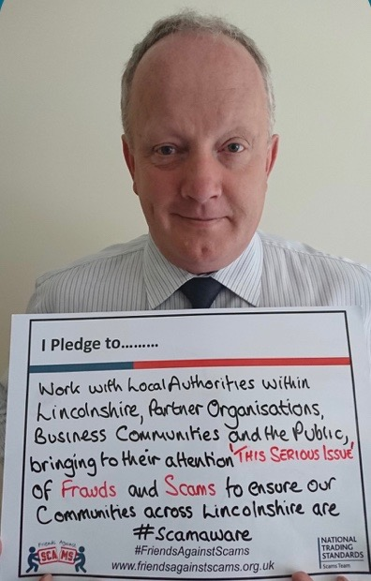
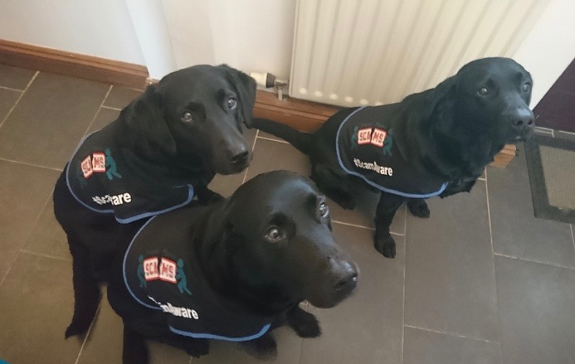
Deputy PCC Stuart Tweedale
has promised to become
our first Scambassador
and help highlight the
issues. His dogs are also
helping him
to spread the word.

Slide 30
Thank you for joining us today
www.FriendsAgainstScams.org.uk

