Slide 1
Proportionate Care
(previously referred to as
Single-Handed Care)
Notes:
Introductions – Val Knight and Janette Daley

Slide 2
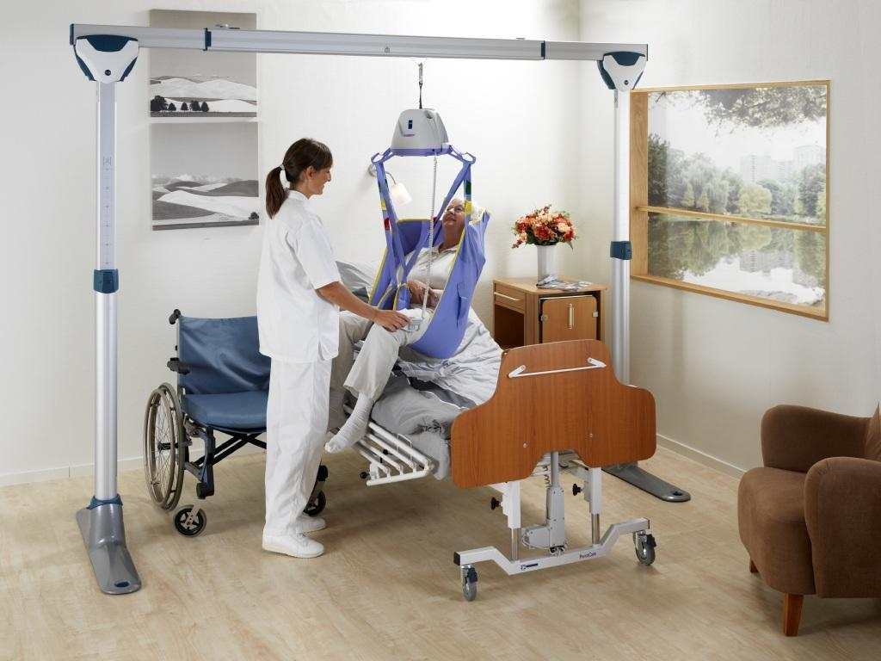
What is Proportionate Care?
Notes:
Proportionate care is the appropriate level of care provided to the service user and as a result, they are cared for in a much more dignified and safe manner with techniques and the provision of equipment. This can mean reducing the care from
one to none or
two to one or
three to two etc.
Several benefits
This is not a new concept. A host of other local authorities have already implemented Proportionate care as their default position, with multiple carers being the exception not the rule.

Slide 3

WHY?
What’s the point?
Why not carry on as we are?
What’s wrong with the current system?

Slide 4
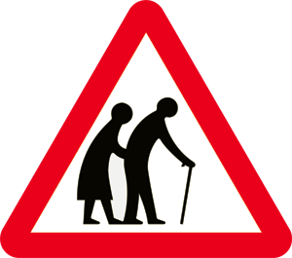



Increase Capacity In The Care Market
Notes:
There is a growing demand for care provision across the country with a national shortage of carers as people are living longer and remaining at home with complex health conditions.
Therefore, by reducing the number of carers required we can free up care for others who need it, by upskilling care staff and providing training in proportionate care we can reduce risks with moving and handling, and future proof the care market
There’s a growing demand for care provision as people are living longer with complex health conditions

Slide 5
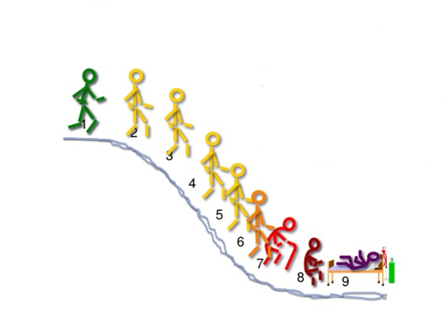
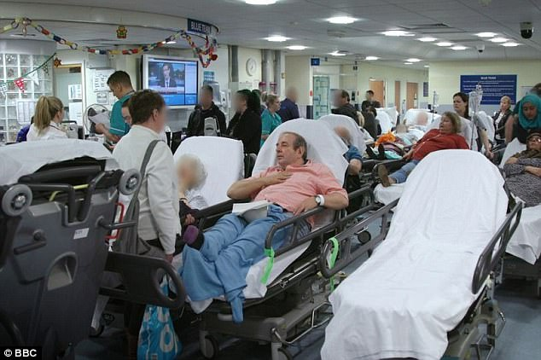
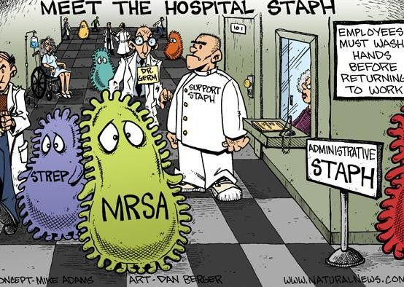
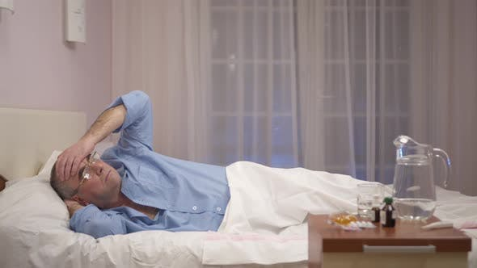

Reduce Delayed Transfers of Care
Notes:
Delayed transfers of care due to difficulty sourcing multiple carer packages can lead to deconditioning and loss of functional skills, reduced rehab potential and therefore, increased dependence on support, which has a negative impact on mental health and wellbeing
Delays in discharge can lead to Increased risk of hospital acquired infection, and in some cases, unnecessary admission to short term care
Uncertainty/ inconsistency of carers
Increased use of crisis care
Shortage of hospital beds/ increased pressure on hospital systems
Longer waiting times for intermediate care beds due to high dependency of 2:1 care

Slide 6
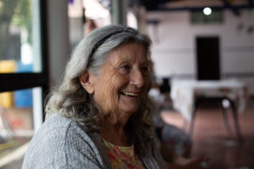

Improve Service User Outcomes
Personalised Experience of Care, Empowerment, Independence &
Improved Mental and Physical Health and Wellbeing
This Photo by Unknown Author is licensed under CC BY
Notes:
By introducing new techniques and equipment, care which is proportionate to need can enhance privacy & dignity, improve interactions and relationships and increase independence & Empowerment as 1 carer is more likely to encourage participation during care, rather than passive intervention

Slide 7
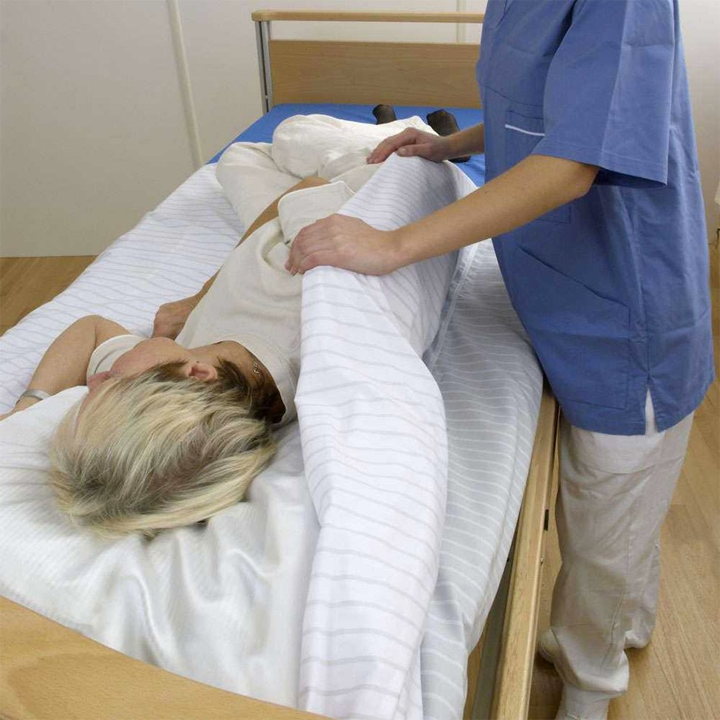
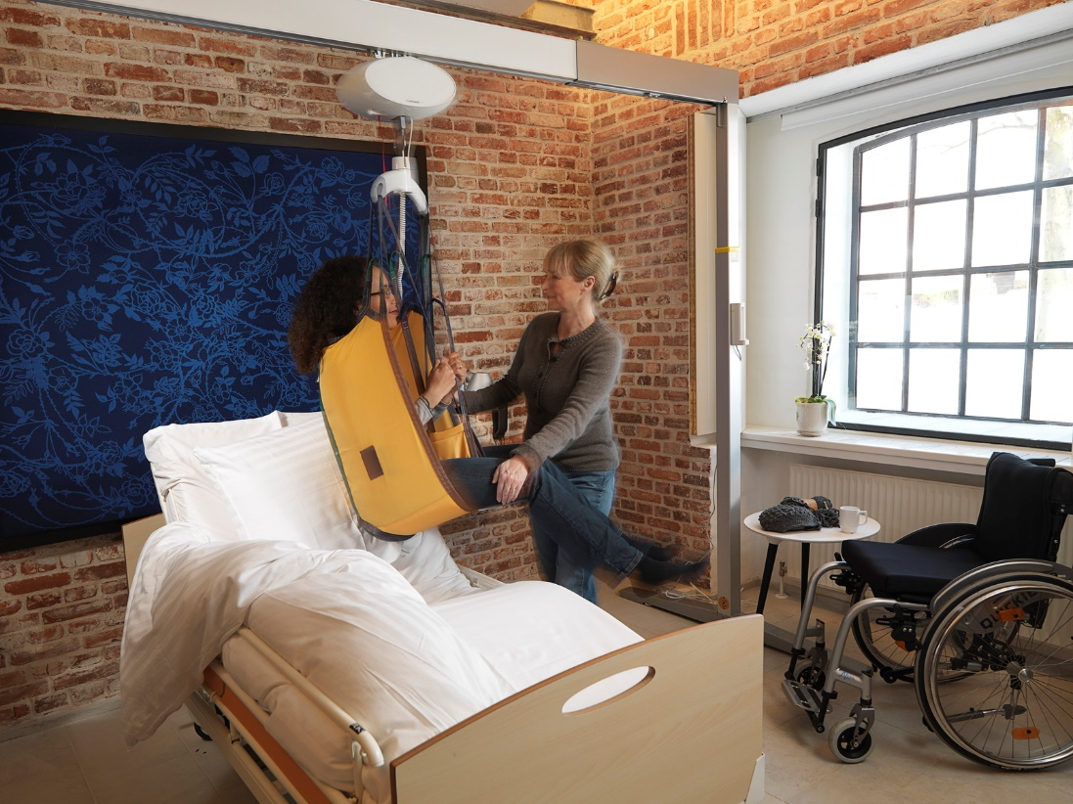
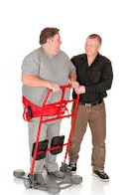
Equipment Examples
Notes:
Equipment available which promotes proportionate care include in-bed slide sheets, manual and powered stand-aids and gantry or ceiling track hoists, which can reduce the numbers of carers required

Slide 8
Common Concerns and myths
Moving and handling equipment requires two carers to use
Care provider policy states it must be 2 for moving and handling
Insurance stipulates must be two for moving and handling
It is against the law
2 carers have been recommended in the past or by other health professionals
Notes:
TILEO
TASK, INDIVIDUAL, LOAD, ENVIRONMENT and OTHER FACTORS
Specific moving and handling needs specialist assessment should be sought from : occupational therapists and physiotherapists;  manual handling advisers with experience in health and social care;  professional bodies and organisations, such as the National Back Exchange or Chartered Society for Physiotherapists (see ‘Find out more’ at the end of the chapter).

Slide 9
Common Concerns Addressed
ALL moving and handling tasks must be individually risk assessed by a trained person, and a safer handling plan should be provided
Specific/complex moving and handling assessments should be carried out by Occupational Therapists/Physiotherapists/Moving and Handling specialists - LCC OTs are trained and skilled in proportionate care
Specialised equipment is available to support proportionate care
All moving and handling tasks should be reviewed by a trained competent person
Notes:
http://www.hse.gov.uk/pubns/hsis3.pdf
Health and Social Care Act 2008 (Regulated Activities) Regulations 2014 (Part 3) (as amended)
Care Quality Commission (Registration) Regulations 2009 (Part 4) (as amended)

Slide 10
Long Term Plan
1:1 care will be the norm
Multiple carer packages require assessment by an Occupational Therapist and approval by senior management
LCC will be able to meet the needs of ALL it’s residents, providing care proportionate to needs whilst promoting safety, privacy, dignity and independence.

