Slide 1
Delegation Portal Update
Provider Webinar
Thursday 28th September

Slide 2
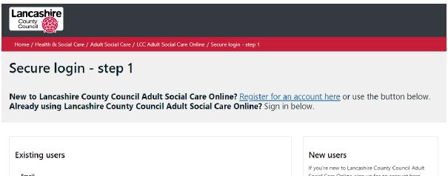
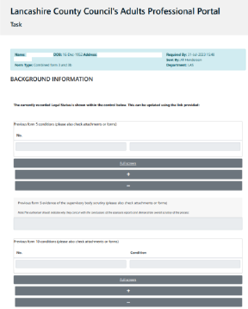
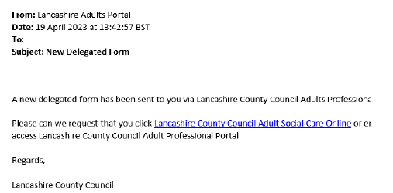
Delegation Portal Summary
The Portals will allow new capability in the way LCC digitally interacts with professionals and citizens.
The Delegation Portal will allow Independent BIAs to contribute to the DOLs Assessments.
The Delegation Portal is a secure platform which replaces the transfer of information via email.
Other use cases which will be identified and implemented in future.

Slide 3



Independent BIA Letter
Every Independent BIA will be provided with an official letter to share with care homes or interested parties.
Official Letter
This is to provide assurance that the work and information that BIAs are requesting is being undertaken by Lancashire County Council.
Assurance
Request
Please request to see their letter if you are ever unsure.

