Slide 1
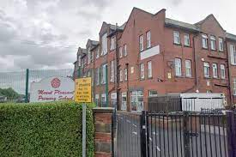
RE
Mount Pleasant Primary School
By
Natasha Finch

Slide 2

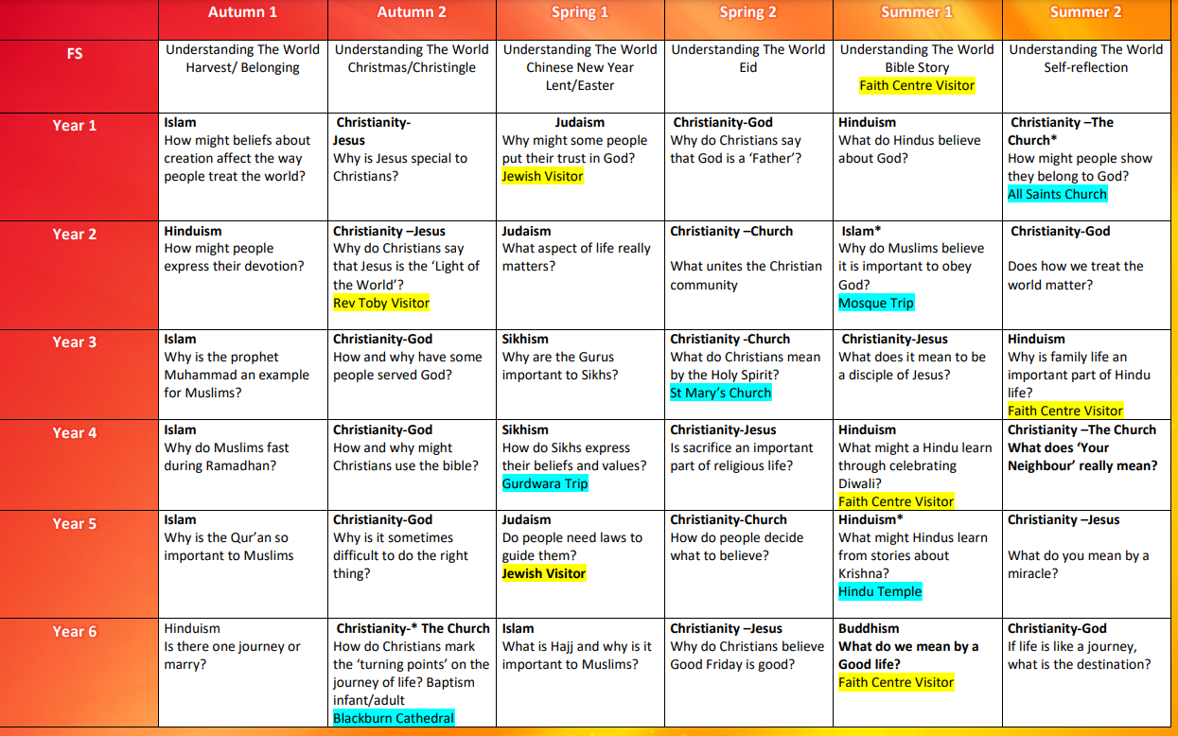
How we teach…

Slide 3
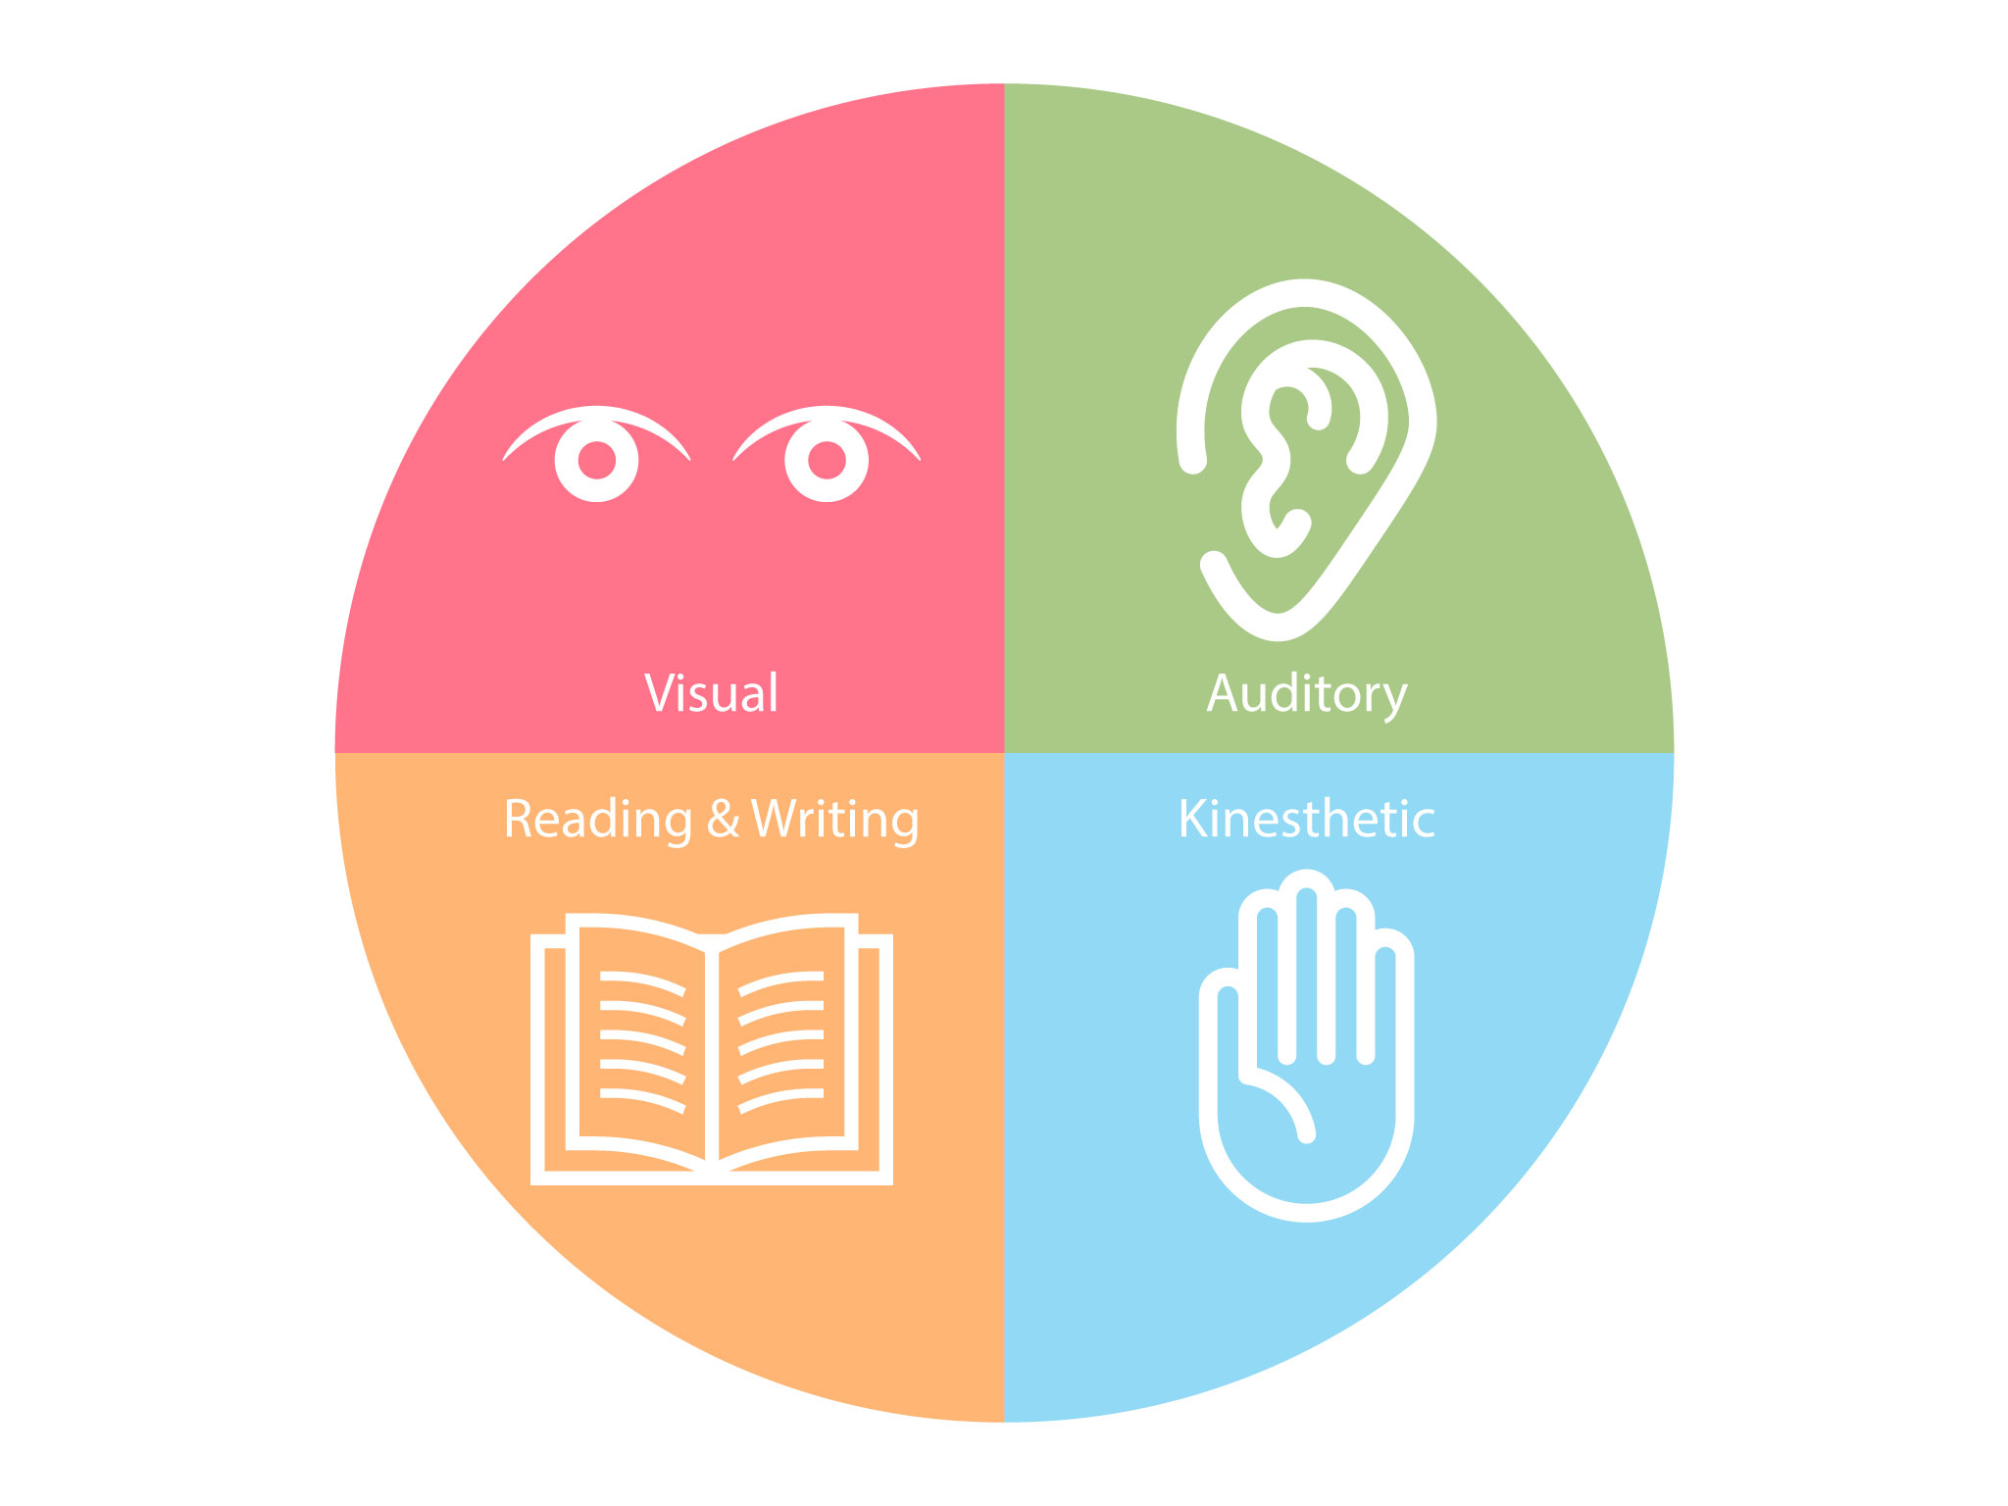
A VARIED APPROACH…
A varied approach to learning.
Notes:
At Mount Pleasant, we encourage a passion for RE through completing a range of different activities to suit the needs of every child and over the unit of work, each year group doesn’t just ‘write’ key findings, beliefs and about each religion – we emerge the children and try to create fun and engaging lessons which keeps the children interested and focussed.
RE isn’t an English lesson and we believe that RE can be completed through a range of activities such as drama, role play, art work, going outside for first hand experiences, practical lessons, reading, listening and also writing.
Here are some ways in which RE has been taught in our school

Slide 4
Practical lessons
Self reflection walk – searching for a personal meaning
Hot Seating/ drama
Art Work
First hand experiences
Notes:
Year groups have completed self reflections and thought about how that religious view relates to their own life – For example, In Islam the children discuss that muslims believe the world is wonderful so we took a group of children outside, we walked through the school grounds and to a local park/ woods and gave the children the first hand experience to discuss how they thought the world was wonderful and what they could do look after the world. In Year 6, the discussed The Easter story in depth and watched an Easter story clip. They then went onto discussing the thoughts, feelings and opinions of the people involved which brought up lots of questions and the teachers, we happy to adapt the lessons, to answer and research any questions that they children learnt and gave the children time and a safe space to debate their own opinions on the matter.
In Year 2, they learnt about the creation story and instead of writing about what happened during this period, the children expressed the Creation through art work and they could present this however the like – giving the children ownership.
In Year 1, we were discussing the festival of sukkot and how the jewish faith create sukkahs to remember the jewish making they way to the promise land and escaping slavery. We discussed the festival, researched how the jewish celebrate this and then we provided the children with the different elements to a sukkah and created one. Once it had been built we all sat around it and discussed that Jewish would eat their meals, so we had snack time in our sukkah and discussed what we were grateful for. By the end of the lesson, the children could identify the key events to the festival and all of the elements used in sukkah.

Slide 5
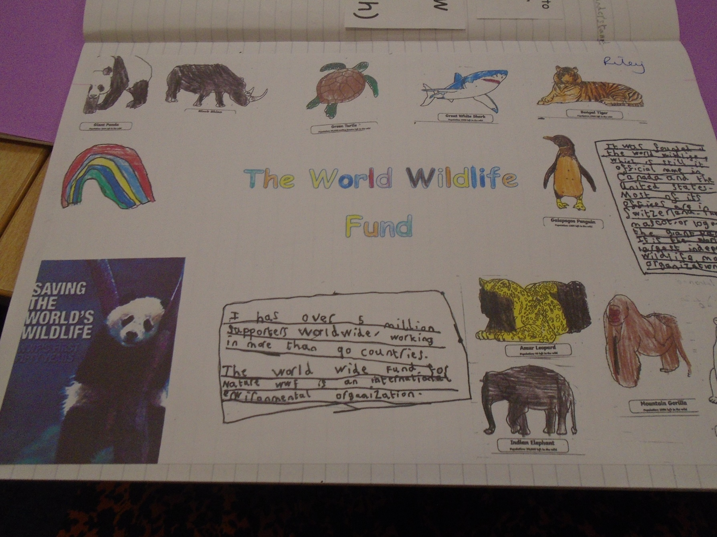
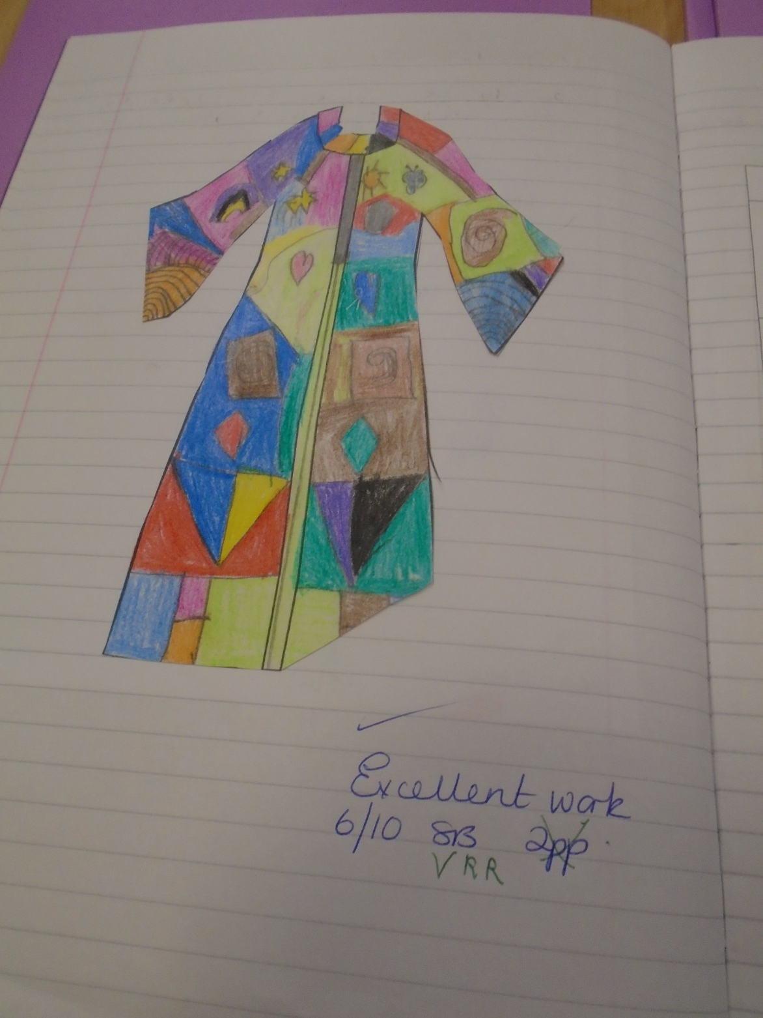
Examples of Work

Slide 6
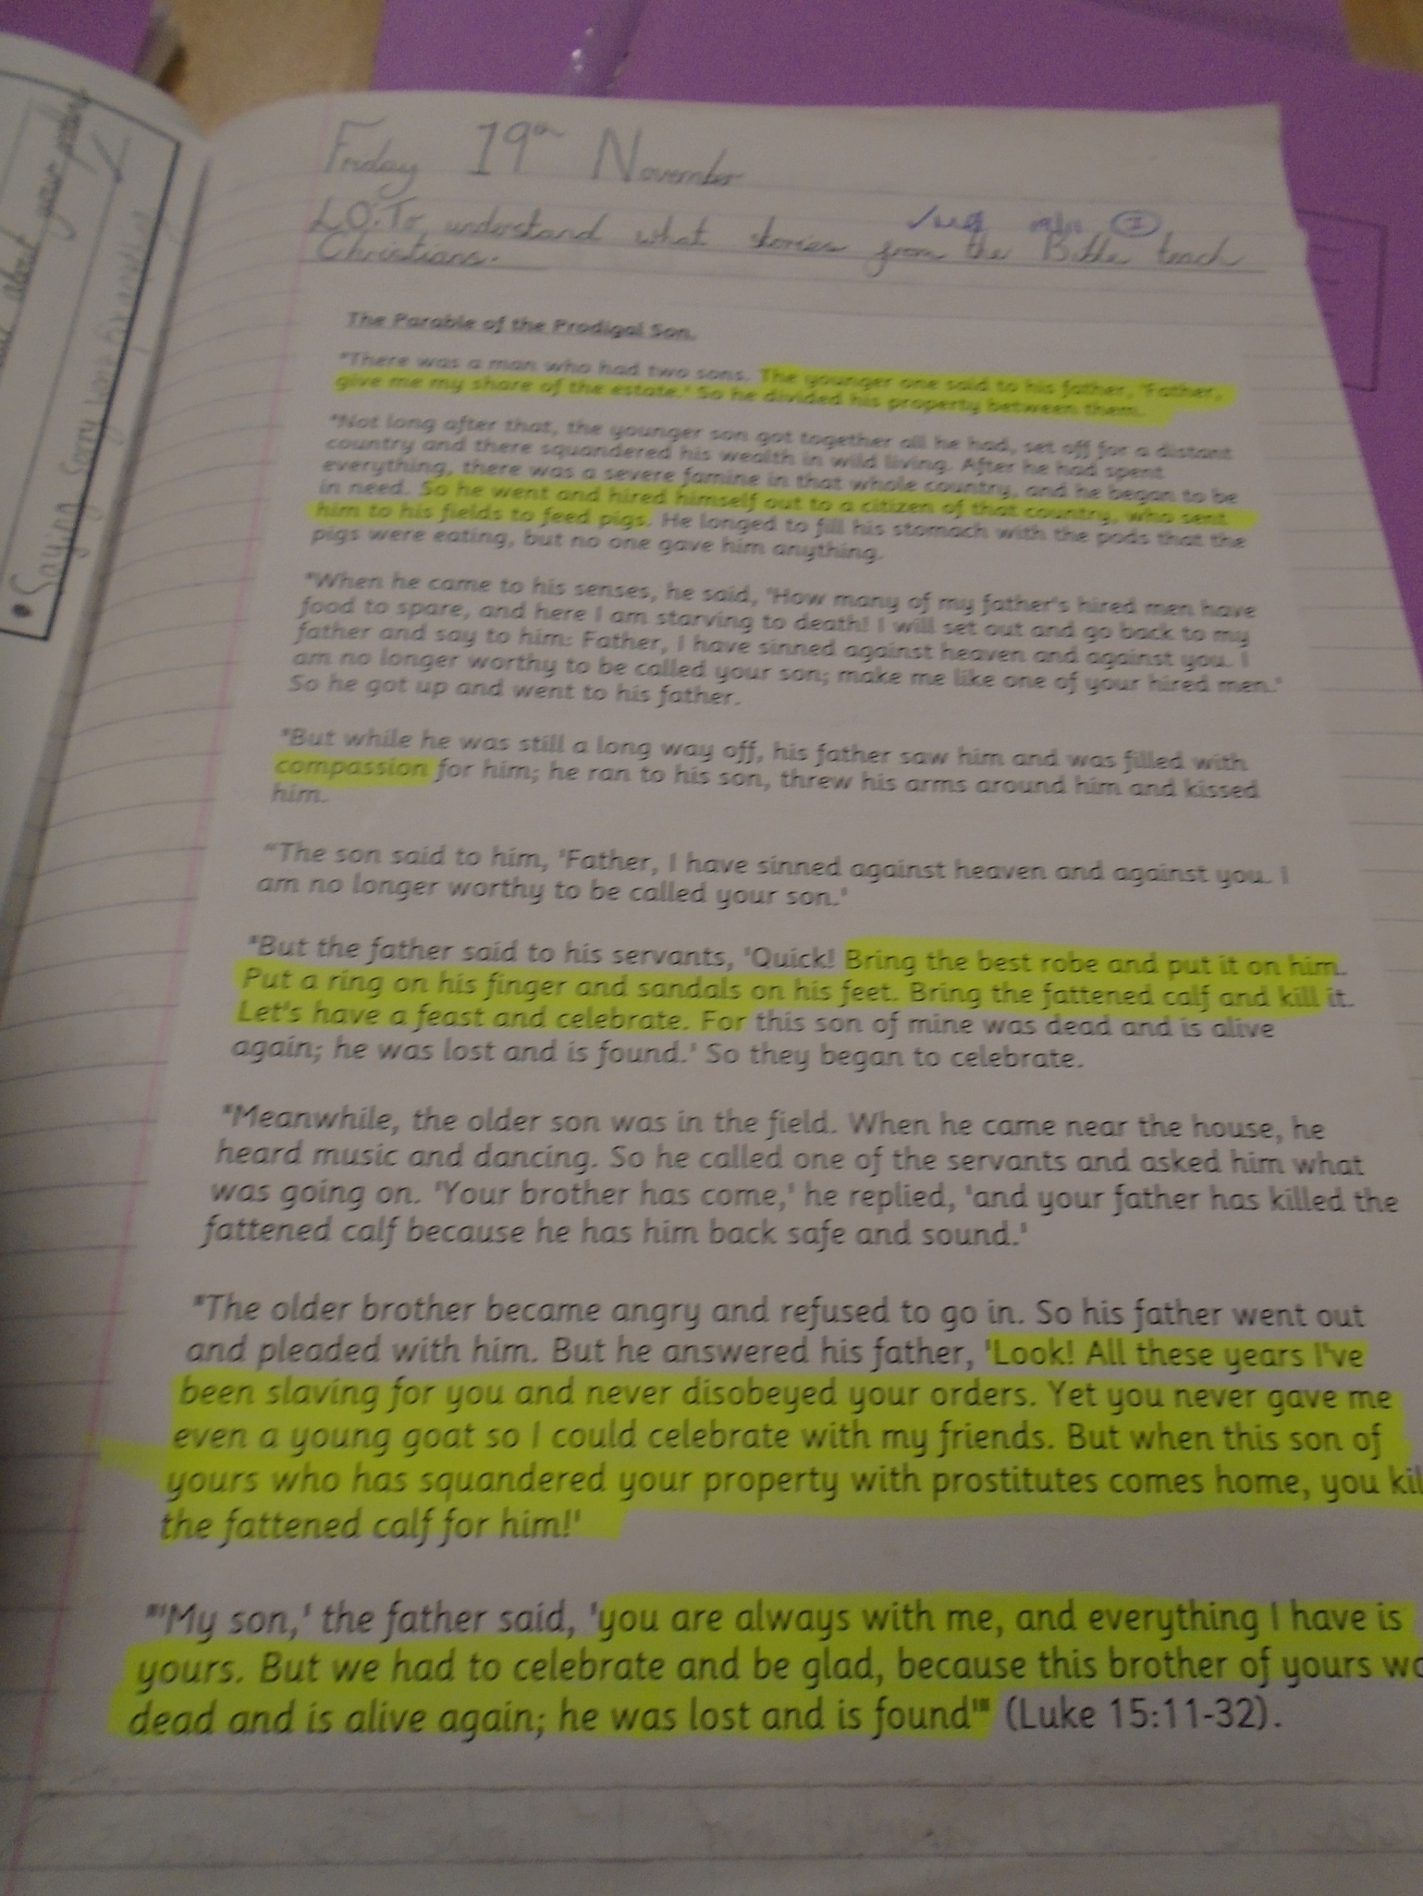
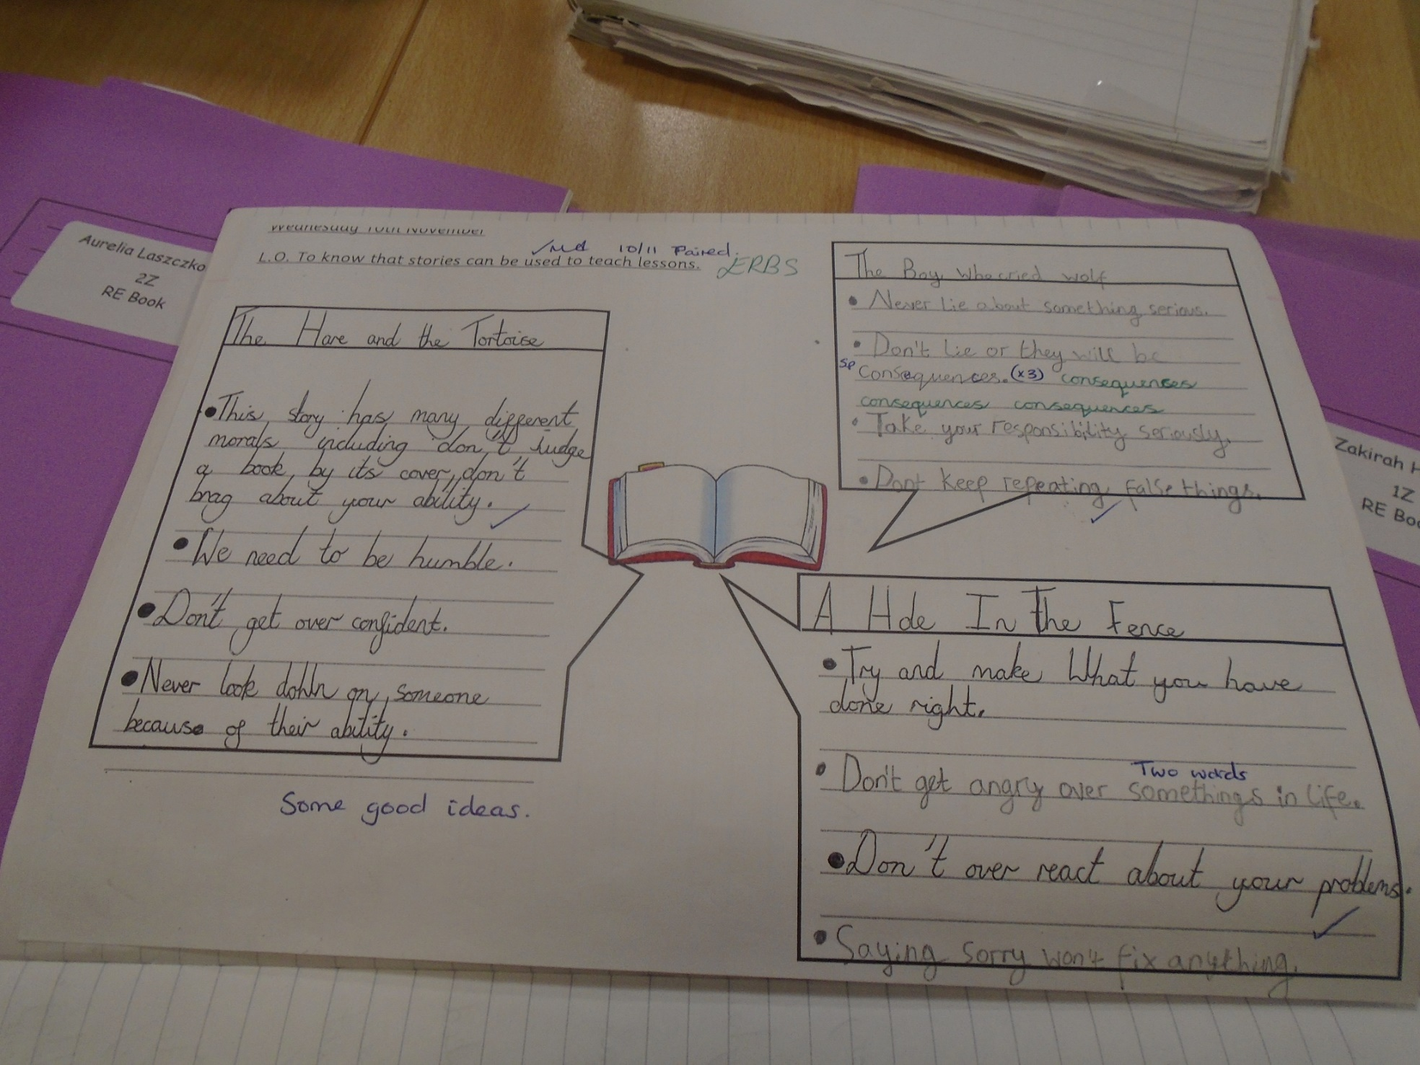
Examples of Work

Slide 7
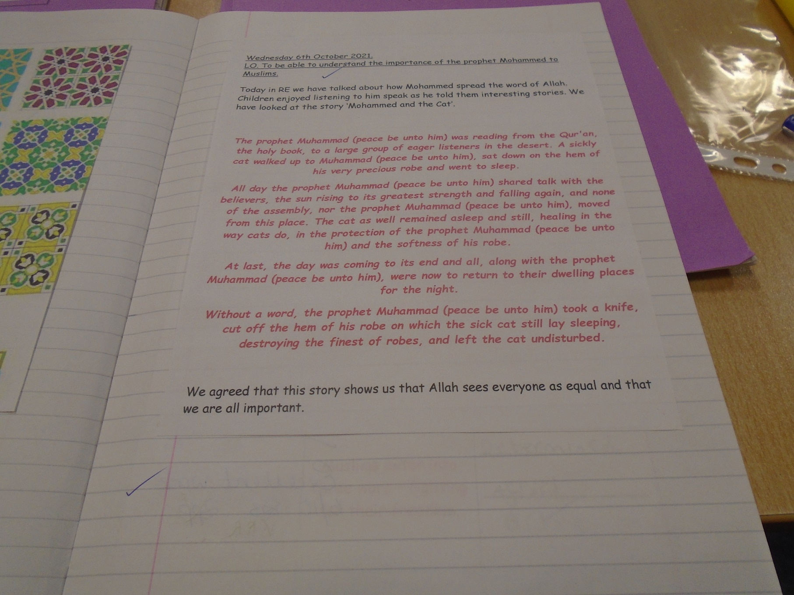
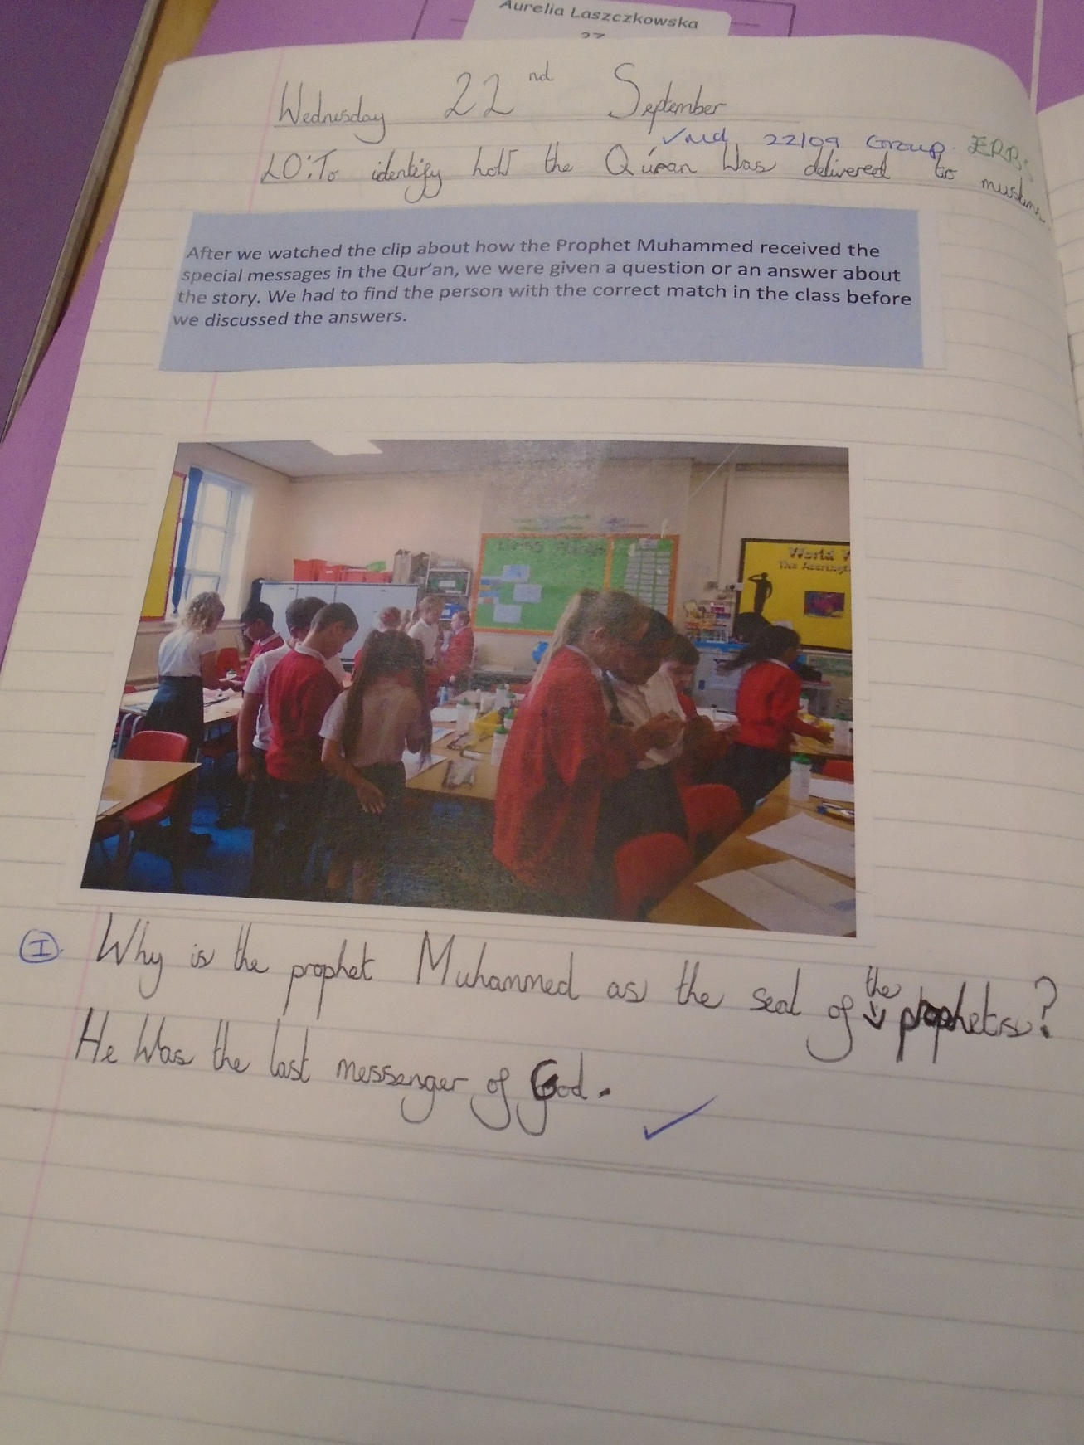
Examples of Work

Slide 8
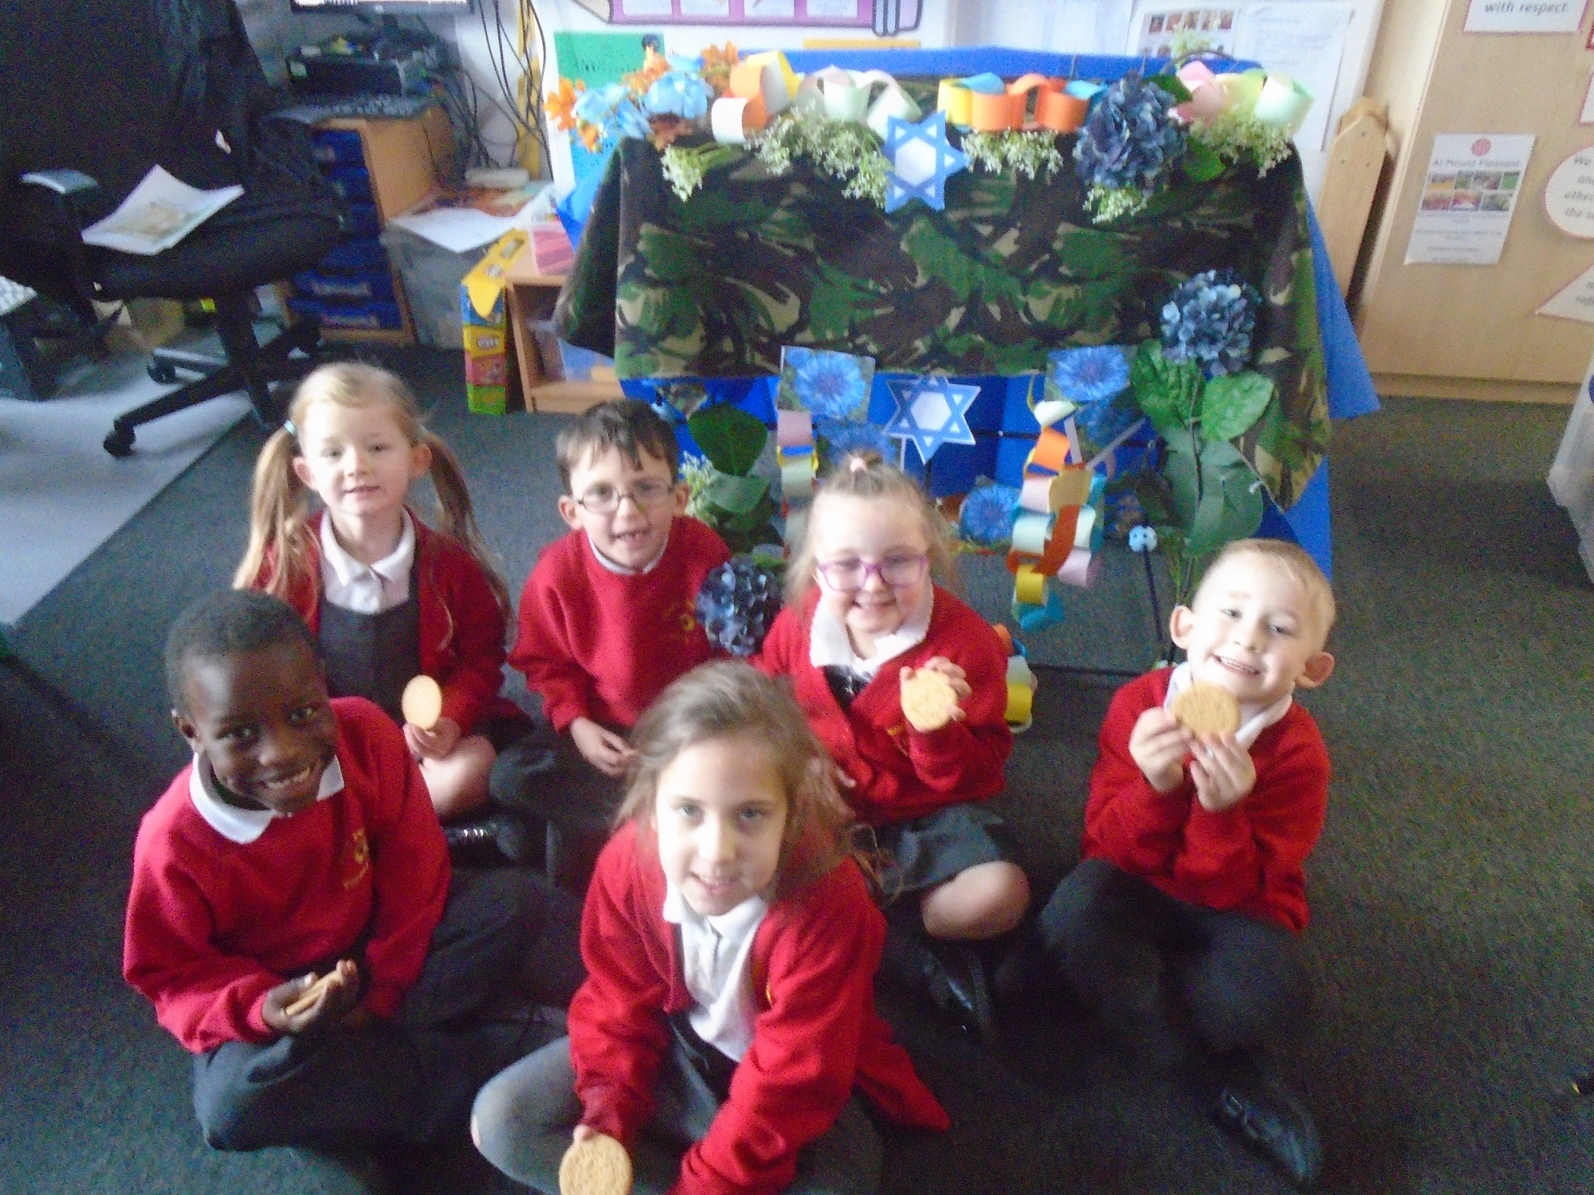
Examples of Work
Notes:
Y

Slide 9
Visits and visitors
Every year group, is allocated a visit and a visitor each year. The children enjoy taking part in these visit/ listening to visitors which enhances their learning and the children can ask questions that teachers may not know the answer to.
Year 1 – Jewish visitor, trip to a church.
Year 2 – Chrisitian visitor, trip to a mosque
Year 3 – Trip to a catholic church and a Hinduism visitor.
Year 4 – Trip to Gurdwara and a Hinduism visitor.
Year 5 – Jewish Visitor and trip to a hindu temple
Year 6 – Blackburn Cathedral and Buddhism visitor.

Slide 10
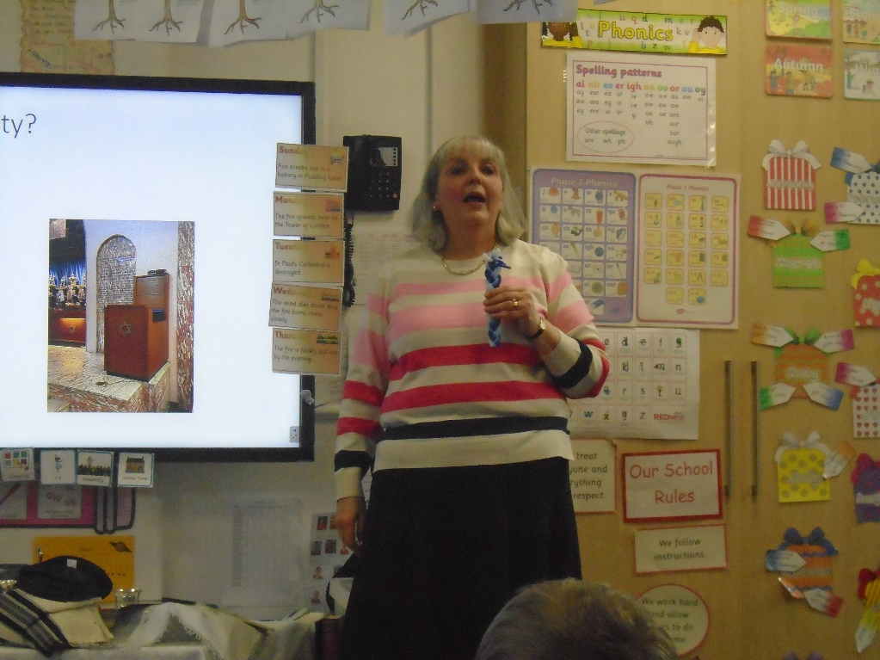
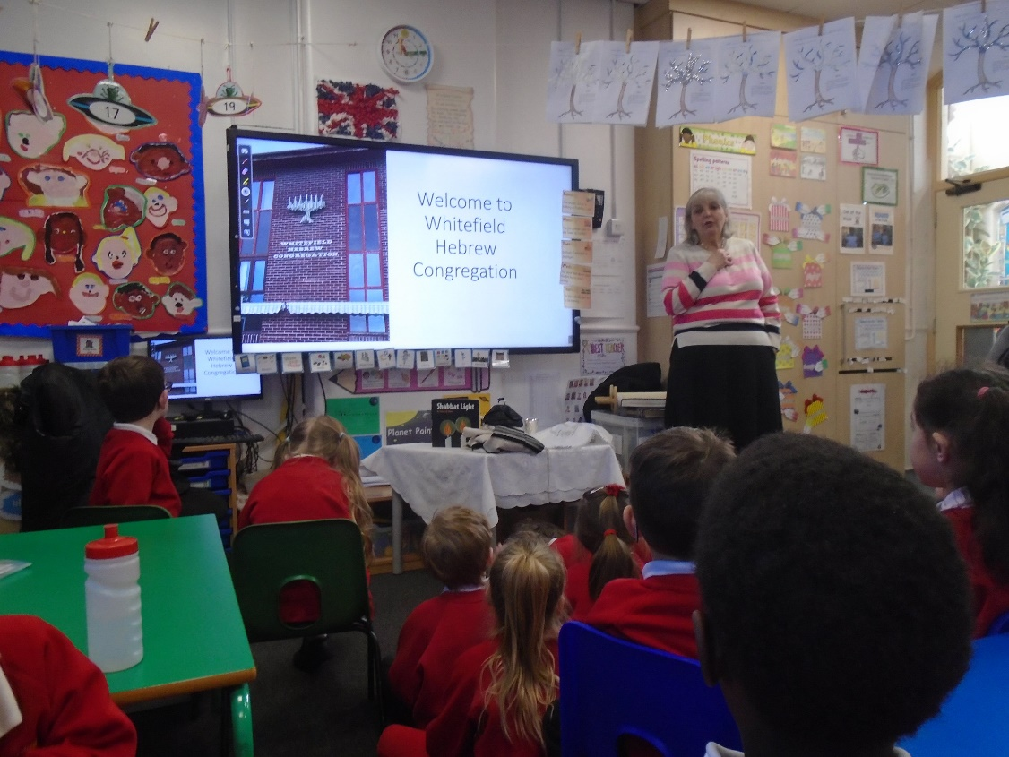
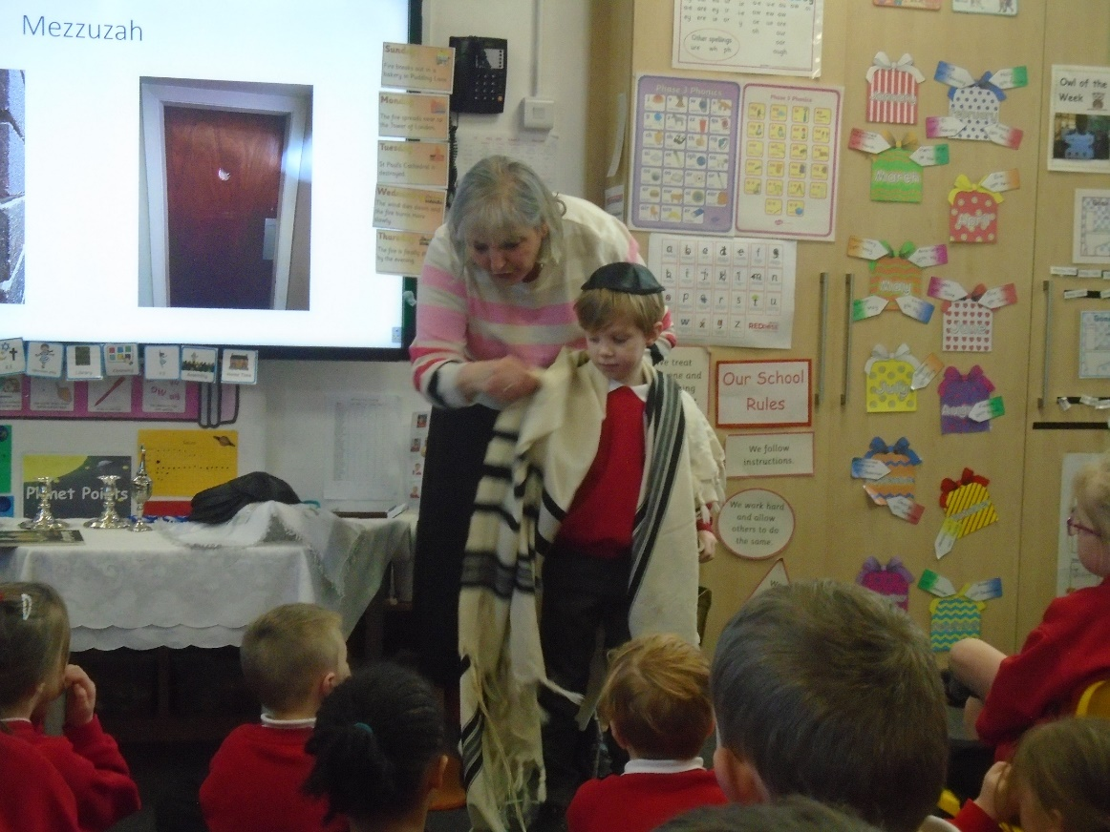
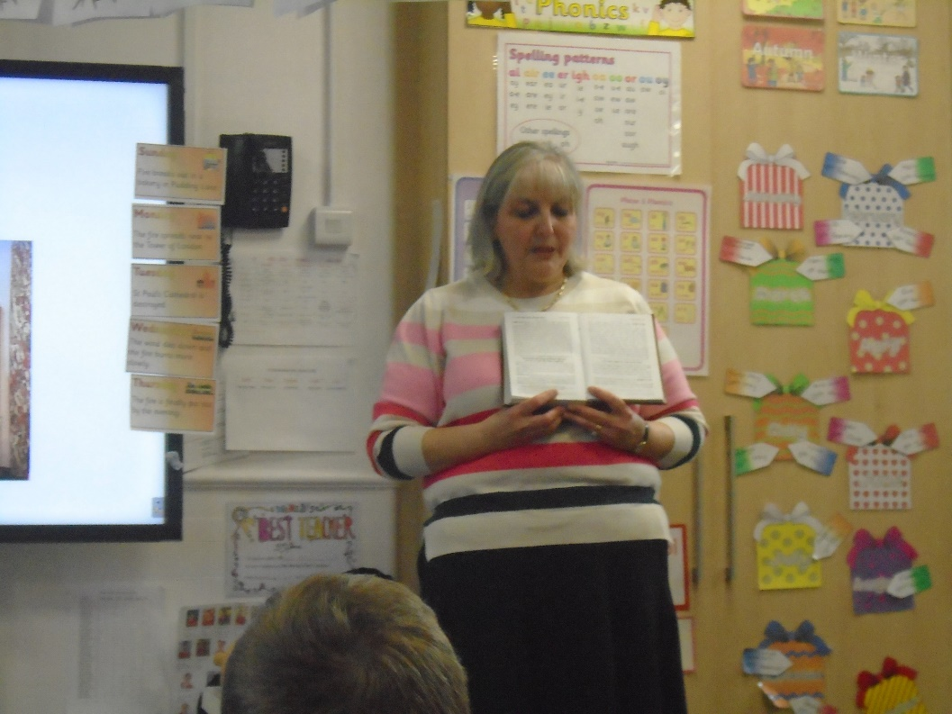
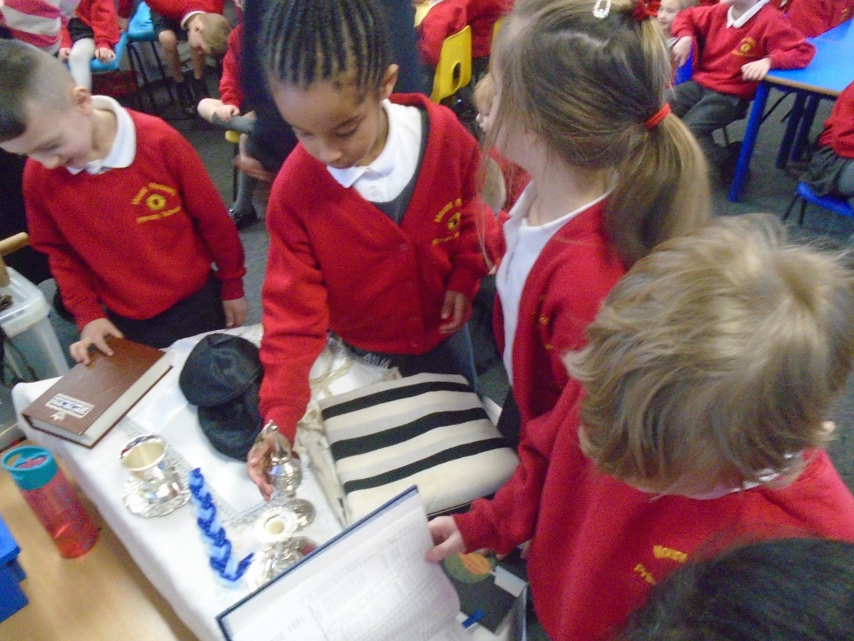
Judaism

Slide 11
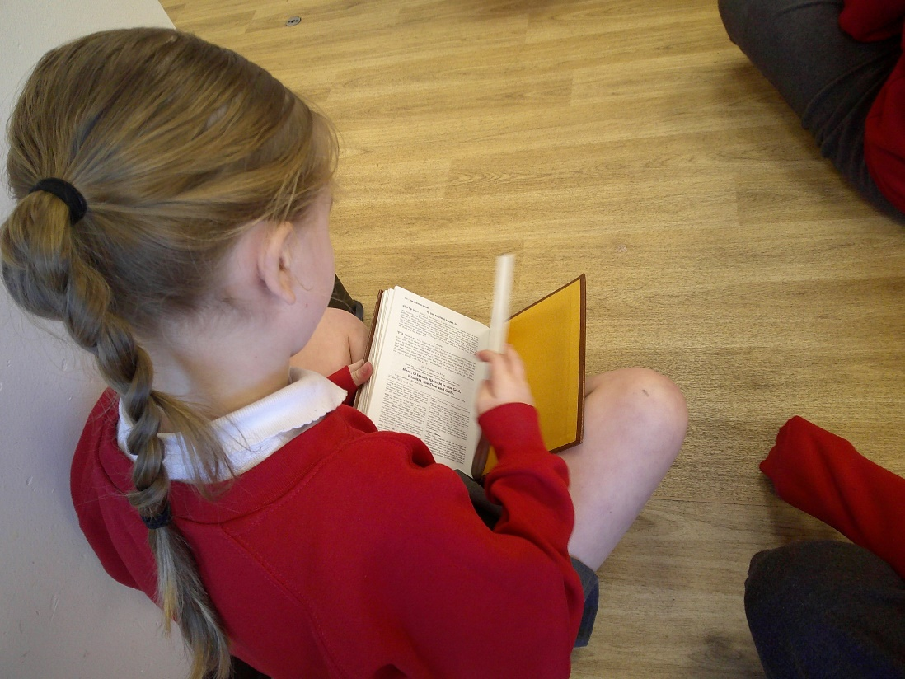
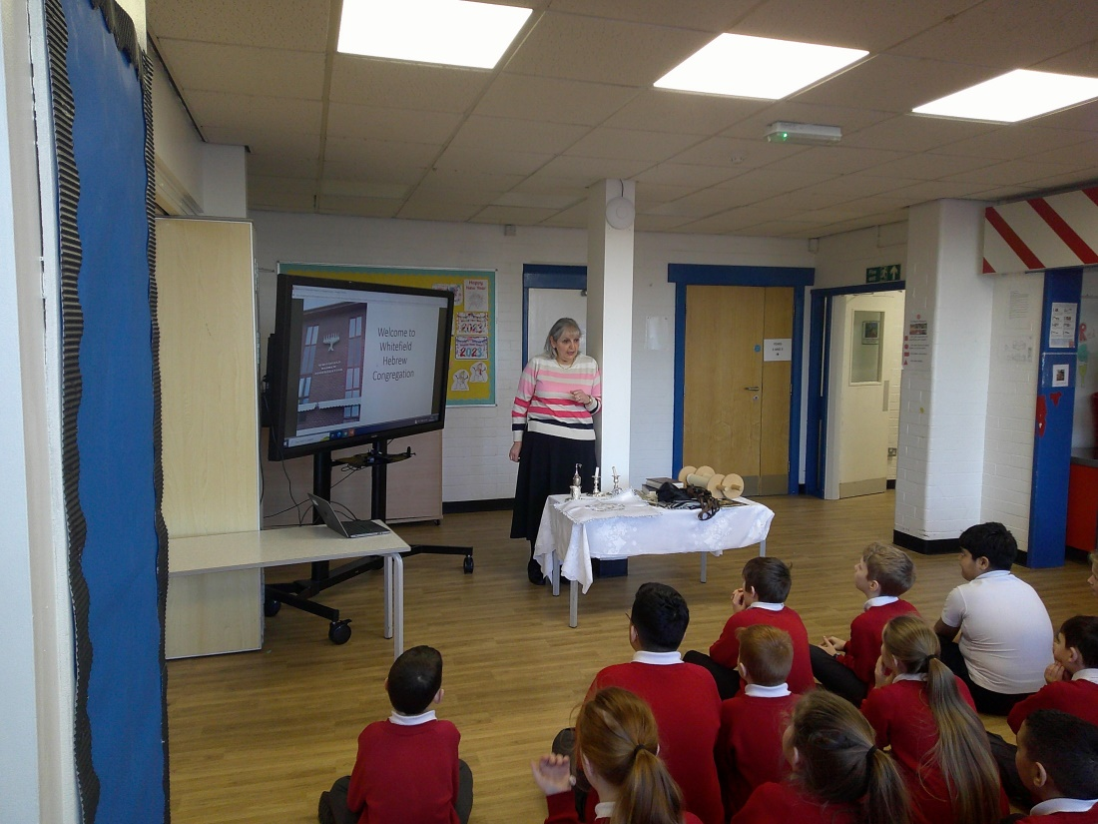
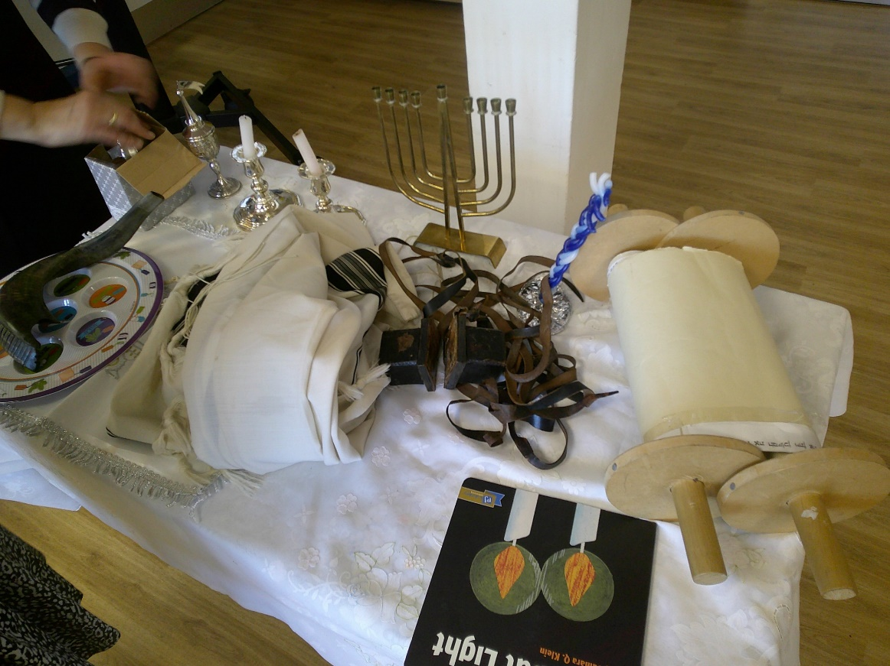
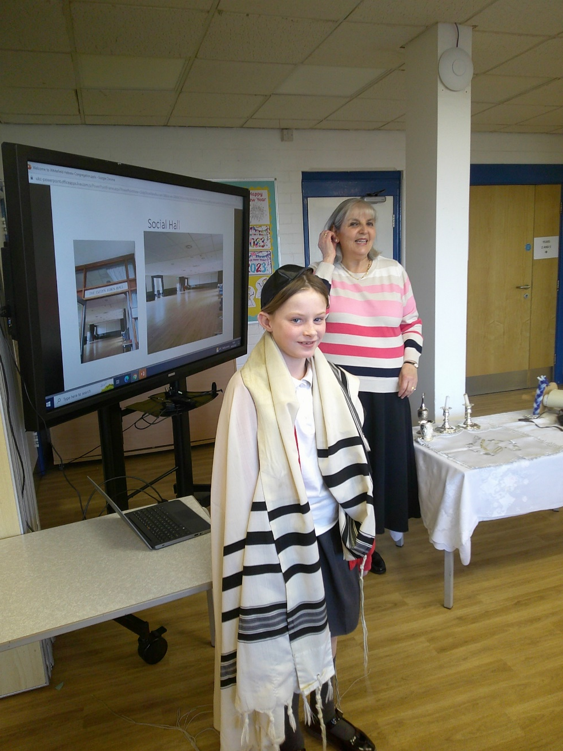
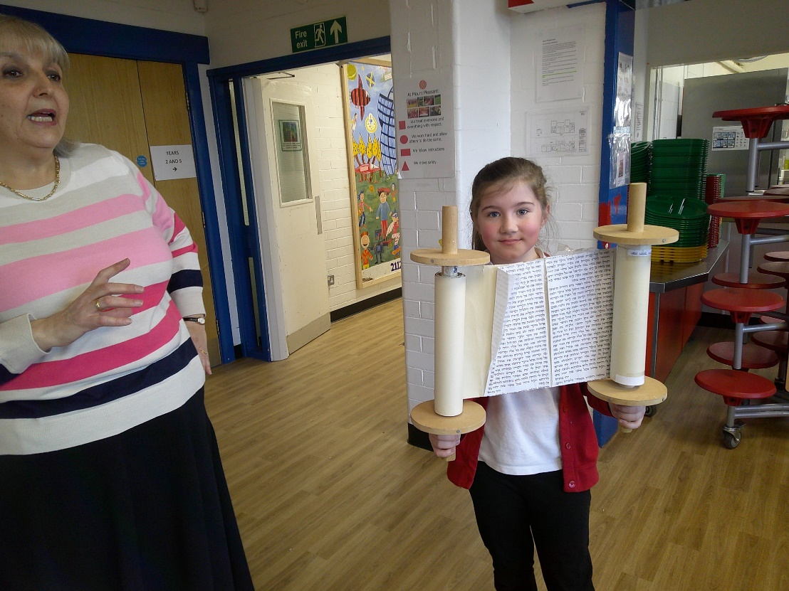
Judaism

Slide 12
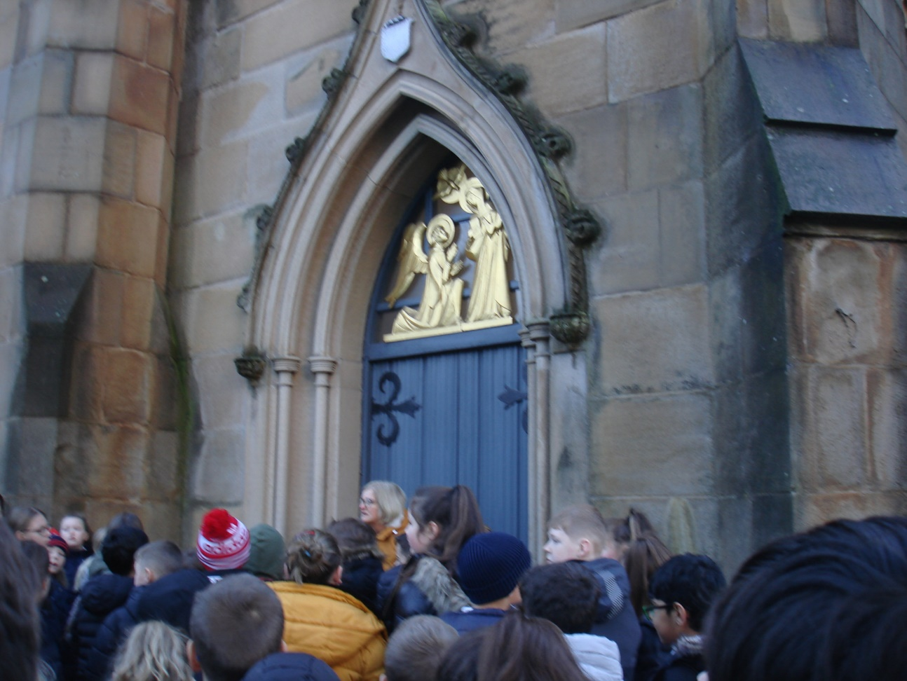
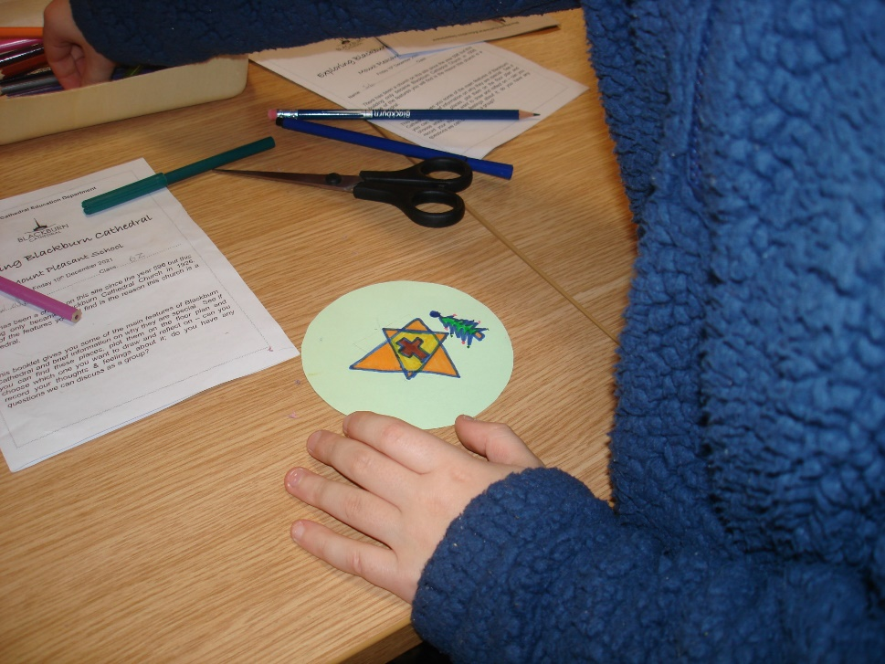
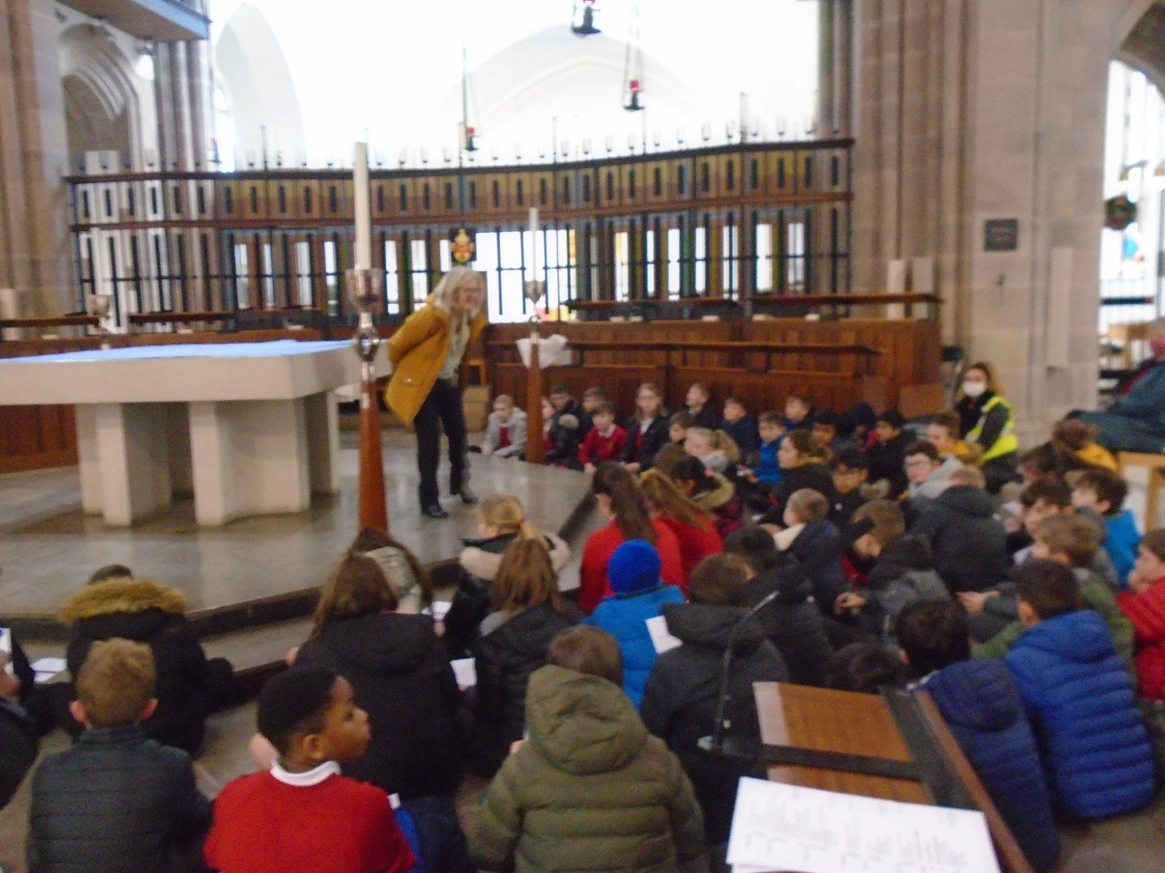
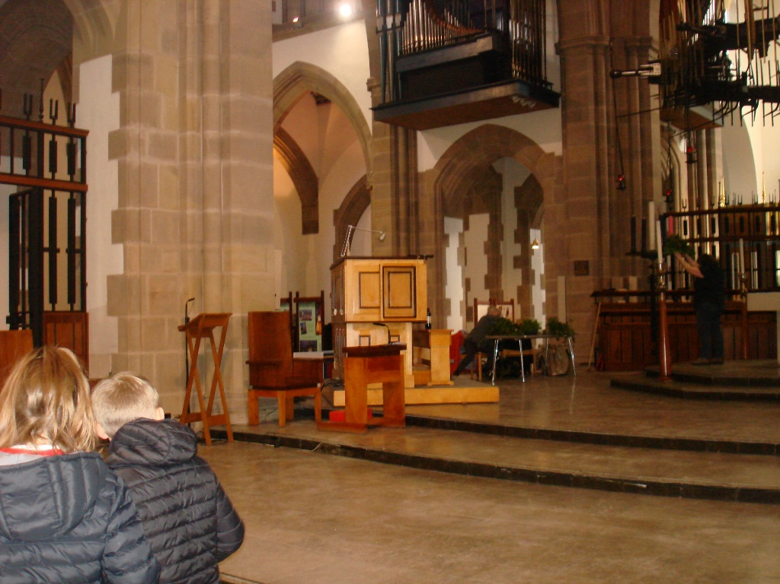
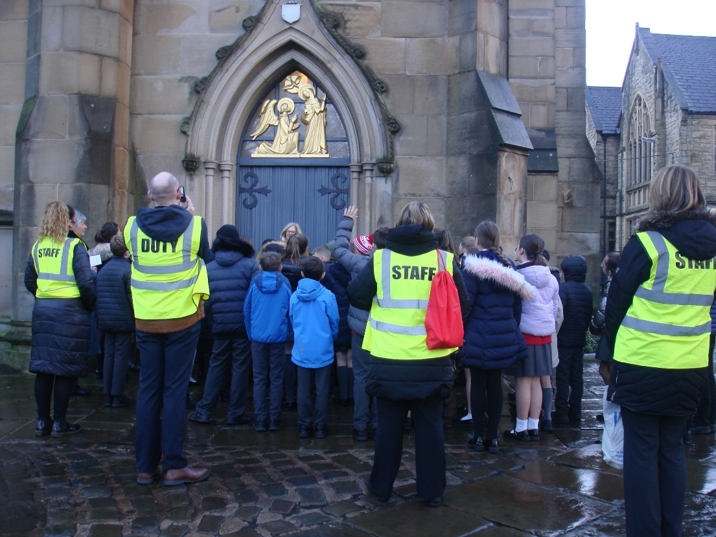
Blackburn Cathedral

Slide 13
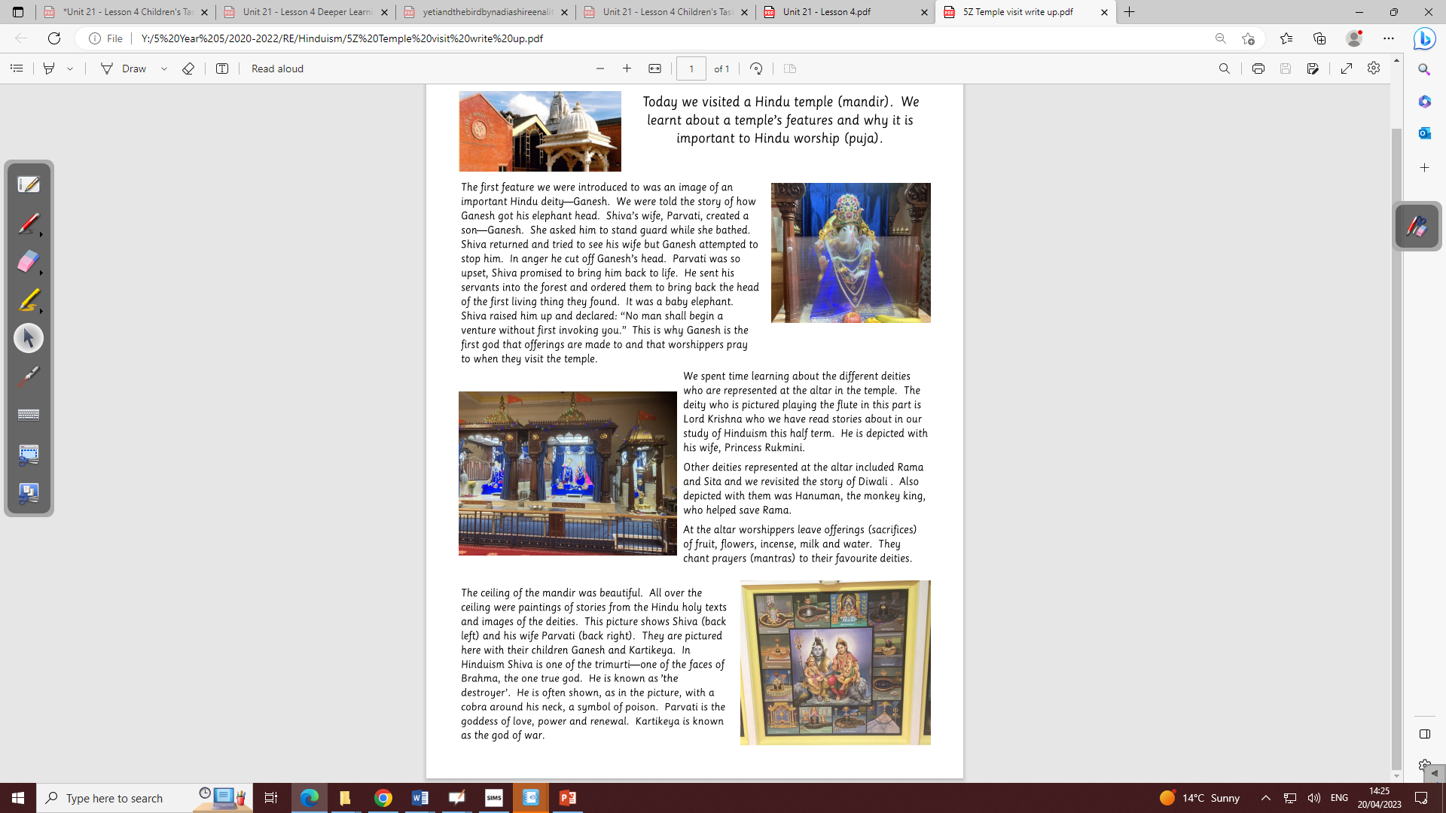
Hindu Temple

Slide 14
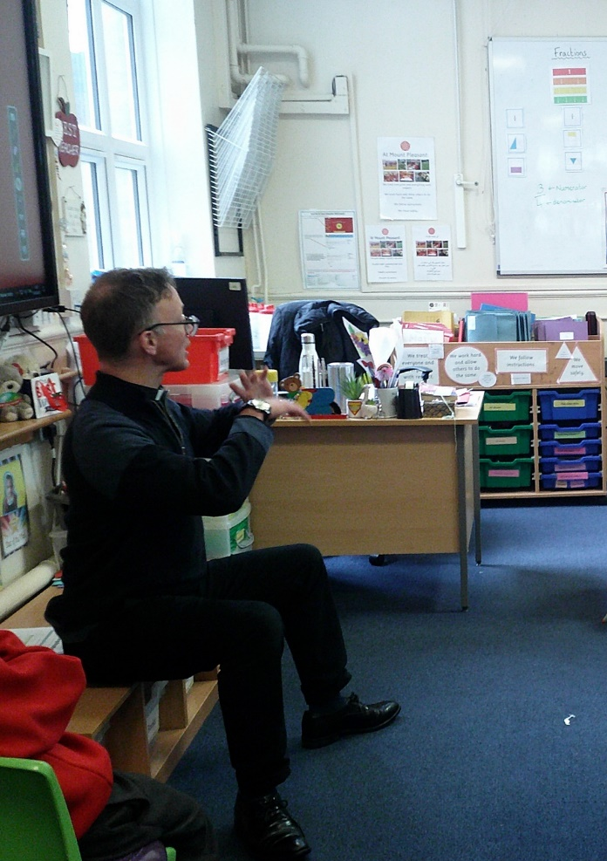
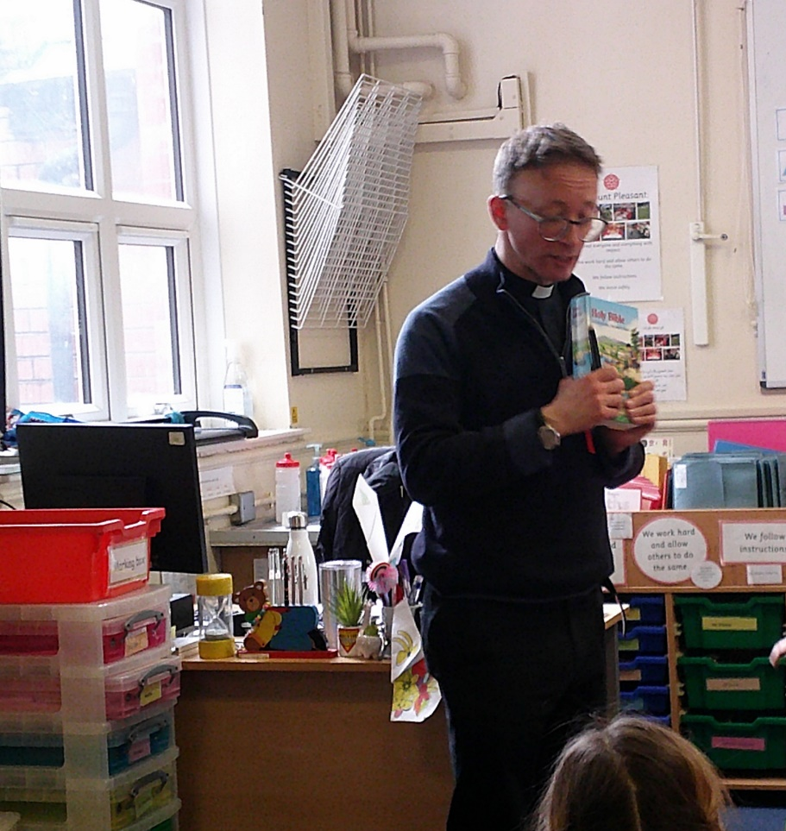
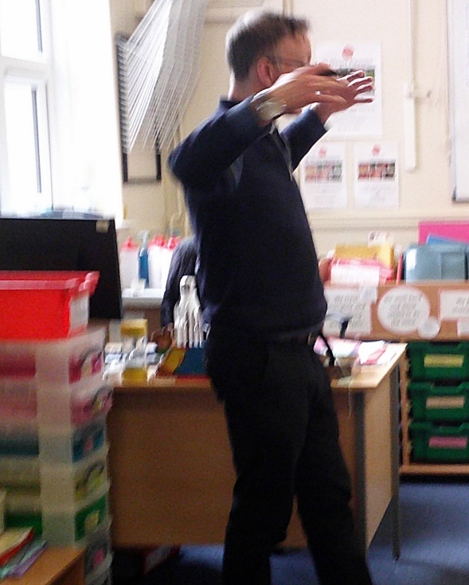
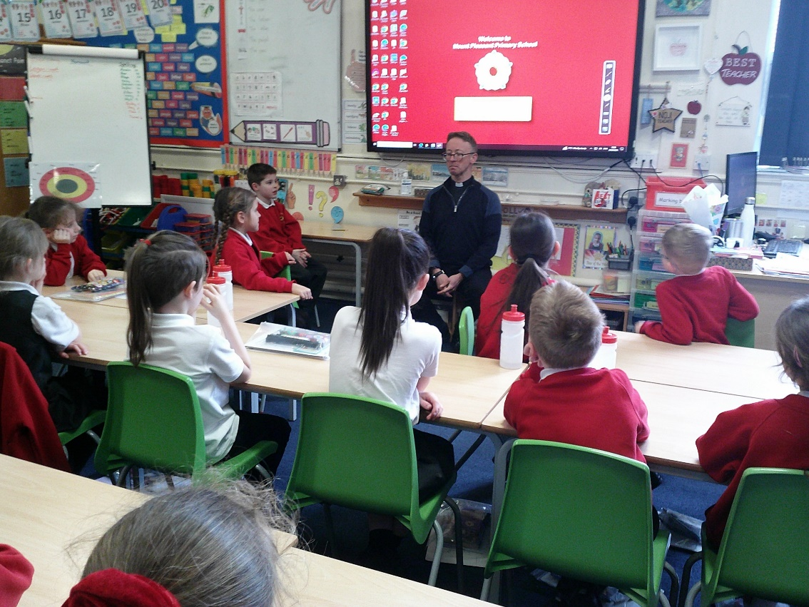
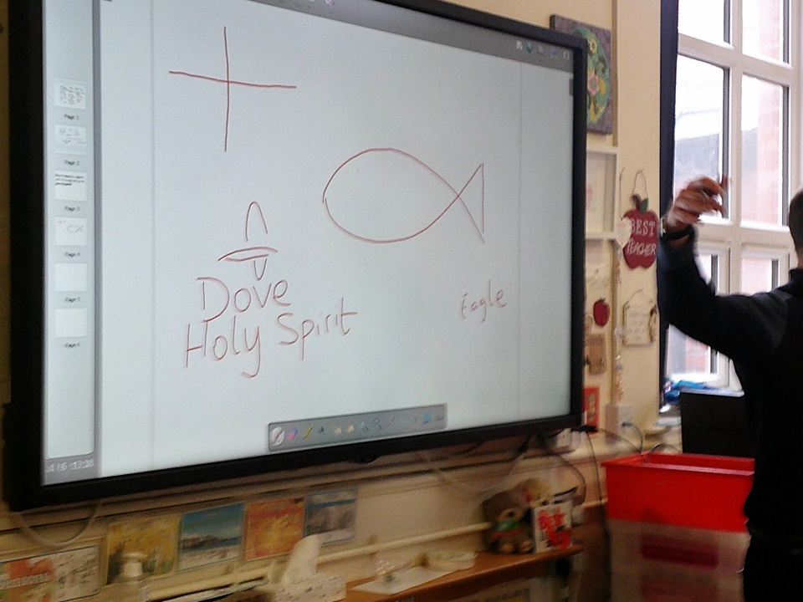
Rev Toby

Slide 15
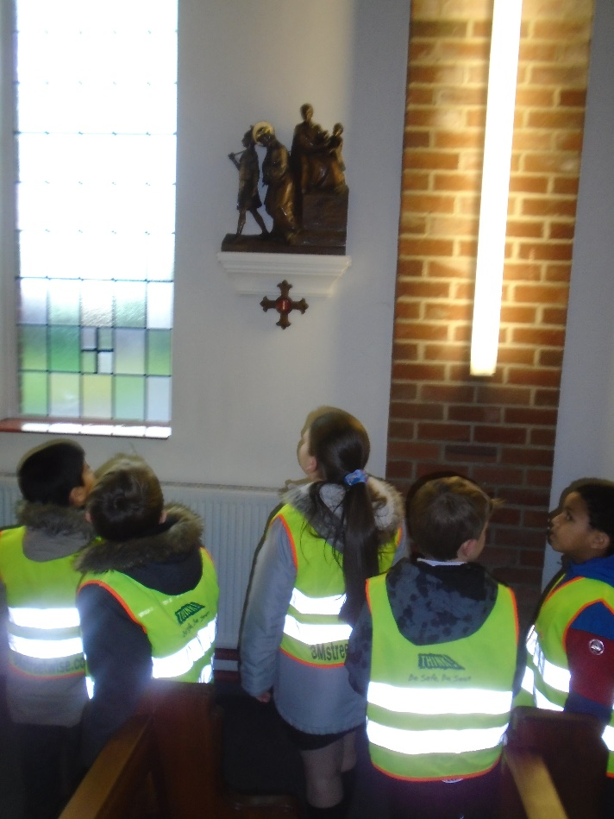
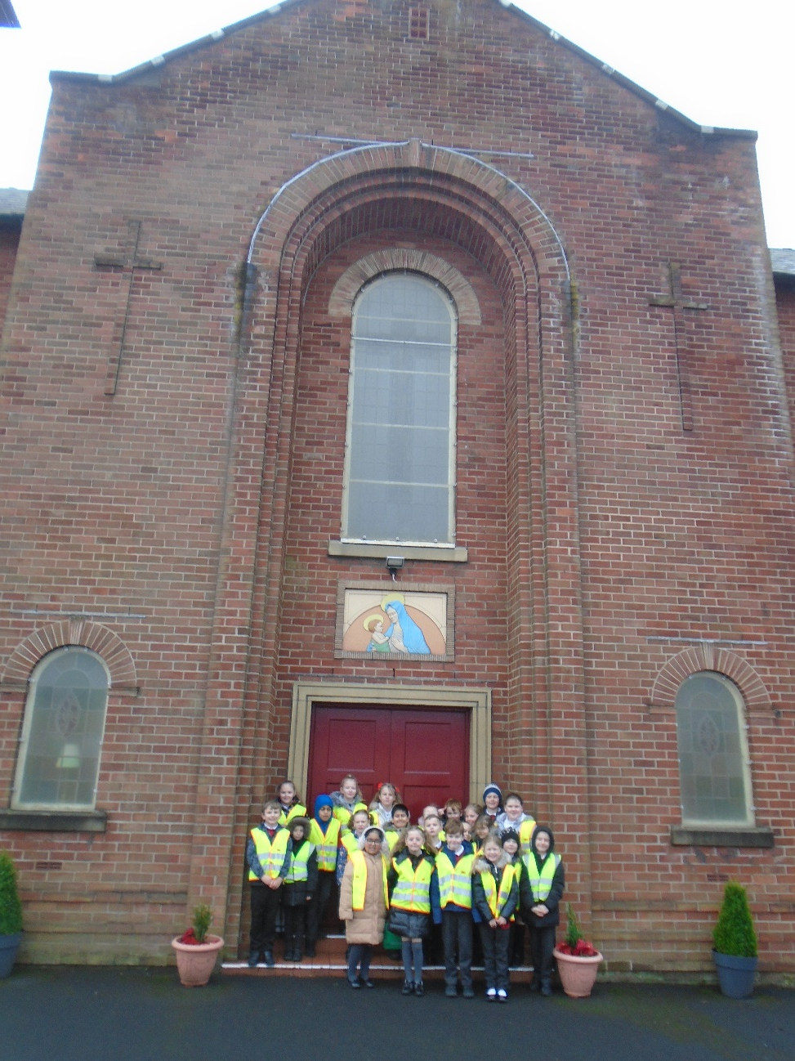
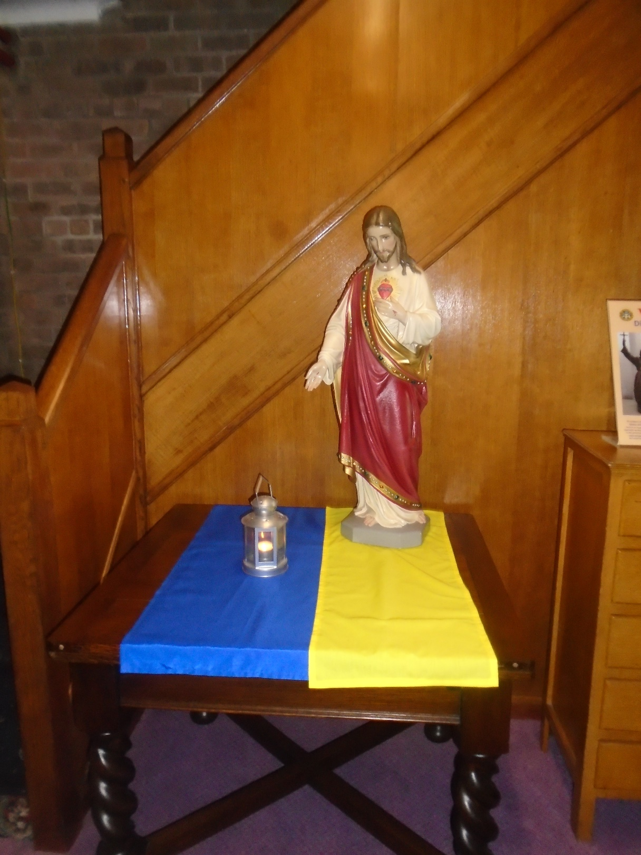
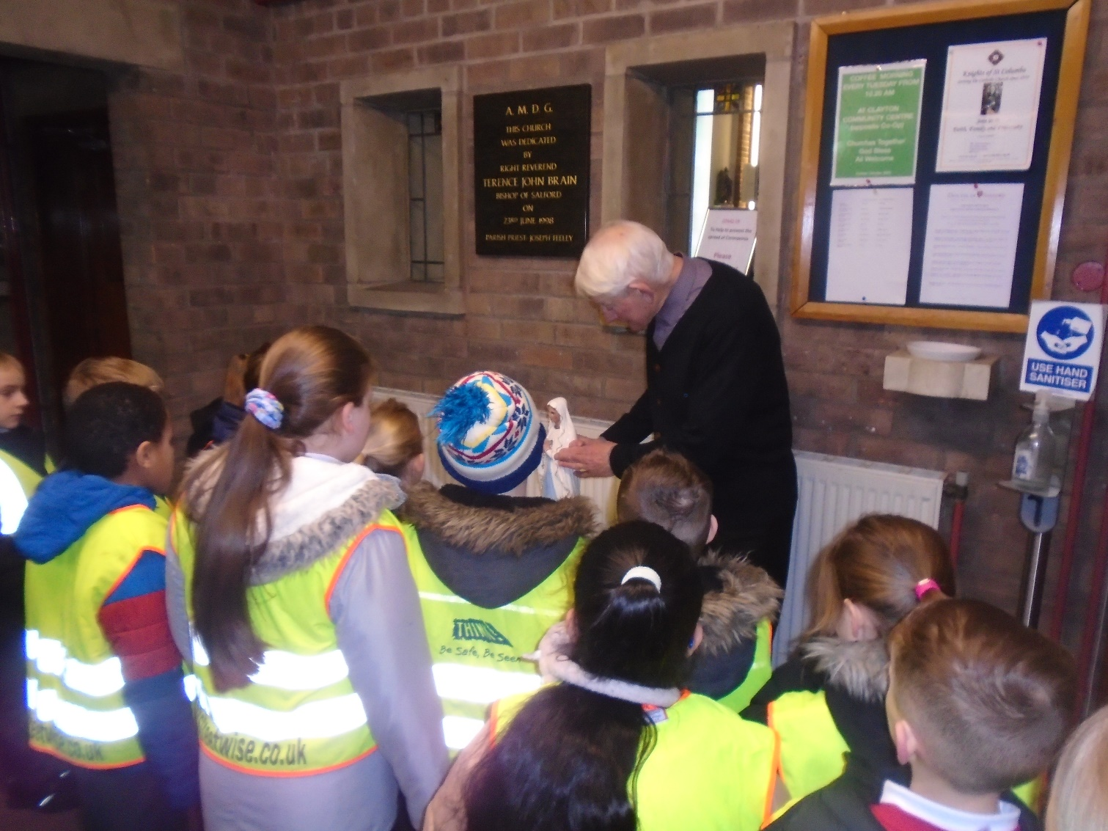
Catholic Church

Slide 16
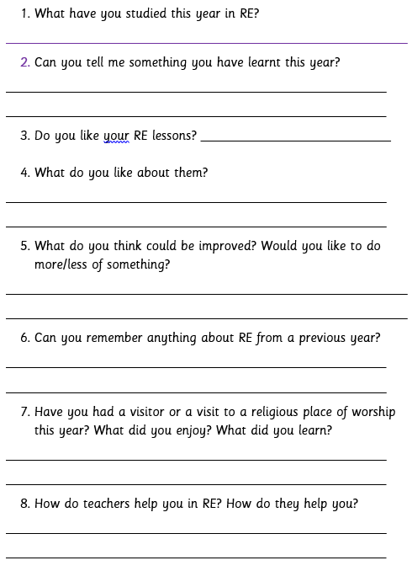
Listening To Children
Asking the children on how to improve and what was effective.
An example of the questions I ask.
The children love to feedback and we take their ideas and adapt our planning.

