Slide 1
Post Infection Review
(PIR tool)
A tool for the outbreaks of GERMS (Gastrointestinal, Ectoparasites, Respiratory, Multi-drug resistance organisms, Skin) within social care settings

Slide 2




Introduction
Welcome/housekeeping/registration
Intro to the IPC Team
Presentation/activities
Evaluation forms/paper or online/certificate of attendance

Slide 3

Post infection Review
Aims of todays session are:
To improve awareness of Post Infection Reviews (PIR’s) and how undertaking them could support improvements in your setting to prevent future outbreaks
Notes:
As stated

Slide 4
Learning Outcomes
Understand and build on knowledge of what a PIR is
Understand how undertaking a PIR could support improvements in your setting with future outbreaks
Apply the knowledge learnt from today, and put into practice
Notes:
As stated

Slide 5
What we will cover
The process and purpose of a PIR, and when one needs completing
Chain of infection
Timeline of events
Learning points & action plans
Lessons learnt and how to implement the lessons learnt into your workplace
Notes:
In order to put into practice and obtain the learning outcomes:- We will cover the following

Slide 6
Process and Purpose
A PIR is a process to help to identify any critical points and contributory factors leading to certain infections or outbreaks
Enables lessons to be learnt and recommendations for improvement
The PIR tool assists care settings to understand how outbreaks or unusual infections from GERMS (Gastrointestinal, Ectoparasites, Respiratory, Multi-drug resistance organisms, Skin) have occurred within the care settings
The PIR form is a resource for Providers and NOT a monitoring tool
Notes:
To ensure findings are reported and disseminated to colleagues working within social care throughout the Lancashire County Council and Blackburn with Darwen footprint. To improve intelligence about outbreaks and identify the steps to be taken to minimise harm for residents, service users & staff members

Slide 7
The PIR Process
The PIR process will:
Assist care home providers and infection prevention leads to understand the causes of the outbreak
Help to identify factors that may have contributed to the infection outbreak
Help to identify any parts of the resident’s care pathway which may have contributed to the infection to prevent a similar occurrence
Establish what went well with the care given
Establish what improvements could be made
Help identify the lessons learnt from the outbreak, improving practice for the future
Lead to greater awareness, changed behaviours and agreed improvements in care

Slide 8
Main considerations when completing a PIR form
Does the resident's care pathway identify any critical problems/issues with care or service delivery issues?
What happened?
Why did it happen?
When did it happen?
Where did it happen?
Who was affected?
How did it impact the delivery of service?

Slide 9
When to complete a PIR
When a social care setting has an outbreak, or an unusual infection
An outbreak is defined as:
  Two or more cases which meet the clinical case definition of laboratory confirmed cases, linked by time and place
  The cases can be a combination of staff and residents or exclusive to residents or exclusive to staff

Slide 10
Which outbreaks can I fill in a PIR form for (GERMS)
Gastrointestinal – Hepatitis A (Hep A), Norovirus, Clostridioides difficile (C. diff), Escherichia coli (E. coli)
Ectoparasites – Scabies, Head lice
Respiratory – Influenza (please see separate PIR form for Coronavirus), Strep throat (Group A streptococcal (GAS))
Multi-drug Resistance Organism's (MDRO) – Meticillin Resistant Staphylococcus Aureus (MRSA), carbapenemase-producing organism (CPO)
Skin – Cellulitis (GAS), Impetigo (GAS)
Or any other outbreaks which the home has had and you think filling a PIR form in will help with understanding the cause
Notes:
Any of the listed

Slide 11
Successful use of the tool
Successful use of the tool depends on the PIR being:
Completed as soon as possible after the outbreak is confirmed
• Open and honest
• Multidisciplinary- all involved
• Used to drive improvements in care
• A non-blame process

Slide 12
Example of a contents page of the PIR Tool
Introduction | Page 4
Gastrointestinal chain of infection | Page 6 (Appendix A)
Ectoparasites chain of infection | Page 7 (Appendix B)
Respiratory chain of infection | Page 8 (Appendix C)
Multi-drug Resistance Organisms (MDRO) chain of infection | Page 9 (Appendix D)
Skin chain of infection | Page 10 (Appendix E)
PIR template | Page 12-15
Notes:
This is an example of the contents page from a PIR form which has been created by the IPC team
Link back to GERMS on page 10
Note:- This document is available on the website

Slide 13
Activity
Look at the scenario you have been given and produce a completed outbreak PIR Template, for Activity 1
Notes:
Don’t worry we are going to go through each activity one by one

Slide 14
The Scenario
Rising Star Care Home
Jimmy had 3 episodes of loose stools on the 1st December, at 10am, 4pm, and 10pm.
He was isolated as a precaution in his room and barrier nurse precautions were put in place.
Jimmy’s symptoms started on the third floor, where he resides. He has his own en-suite.
Derek, who also resides on the third floor, started with vomiting and diarrhoea at 8pm on the 1st December. He was also isolated and barrier nursed. He uses a commode in his bedroom for toileting.
Julie, care assistant, rang in sick on the morning of 2nd December with symptoms of diarrhoea. She last worked yesterday, on the third floor, and had given Derek toilet care. She wore gloves but was observed not washing her hands after removing the gloves. She then went on her lunch break.
Notes:
Read through the scenario

Slide 15
Activity 1
OUTBREAK PIR Template
Name of Home or Organisation
Service Lead/manager conducting PIR
LCC IPCN supporting the PIR
Type of outbreak identified (GERMS)
Date outbreak identified
Number of symptomatic residents
Number of symptomatic staff
Date outbreak closed
Notes:
Have the blank example of this page on display when the groups are completing their activity
Hand out a blank copy of Activity 1 to each table

Slide 16
Completed Activity 1
OUTBREAK PIR Template
Name of Home or Organisation | Rising Star care home
Service Lead/manager conducting PIR | Manager’s name
LCC IPCN supporting the PIR | Email the IPC team
Type of outbreak identified (GERMS) | Gastrointestinal
Date outbreak identified | 01/12/2021
Number of symptomatic residents | 2
Number of symptomatic staff | 1
Date outbreak closed
Notes:
Talk through the completed example form and engage with the participants regarding their answers

Slide 17
Timeline
Looking at any common themes and trends that have occurred

Slide 18
Activity 2
Timeline of Events
Date | Time | How many affected (staff/service users) | Where did this take place e.g. which unit/floor? | What happened? | What interventions were put in place?
Notes:
Have blank example of this page on display when the groups are completing their activity
Hand out a blank copy of Activity 2 to each table

Slide 19
Completed Activity 2
Timeline of Events
Date | Time | How many affected (staff/service users) | Where did this take place e.g. which unit/floor? | What happened? | What interventions were put in place?
01/12/21 | 10am | Jimmy (resident) | Third floor | Loose stools | Isolated in room until 48 hours symptom free. Barrier nursed
01/12/21 | 8pm | Derek (resident) | Third floor | Vomiting and diarrhoea | Isolated in room until 48 hours symptom free. Barrier nursed
02/12/21 | am | Julie (staff) | Worked on third floor 01/12/2021 | Diarrhoea | To remain off work until 48 hours symptom free
Notes:
Talk through the completed example form and engage with the participants regarding their answers

Slide 20
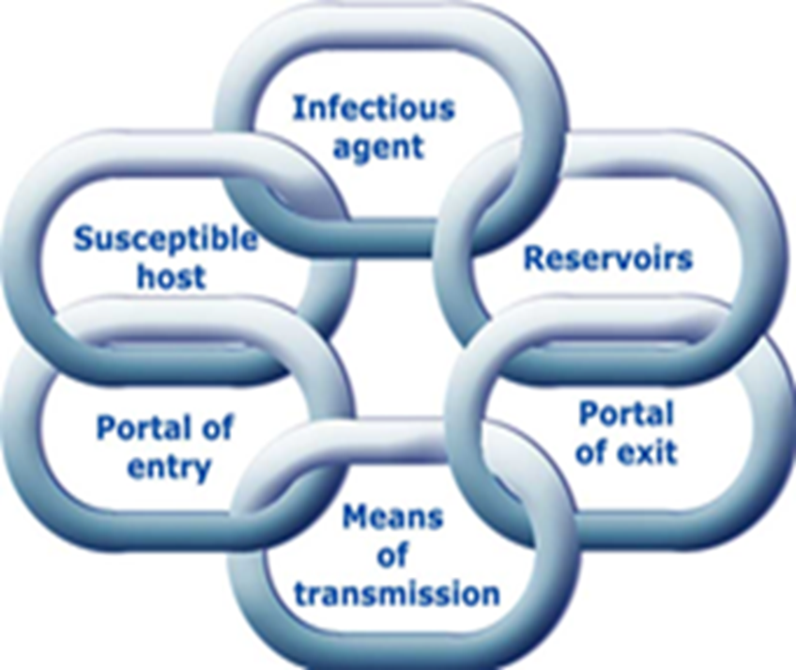
Chain of Infection
Notes:
Breaking any link in the chain will assist in preventing the spread of micro-organisms

Slide 21
Chain of Infection examples

Slide 22
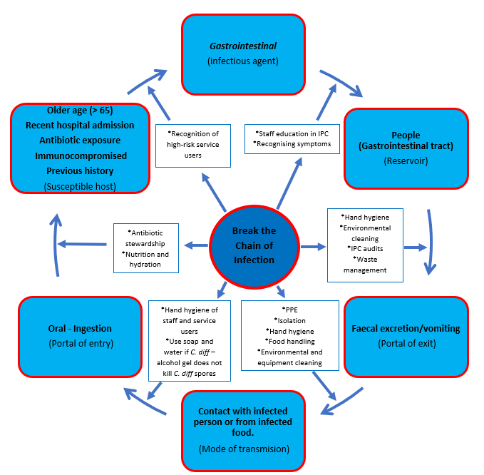
Chain of Infection
Notes:
Between the mode of transmission / portal of entry can be one of the best places to break the chain ( improved hand hygiene/donning and doffing)

Slide 23
Chain of Infection
Please use the chain of infection below to help with your post infection review for gastrointestinal infections
Have a look at each part of the chain and see what actions can be taken to break the chain to influence the management of future infections
Notes:
Refer back to chain of infection using the PIR form we are promoting

Slide 24
Activity 3
Think about the actions needed to break the chain of infection for a gastrointestinal illness
Notes:
Have blank example of this page on display when the groups are completing their activity
Hand out a blank copy of Activity 3 to each table

Slide 25
Completed Activity 3
Notes:
Have blank example of this page on display when the groups are completing their activity
Hand out a blank copy of Activity 3 to each table

Slide 26
How to implement the lessons learnt into your workplace
Choose realistic goals for the action plan
Look at how these can be implemented and used within the setting on an everyday basis

Slide 27
Learning Points & Action Plan
A PIR document is usually completed by the manager, it’s findings, the action plan and the lessons learnt should be shared with all staff, to increase awareness and help to stop future outbreaks

Slide 28
Messages to take away
Familiarise yourself with the chain of infection and add it to the IPC training of staff and in your IPC policy
You may want to add it to your IPC board
A PIR is a tool to help improve practice and IPC standards within the setting
A PIR is a ‘non-blame’ process and it is designed to strengthen IPC practices within the setting
Findings of PIR’s should be shared with staff to highlight any gaps in knowledge and to promote improvements in IPC practice
Please share your completed PIR forms with us to improve our intelligence about outbreaks

Slide 29
References
https://www.lancashire.gov.uk/practitioners/health/infection-prevention-and-control/

Slide 30


