Slide 1

Infection Prevention Back To Basics
Aims of todays session are
To Improve awareness of ‘the basics’ of infection prevention that are required to stop the spread of infections.

Slide 2
Infection Prevention Back To Basics
Aims of todays session are
To Improve awareness of ‘the basics’ of infection prevention that are required to stop the spread of infections.

Slide 3
Infection Control precautions
Hand Hygiene
Personal Protective Equipment (PPE)
Waste
Decontamination of equipment & the environment.
Sharp safety
Notes:
Talk about the standard precautions………
Manager has the responsibility to ensure the right equipment is in place and the correct storage facilities are available.
Should be ingrained in practice.

Slide 4
Learning Outcomes
What are standard precautions in relation to infection prevention.
Build on knowledge of how you can prevent the spread of infection.
Understand the importance of breaking the chain of infection.
Apply the knowledge learnt today to refocus basic infection prevention practices.

Slide 5
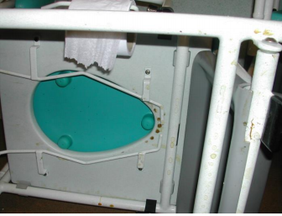


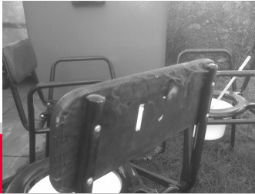


Poor hand hygiene facilities and compliance
Untidy Laundries
Damaged/Dirty Equipment
Insufficient Training or refreshers.
Incorrect use of PPE
Dirty environment. Toilet/bathrooms
Notes:
Talk about some Common Problems in Care homes – other settings.
Which can also to contribute to Common infections spreading….
• Urinary tract infections • Skin/soft tissue • Chest • CDI (causes diarrhoea).
Can lead to outbreaks.

Slide 6
Chain of Infection
There are many different germs and infections inside and outside of the care setting. Despite the variety of viruses and bacteria, germs spread from person to person through a common series of events. Therefore, to prevent germs from infecting more people, we must break the chain of infection.
There are six points at which the chain can be broken and a germ can be stopped from infecting another person. The six links include: the infectious agent, reservoir, portal of exit, mode of transmission, portal of entry, and susceptible host.
Infectious agent is the pathogen (germ) that causes diseases.
Reservoir includes places in the environment where the pathogen lives (this includes people, animals and insects, medical equipment, and soil and water).
Portal of exit is the way the infectious agent leaves the reservoir (through open wounds, aerosols, and splatter of body fluids including coughing, sneezing, and saliva).
Mode of transmission is the way the infectious agent can be passed on (through direct or indirect contact, ingestion, or inhalation).
Portal of entry is the way the infectious agent can enter a new host (through broken skin, the respiratory tract, mucous membranes, and catheters and tubes).
Susceptible host can be any person (the most vulnerable of whom are receiving healthcare, are immunocompromised, or have invasive medical devices including lines, devices, and airways)
Notes:
The Concept Of Infection: The goal of Infection Control, for any disease, is to keep people from getting sick….. One of the easiest way’s to prevent an Infection Spreading is by breaking the chain of Infection.
Controlling the Source of Viruses: Our breath contains a lot of water that can't usually be seen, called respiratory droplets, and can contain virus particles.
The Spread of Viruses from Surfaces to People: Viruses can spread in various ways through respiratory droplets on surfaces.
Hand Hygiene: Practicing hand hygiene is a simple, but effective way to prevent infections.

Slide 7
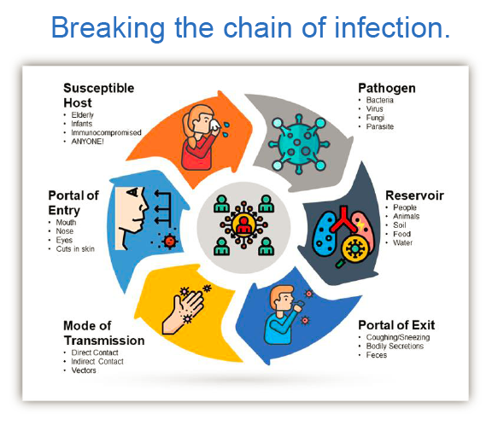
GP Infection Prevention – NHS Tameside & Glossop Clinical Commissioning Group.
Notes:
For people living in care homes, infections can be serious, and in some cases, life-threatening. They can also make existing medical conditions worse. Regular contact with staff, other residents, family and friends and the shared living space all mean infection can easily be passed around. It is therefore vital to take the steps that can help prevent infection occurring.
The way to stop germs from spreading is by interrupting this chain at any link. Break the chain by cleaning your hands frequently, staying up to date on your vaccines (including the flu shot), covering coughs and sneezes and staying home when sick, following the rules for standard and contact isolation, using personal protective equipment the right way, cleaning and disinfecting the environment, sterilizing medical instruments and equipment, following safe injection practices, and using antibiotics wisely to prevent antibiotic resistance.
It is important that clear information on the standards of infection prevention and control in care homes is available to allow informed choice and promote confidence in the quality of care provided. Families and carers will want to be assured that the care their relatives and dependants receive is provided in a clean and safe environment.
Prevention Strategies.
To prevent and of viruses, WHO recommends employing basic hygiene principles through standard and transmission-based precaution.
Standard precautions include:
hand hygiene (5 Moments for Hand Hygiene);
use of personal protective equipment (PPE)
routine environment cleaning;
cough etiquette
aseptic technique

Slide 8
Respiratory & Cough Hygiene
The aim of respiratory and cough hygiene is to reduce and prevent the risk of cross-transmission of respiratory illness and pathogens such as Covid-19.
(Catch it, Bin it, Kill it)
Following the rules will help you to stop the spread of infection through coughs and sneezes.
Keep hands contaminated with respiratory secretions (produced during coughing and sneezing) away from your eyes, nose and mouth.
You can promote respiratory and cough hygiene with your residents/service users too.
Providing tissues, plastic bags for used tissues and hand washing stations will all help.
• Cover your nose and mouth with a disposable tissue when sneezing, coughing, wiping and blowing the nose.
• Dispose of all of your used tissues quickly into a waste bin.
• Wash your hands with liquid soap and water after coughing, sneezing, using tissues, or after contact with respiratory secretions or anything contaminated by these secretions
Notes:
Respiratory and cough hygiene can help reduce the risk of spreading respiratory (related to breathing) infections, protecting those in contact with the infected person, e.g. residents, visitors and staff.
Staff should adopt good respiratory and cough hygiene practices themselves and promote them to residents.
When caring for residents in relation to COVID-19 or any other new emerging infections, staff should refer to national infection prevention and control guidance.

Slide 9
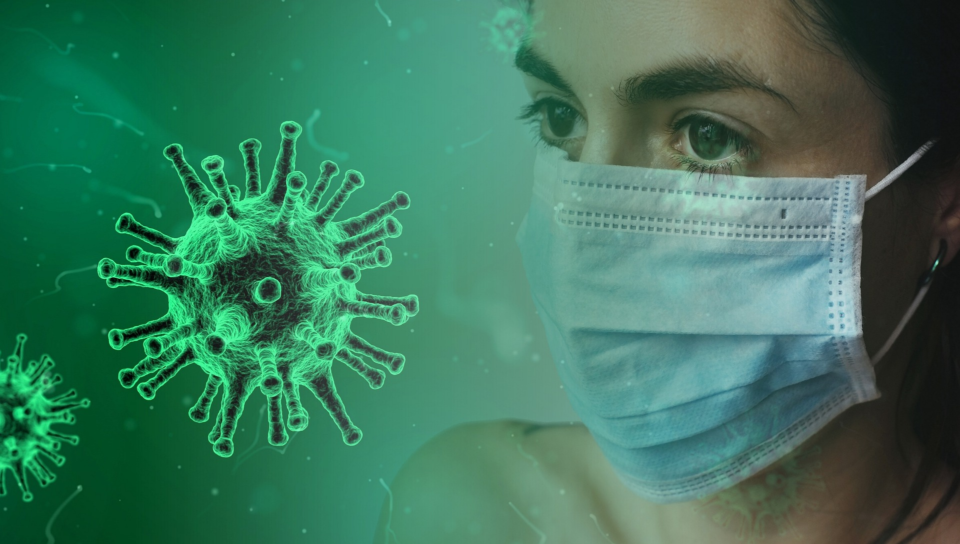
PPE
Notes:
PPE is used to prevent or reduce the spread of infection. Effective and appropriate use of PPE is one of several actions to reduce the spread of Infections.
You should be assessing your likely exposure to the infection and ensure PPE is worn that provides enough protection to you from the risks.
Just like you would protect yourself from exposure to the sun by wearing sunscreen and a hat, the same applies to IPC and PPE. PPE includes, gloves, aprons, eye protection and facemasks.
PPE should be used correctly and is only effective when combined with, cleaning your hands regularly and appropriately, as with other measures.
Following standard infection prevention and control precautions.
Following the correct technique for putting on and taking off PPE.
Safe disposal of used PPE.
Perform hand hygiene immediately before every episode of care and after any activity or contact that potentially results in your hands becoming contaminated. This includes the removal of PPE.

Slide 10
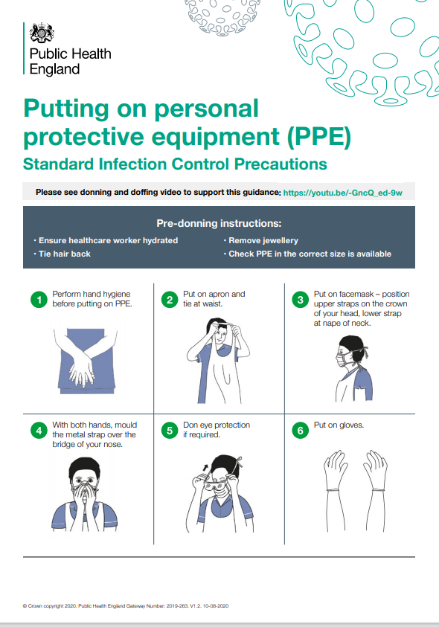
Putting on PPE
Perform Hand Hygiene before putting on PPE.
Put on apron and tie the waist.
Put on facemask – Position upper straps on the crown of your head, lower strap at nape of neck.
With both hands, mould the metal strap over the bridge of your nose.
Done Eye protection if required.
Put on gloves.
Notes:
Pre Donning Instructions.: (1) Ensure care worker is hydrated (2) Tie Hair Back. (3) Remove Jewellery including watches. (4) Ensure Bare Below Elbows (BBE). (5) Check PPE is the correct size available.
Keep hands away from face
Limit surfaces touched
Change when torn or heavily contaminated
Work from clean to dirty

Slide 11
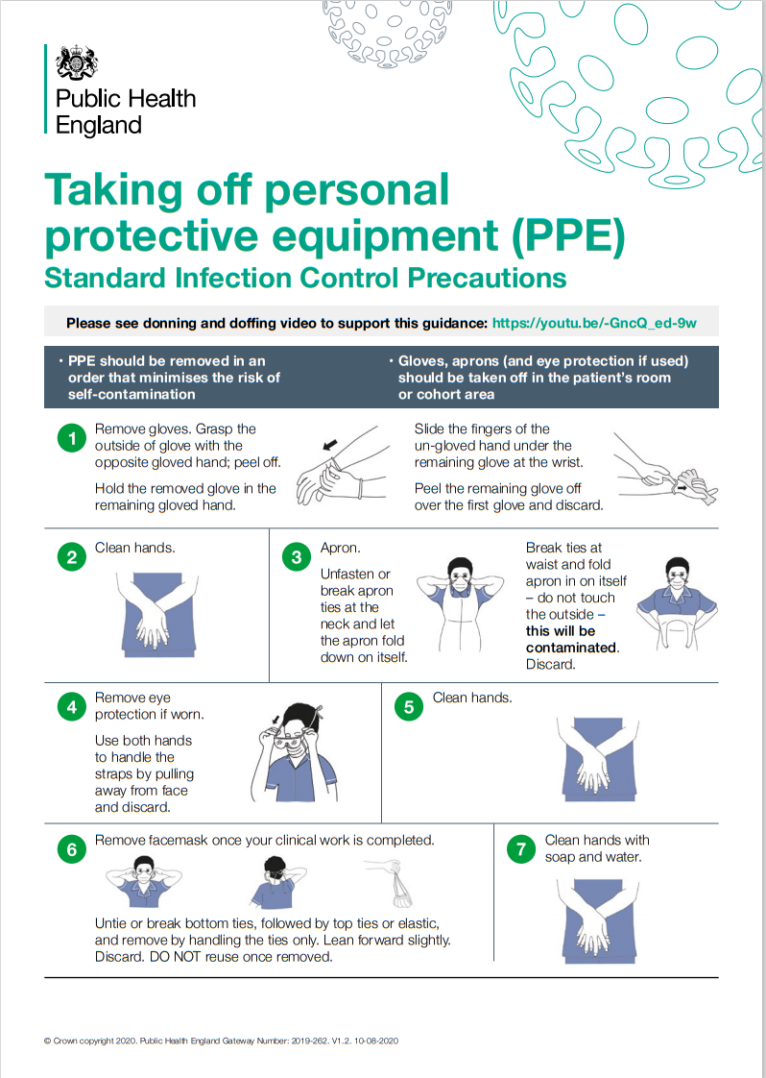
Taking off PPE
Remove all PPE before exiting the residents room except respirator if worn.
Perform hand hygiene between steps if hands become contaminated and immediately after removing all PPE.
Notes:
PPE should be removed in an order that minimises the potential of self contamination.
Before leaving the room or cohort area where service users/residents are being cared for, remove gloves and apron.
Once outside the room remove face mask and dispose of them as infectious clinical waste.
Gloves
Hand hygiene
Gown/Apron
Eye protection
Hand hygiene
Mask or respirator
Hand hygiene

Slide 12

Use of Gloves
Gloves are not a substitute for handwashing.
Hand contamination is possible during glove removal.
Hand washing after glove removal is essential and also before sterile glove use.
Hypersensitivity to latex is increasing and powder-free gloves should always be used.
Gloves must be changed: – between clean and dirty tasks – between service users and residents.
Notes:
Increase in use over recent months/years. Having sufficient supply and access to gloves and other PPE across the home.
The type of glove used should be based on a risk assessment of the task being carried out. There are a number of different types of gloves: vinyl, nitrile and natural rubber latex.
Employers should consider carefully the risks when selecting gloves for use in the health and social care sector. HSE has provided specific guidance on selecting latex gloves and recommends following HSE’s glove selection guidance when considering glove use in the workplace (latex or otherwise).

Slide 13
Safe Management of Equipment
Any equipment you use for healthcare, must be fit for purpose.
It is good practice to keep logs of when your equipment was purchased (including manufacturer warranties and quality checks) and any maintenance or servicing documentation that your equipment goes through.
Should anything ever go wrong with your equipment, you have the evidence to prove it has been well maintained and looked after.
In order to comply with the Health and Social Care Act 2008: Code of Practice on the prevention and control of infections and related guidance, equipment (including medical devices) that comes into contact with the resident, e.g. wheelchairs, blood glucose meters, nebulisers, must be decontaminated appropriately between use on another resident. There should be a designated Infection Prevention lead person who is responsible for infection prevention and control (including cleanliness) management.
Notes:
Make sure single use of equipment – e.g medicine pots etc.
Staff should carry out monthly audits using a audit tool to assess the standard of cleanliness of equipment. CQC recommends that there should be documented evidence that stored equipment has been decontaminated and is within one month of the date when it was cleaned, e.g. ‘I am clean’ indicator tape.
In the event of non-compliance, action plans should be produced and review regularly. Completed audit tools should be kept locally for good practice assurance and as evidence for CQC inspections.
Link to the audit tool is added to the reference section.

Slide 14
Safe Management of Environment
To the naked eye, your care environment might look clean.
Floors are polished, windows glisten, rubbish is emptied and there is no obvious dust on the furniture.
However, there are millions of potentially dangerous micro-organisms on your surfaces such as door handles, toilet seats, rails, linen and tables.
In these critical areas, cleaning plays a vital role in reducing the risk of infection to you are your patients.
The cleaning, disinfection and sterilisation of equipment and surfaces are essential for making it safe.
Without these steps, microorganisms such viruses can survive and cause infection.
Notes:
The cleanliness of the environment is important to support infection prevention and control, help reduce the incidence of healthcare associated infections and ensure resident’s confidence.
Staff play an important role in improving the quality of the environment and maintaining standards.

Slide 15
Activity 1.
Each table to feed back.
Picture 1 and Picture 2 and picture 3.

Slide 16
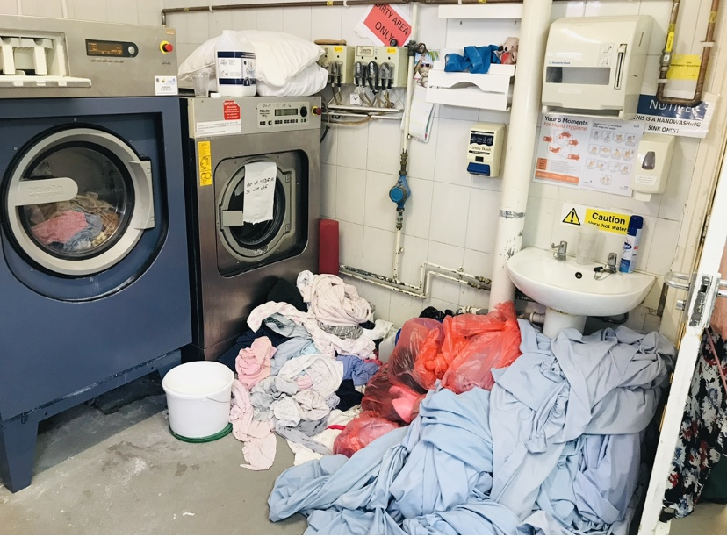
Notes:
Talk about the photo.
Machine not working – what could they do as an alternative?
Washing piled up.
HH sink not accessible.

Slide 17
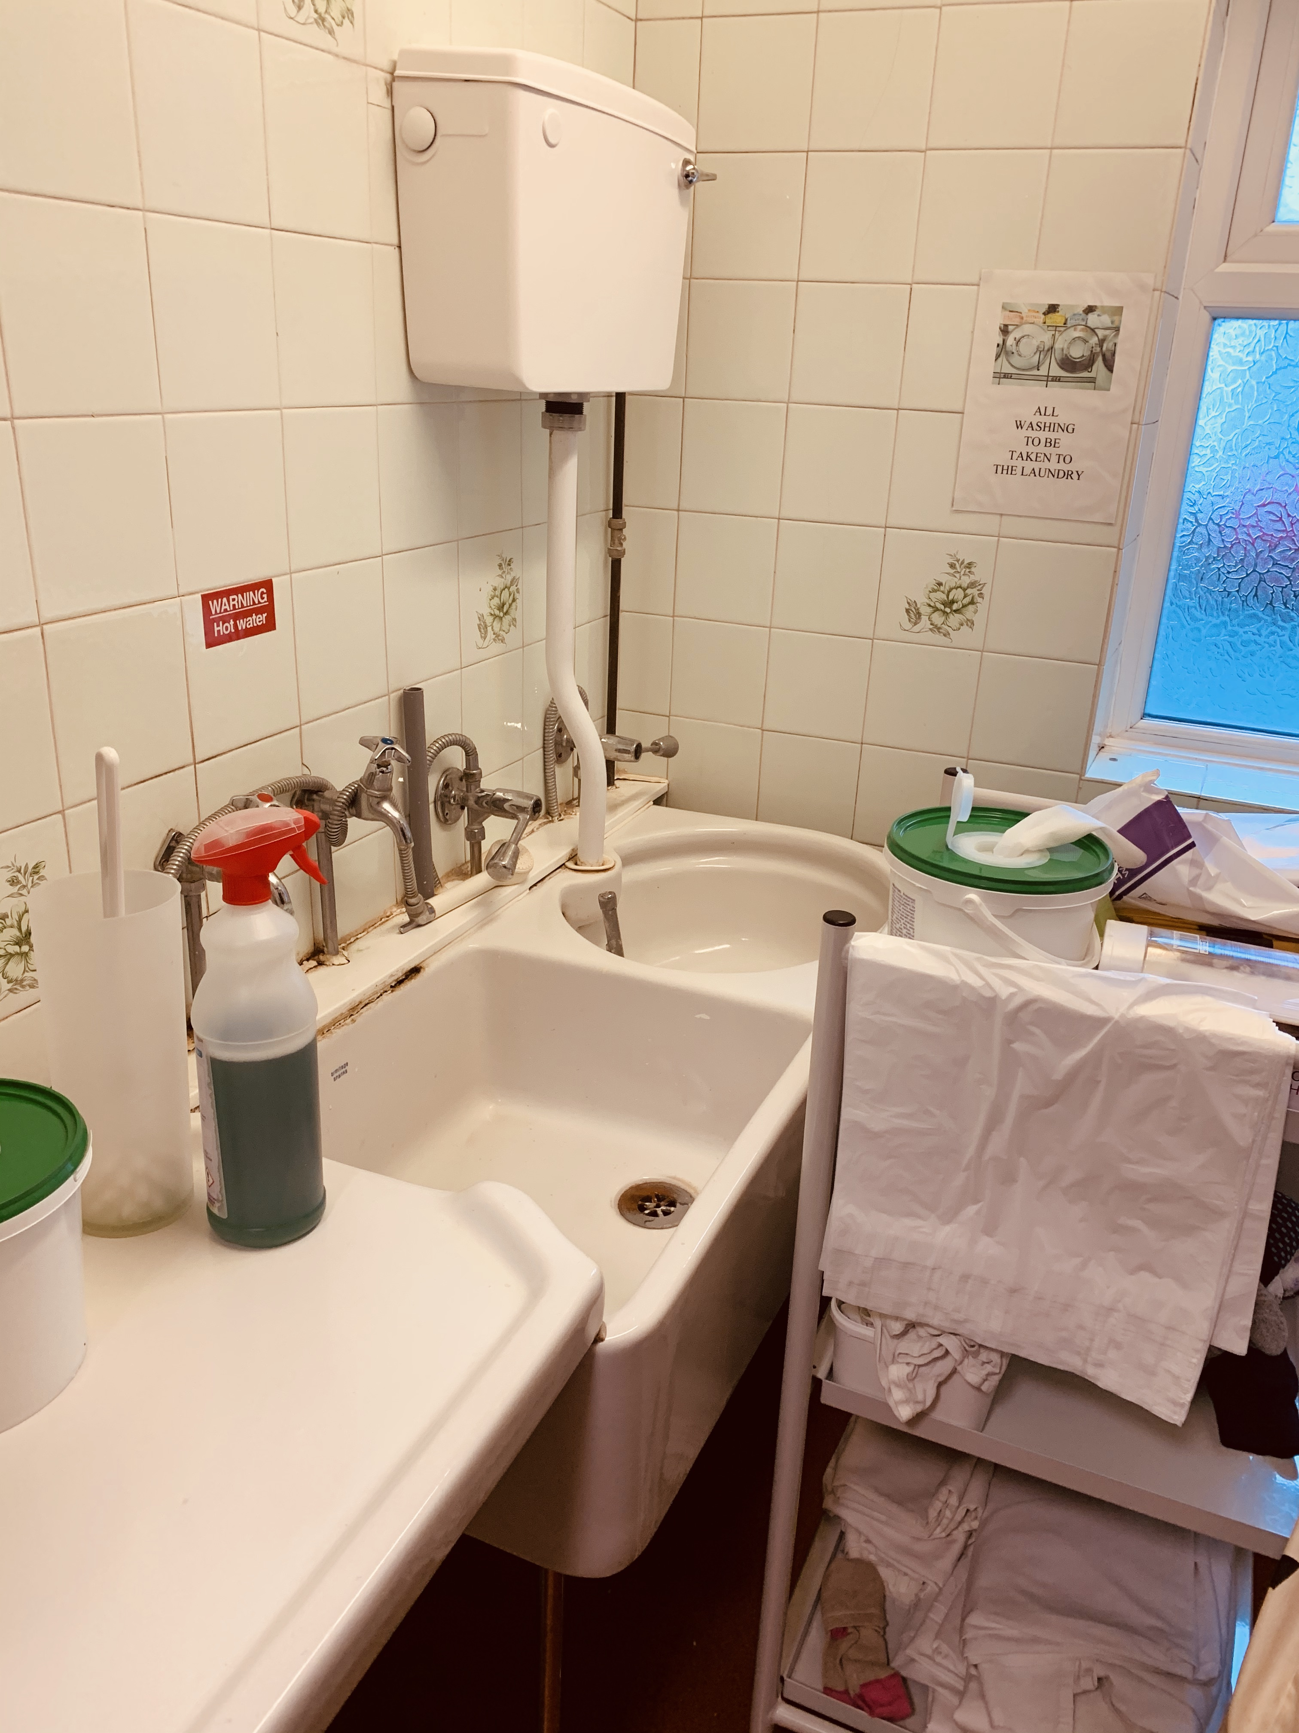
Notes:
Sluice room
Toilet brush for washing commode pans
Clean laundry trolley with bed sheets etc which obstructed the hand hygiene sink

Slide 18
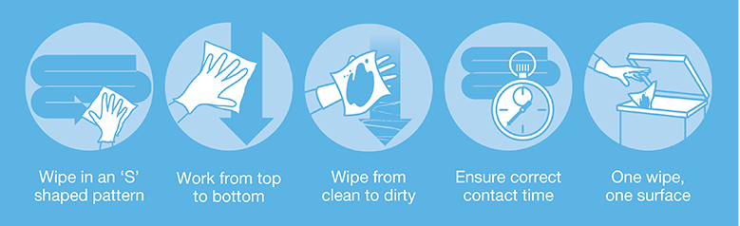
The five principles of cleaning
Notes:
The golden rule for cleaning is to always work from the cleanest area toward the dirtiest area, and from top to bottom, covering all surfaces using a ‘S’ shaped pattern, taking care not to go over the same area twice.
This will greatly reduce the risk of cross contamination. PPE should always be worn, e.g. disposable gloves, apron, mask and eye protection.
Maintaining a clean environment is crucial to prevent the spread of infection.

Slide 19
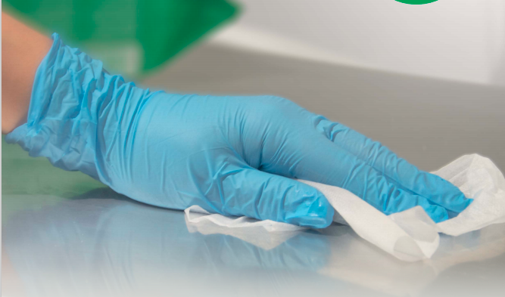
Decontamination of Equipment
Between service users/residents.
Using the appropriate products and method.
Risk level/type of infection.
Manufacturers guidance.
Single use.

Slide 20
Safe Management of Linen
For all infectious linen, that is linen that has been used by a resident/service user who is known or suspected to be infectious and/or linen that is contaminated with blood and/or other body fluids.
You should follow these simple steps.
Place directly into a water-soluble / alginate bag and secure; then place into a plastic bag e.g. clear bag and secure before placing in a laundry receptacle. This applies also to any item(s) heavily soiled and unlikely to be fit for reuse.
Used and infectious linen bags/receptacles must be tagged e.g. ward/care area and date.
Store all used/infectious linen in a designated, safe, lockable area whilst awaiting uplift. Uplift schedules must be acceptable to the care area and there should be no build-up of linen receptacles.

Slide 21
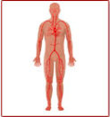
Blood-borne viruses (BBV)
Blood-borne virus (BBV) infections are spread by direct contact with the blood of an infected person.
The main blood-borne viruses of concern are:
Human immunodeficiency virus (HIV), which causes acquired immune deficiency syndrome (AIDS), Hepatitis B virus (HBV) and hepatitis C virus (HCV) which cause hepatitis.
These three viruses are considered together because infection control requirements are similar due to similarities in their transmission routes.
As a result of the lack of early symptoms in some infected people and the ability of the viruses to persist as chronic infections, many people who carry these blood-borne viruses may not be aware they are infected.
Notes:
Precautions to prevent inoculation of blood and certain body fluids will prevent transmission of these viruses. In a care home setting these include:
Intervention when care staff come into contact with blood or bodily fluids – all should be treated as potentially infected.
• Standard infection control precautions
• Use of safety sharps where assessment indicates they will provide safe systems of working for staff
• Protection of clinical and other relevant staff with hepatitis B vaccination

Slide 22
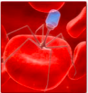
Standard infection prevention and control precautions for reducing the risk of transmission of BBVs
Always
Keep cuts or broken skin covered with waterproof dressings.
Protect eyes, mouth and nose from blood splashes where there is a risk of splashing.
Avoid direct skin contact with blood and blood stained body fluids (if blood/blood stained body fluids are splashed on to the skin, wash off with liquid soap and warm running water).
Wear disposable latex or nitrile gloves when contact with blood or blood stained body fluid is likely (vinyl gloves are not recommended for contact with blood).
Always clean hands before putting on and after removing gloves.
Always clean hands before and after giving first aid.
Contain and promptly clean and disinfect surfaces contaminated by spillages of blood and blood stained body fluids.
Never share razors or toothbrushes as they can be contaminated.
Notes:
Spillages of blood or body fluids Urine, faeces, sputum, tears, sweat and vomit are not considered to pose a risk of BBV infection unless they are contaminated with blood.
Spillages must be decontaminated immediately by staff trained to undertake this safely.
Responsibilities for the decontamination of blood and body fluid spillages should be clear within each area/care setting.
It is good practice to ensure access to a dedicated blood/bodily fluid spillage kit.

Slide 23

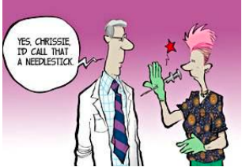
Management of Sharps
This refers mainly to the use of needles for which staff will need to have the right training and skills. To help prevent infection:
Handle sharps as little as possible and don't pass them from hand to hand.
Do not bend, break or recap a used needle.
Put used sharps in the right container straight away.
Don't use sharps containers for anything else.
Dispose of sharps containers when the fill line is reached, or every 3 months - whichever occurs first.
Notes:
Sharps include needles, lancets, razors, nail clippers, scissors and any other sharp instrument which may prick, scratch or cut you and which has been contaminated with blood from a client or an unknown source. Sharps can also include bites and scratches from humans and animals. Injuries from sharps are a cause of exposure to blood borne viruses and other infections.
Sharps can also include bites and scratches from humans and animals. Injuries from sharps are a cause of exposure to blood borne viruses and other infections.
Those working with some client groups and in certain work areas may be at a greater risk from sharp injuries and exposure to blood borne viruses and will therefore need to take extra caution. Services must have procedures in place for post exposure to disease in the event an injury occurs. Care staff must be trained in the safe handling and disposal of sharps.
Refer to LCC website on more information of Sharp Safety.

Slide 24

Importance of Waste Management
Notes:
Measure the success of your waste management system with a monitoring tool that easily integrates into your workflow. Conduct regular inspections of your waste management process from segregation and collection to storage, transportation, and disposal. An example of a monitoring tool you could use are checklists.
These are easy to use and they help get more things done in a shorter period of time. Monitoring checklists also help ensure that people get their daily, weekly, and monthly tasks done on time.
These are just some of the practices you can do to ensure proper waste management in your setting. .

Slide 25
Safe Disposal of Waste
Any waste your organisation produces that may contain living microorganisms or their toxins and may have the potential to cause harm or infection in humans, is called hazardous waste.
It is highly likely that you will need to separate and segregate your waste.
Items like used gloves, aprons, swabs, dressings and other non-sharps that are contaminated with blood and bodily fluids will need segregation, if you are generating it in large amounts.
The way you safely dispose of this waste depends on a number of things:
The type of the waste, whether it is sharp or non-sharp.
How likely it is to contain infectious microorganisms.
The quantity of the waste you generate.
Notes:
All staff are responsible for the safe management and disposal of waste and should understand how waste should be segregated and stored prior to collection or disposal. This is driven by the need to reduce environmental impact, comply with waste regulations and other national guidance such as The Health and Social Care Act 2008: Code of Practice on the prevention and control of infections and related guidance, and reduce costs associated with waste management.
When handling waste, appropriate personal protective equipment (PPE) should be worn, and hands cleaned after removing each item of PPE, e.g. pair of gloves, apron.

Slide 26

Waste Segregation
All Waste should be segregated.
Access to pedal bins in the right locations.
Poor Position of Bins encourages incorrect waste streams and Non – Compliance.
Notes:
Staff in care homes have a responsibility for ensuring that waste is dealt with appropriately from the point of generation to the point of final disposal. All staff should be trained and aware of waste procedures. It remains the legal responsibility of the care home, not the waste contractor, to ensure full compliance with environmental waste regulations.
Clinical waste bins next to sinks are likely to be used for paper hand towels. In most cases, hand towels are general waste. Mixing with clinical waste is prohibited as well as 5-8 times more expensive than general wate.
Waste bins in clinical areas, resident’s rooms and toilets should be lined and foot pedal operated with a lid. Always use the foot operated mechanism to open the lid to prevent hand contamination. If this is used by the resident, a risk assessment should be undertaken.

Slide 27
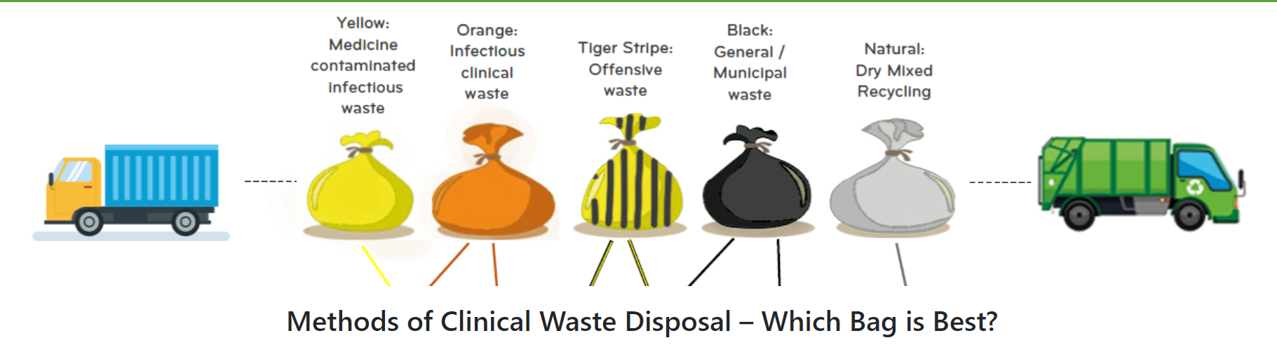

Know your Colours
Notes:
Healthcare waste, such as dressings and disposable clothing, can spread infection. To reduce the risk of this:
Put waste immediately into the right colour storage, bag or container.
Make sure you know how healthcare waste must be labelled and stored.
Make sure residents and their friends and family understand how waste must be handled, stored and disposed of.

Slide 28

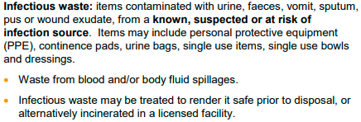

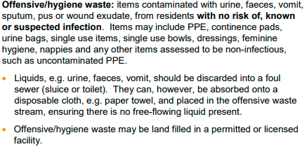
Waste stream guide
Notes:
Waste should be assessed by the member of staff at the time the waste is produced and segregated in the correct colour waste stream identified.

Slide 29

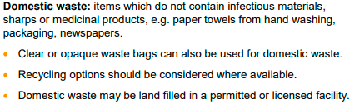


Waste stream guide
Notes:
Colour waste streams may vary depending on waste contractors – check with your local contractor before implementing the waste stream guidance.

Slide 30
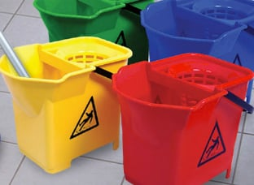
Clean as you go
Notes:
All care home facilities are recommended to adopt the national colour coding scheme for cleaning materials . All cleaning items, e.g. cloths, mops, buckets, aprons, should be colour coded.
Each establishment/service must have in place cleaning schedules, this will include the cleaning of equipment, furniture, floors, curtains, etc.
Refer to the LCC IPC website for further information on cleaning spillages.

Slide 31

Hand Hygiene
Key to IPC
Washing our hands has always been important to prevent the spread of germs.
During the last year, the widespread news coverage of hand hygiene has been helpful in encouraging and reminding everybody about hand hygiene.
Notes:
People are getting back to some normality. However Hand Hygiene should not be forgotten and it’s the most important measure in preventing the spread of infection.
IPC is essential and relevant in all health and social care settings, care homes, domiciliary, supported living etc. All service users are susceptible to acquiring infections. We need to work together to understand the risk factors and implement the measures required to prevent infections.
We need to strengthen our engagement across health and social care to prevent and control infections more effectively. Practicing hand hygiene is a simple, but effective way to prevent infections.

Slide 32
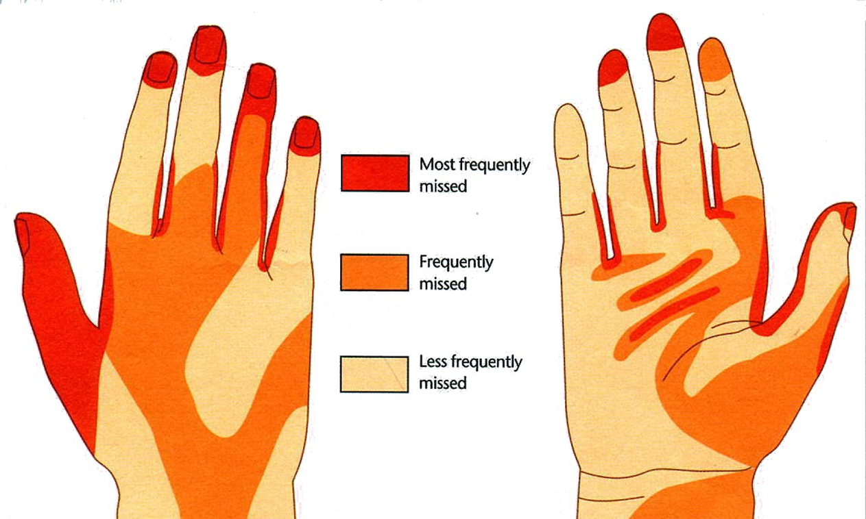
Hand washing is the single most important measure for preventing infection.
Notes:
Areas we often miss: Left Palm of Hand, Right back of hand, also the dominant hand that tends to get parts missed and also thumbs.
Hand gel should be used on hands that look clean and not physically dirty, then it should be soap and water.
If toileting you should use soap and water if available. It's also not effective against Norovirus (unless you are using a specific viricidal) then you should use soap and water again.

Slide 33
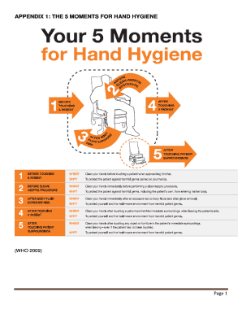
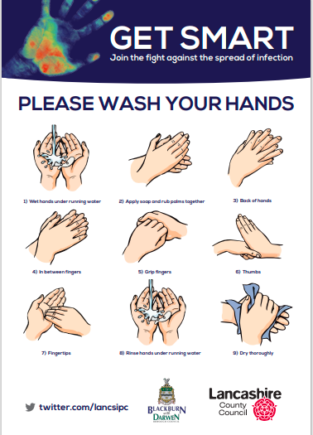
Reminders At Work
Notes:
Your setting will have these posters to remind us. Always laminate and replace worn out posters.
Your 5 Moments for Hand Hygiene at the point of Care: (1) Before service user contact. (2) Before clean/aseptic Task. (3) After Body Fluid Exposure Risk (4) After patient contact. (5) After contact with service user surroundings.
Remember when arriving and leaving the setting to perform hand hygiene effectively
The setting should prompt you to the nearest handwashing facility
Staff take hand hygiene seriously but sometimes when they are really busy they might not clean their hands as often as they should. So if you are worried that they have forgotten it’s OK to remind them. We all welcome your help in keeping you safe.
Remember to have IPC in your workplace Induction and Team meetings agenda. Know your IPC Champion.

Slide 34
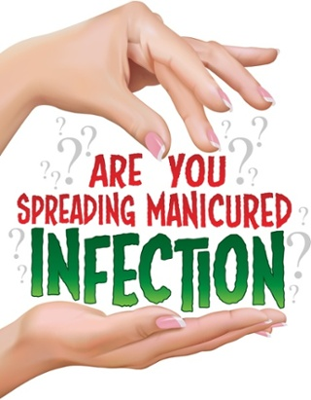

Artificial Nails
Notes:
The most important thing you can do to ensure clean safe care is good hand hygiene.
Evidence shows that artificial nails harbour micro-organisms and have been proven to have spread infection.
Cracks in varnish can harbour micro-organisms. The World Health Organization guidelines on hand hygiene state that wearing artificial acrylic nails can contribute to hands remaining contaminated with pathogens after use of soap or alcohol-based hand gels.
Perform hand hygiene immediately before every episode of care and after any activity or contact that potentially results in your hands becoming contaminated. This includes the removal of PPE, equipment decontamination and waste handling.
Follow your organisation’s policy and procedures on hand hygiene and hand maintenance (for example, keeping nails short, using moisturiser to keep skin on hands intact and not wearing false nails or nail varnish).

Slide 35
Hand hygiene impact
If standards of Hand Hygiene are high and embedded in to your organisation it will help reduce.
More serious illnesses spreading.
Hospitalisations.
Long term disability.
Excess deaths
High financial burden on health care sectors.
Healthcare associated Infections.
MRSA
Clostridium Difficile (C-Diff).
Influenza & Respiratory viruses.
Gastroenteritis caused by Norovirus
Notes:
Having an IPC Champion at your place of work, enables you to discuss and put forward your ideas and any concerns you may have.
They can take this to senior management to discuss further and improve the standards at your workplace which will increase standards for yourself and for your residents/service users.
It is recommended to have IPC on your team meetings agenda to document, discuss and give updates on IPC.

Slide 36
Hand Hygiene Prevention
Wash your hands often (hand wipes and alcohol hand gel are also effective) –especially before and after eating and after going to the toilet.
Wearing Appropriate PPE.
Follow the advice you're given about wound care and looking after devices that could lead to infection (such as urinary catheters or drips).
Report any unclean facilities – do not be afraid to talk to staff if you're concerned about hygiene.
Discuss with your IPC Nominated Champion.

Slide 37
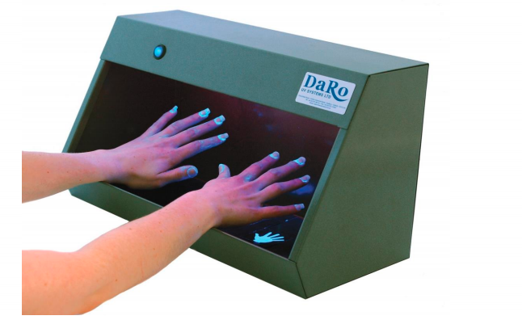
Glow Box
Have a go using the glow bobox.

Slide 38
Audits
What audits happen in your care home?
How often are they carried out?
Why evidencing audits is important?
Regulations
Accountability
CQC inspectors use questions and prompts to look at how well staff and people living in care homes are protected by infection prevention and control (IPC)
Notes:
Care quality audits are one way that providers can find areas for improvement to ensure they meet CQC guidelines on issues such as governance, staffing and safety. Rather than ongoing performance monitoring, audits are focused on making improvements to the service and can be undertaken by existing staff.

Slide 39
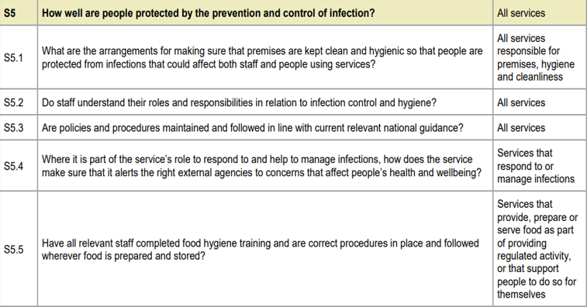
Notes:
S5 = Key Lines of Enquiry. - The questions help gather information about the service's strengths. They also help to understand if there are any gaps or concerns about infection prevention and control.
Although the questions are written for care homes, they plan to adapt them to other types of service.
What they look for after the visit???
Is IPC policy up to date and implemented effectively to prevent and control infection?
Are infection risks to people thoroughly assessed and managed?
What action has been taken to consider and reduce any impact to people/staff who may be disproportionately at risk of COVID-19? (BAME, learning disabilities, dementia)
What changes have been made following the most recent audit?
What contingency planning is in place to address future coronavirus and other infection outbreaks and winter pressures?

Slide 40

The role of the IPC champion within the care home
To support the service in ensuring good Infection Prevention and Control (IPC) practices are adopted and maintained.
To help create and maintain an environment which will reduce the risk of infection.
A main responsibility of this role will be to ensure that staff working within their area are updated in IPC accredited training (recommend annual training), new IPC initiatives and in order to accomplish this they will act as a resource/named person for IPC within their area.
They will undertake/participate in audits/action plans and disseminate relevant information, audit results and actions to team members, work together with their manager and have regular 1:1 meetings to improve practice where applicable.
Notes:
Empowering the IPC Champion in your workplace.
To support the service in ensuring good Infection Prevention and Control (IPC) practices are adopted and maintained in all clinical and non-clinical areas.
To help create and maintain an environment which will reduce the risk of infection to service users/residents, their relatives, social care workers and healthcare workers. This will be achieved by using IPC knowledge, communication skills, nursing and teaching skills.
The IPCCC will support all staff (including trained, non-trained, cleaners/caretakers, activity coordinators, administrative and reception) on matters concerned with IPC and become a role model initiating best practice in IPC issues within their working area.

Slide 41
Messages to take away
Infection Prevention is everyone's responsibility, wherever you work and whatever the setting.
Keep reviewing your setting and practices.
Be familiar with your setting procedures regarding Infection Prevention.
Going forward – how can you involve your service users/residents more.

Slide 42
Summary
We looked at the standard precautions & how we can prevent the spread of infections.
Identifying how we can break the chain of infection & the importance of this.
Best practice in relation to the basics of standard precautions.
Now is a good time to review and assess your basic but essential infection processes.

Slide 43
Look after yourself: Health & Wellbeing
You doing the best for your residents/service users: but don’t forget to do the best for yourself too.
Providing care is emotionally rewarding but can be tough.
Support is available for you:
Wellbeing support line for health and social care workers | Samaritans
https://www.nhs.uk/oneyou/every-mind-matters/

Slide 44
References
COVID-19: infection prevention and control (IPC) - GOV.UK (www.gov.uk)
COVID-19: Donning and doffing of Personal Protective Equipment in Health and Social Care Settings – YouTube
Helping to prevent infection | Quick guides to social care topics | Social care | NICE Communities | About | NICE
Prevention and control of infection in care homes - an information resource (publishing.service.gov.uk)
The Health and Social Care Act 2008: code of practice on the prevention and control of infections and related guidance (publishing.service.gov.uk)
Blood-borne viruses (infectionpreventioncontrol.co.uk)
http://www.infectionpreventioncontrol.co.uk/

Slide 45
References
Personal protective equipment: resource for care workers working in care homes during sustained COVID-19 transmission in England - GOV.UK (www.gov.uk)
Your guide to the 10 Standard Infection Control Precautions (SICPs) (nurses.co.uk)
Bulletin-Care-Homes-No-30-March-2021.pdf (infectionpreventioncontrol.co.uk)
Safe management of care equipment Audit Tool (infectionpreventioncontrol.co.uk)
Safe disposal of waste (infectionpreventioncontrol.co.uk)
Infection prevention and control in care homes | Care Quality Commission (cqc.org.uk)
Care-Home-IPC-Resource-Booklet-December-2020.pdf (infectionpreventioncontrol.co.uk)

Slide 46


