Slide 1
What is Child Sexual Exploitation

Slide 2
What is Child Sexual Exploitation?
Child sexual exploitation is when someone grooms and controls a child for a sexual purpose.
These activities can be broadly separated into two areas:
Street grooming
Online grooming

Slide 3


Sexual exploitation through
street grooming
can include:

Slide 4
Befriending the child, gaining their trust, giving them drugs, alcohol or gifts, asking them to perform sexual acts as a favour or in exchange for something.
Controlling a child through physical or psychological means or through the use of drugs for a sexual purpose
Receiving money or goods in payment for someone to have sex with a child (also referred to as child prostitution)
Paying or exchanging goods for sex with a child

Slide 5
Internal Trafficking - the movement of children within the UK for the purpose of sexually abusing them
The trafficking of children into the UK from other countries for the purpose of sexually abusing them

Slide 6

Online sexual exploitation can include:

Slide 7
An adult pretending to be a child, befriending the child through online chat rooms, social networking websites, email, mobile telephone messaging, gaining their trust, stalking their online activities
Asking children to participate in non-contact sexual activities such as engaging in sexual conversations online or via mobile telephone
Asking children to take and share indecent images of themselves online or through a mobile telephone

Slide 8
Asking children to display sexualised behaviours or perform sexual acts that are recorded or shared live via webcam
The creation, storage and distribution of child abuse images (also referred to as child pornography or indecent images)
Arranging to meet a child in person for the purpose of sexually abusing them.

Slide 9
National CSE Awareness week 2013
“The more you know the more you see”
Campaign 2013
www.trustedtoknow.co.uk

Slide 10


Slide 11
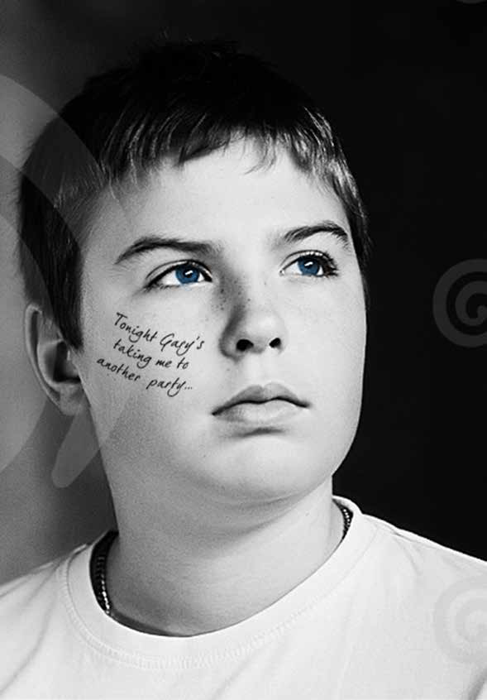

Slide 12
Can you think of any cases of exploitation that have been in the media recently?

