Slide 1
SESSION EIGHT
How much is too much ?

Slide 2
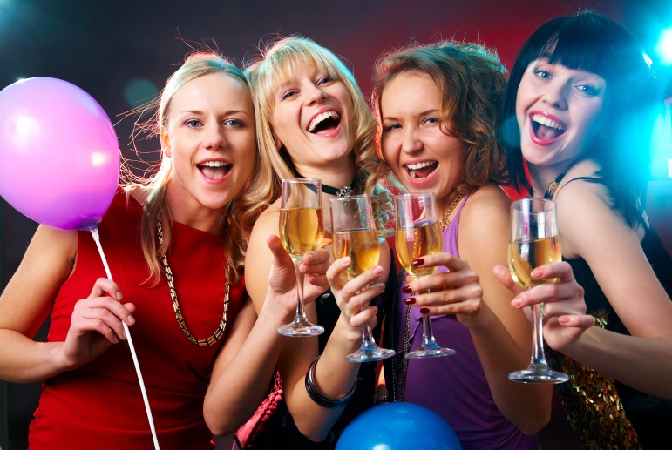
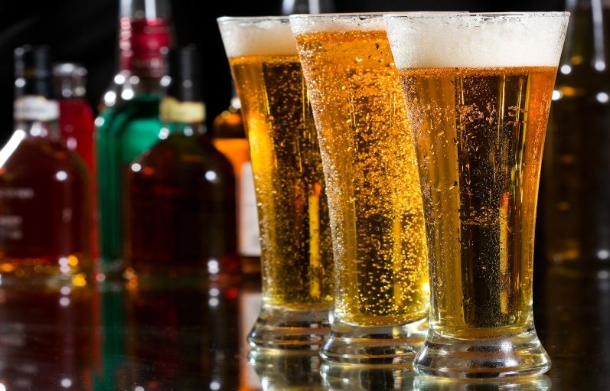
How much is too much ?

Slide 3
How much is too much?
Units and daily guidelines
1 UNIT
A single measure of spirit (40%)
A half pint of lower strength (4%) lager, beer or cider
A small bottle (275ml) of lower strength (4%) alcopop

Slide 4
How much is too much?
Units and daily guidelines
2 UNITS
A 440ml can of medium strength (4.5%) lager, beer or cider
A pint of lower strength (4%) lager, beer or cider
A double measure of spirit (40%)
A standard glass (175ml) of lower strength (12%) wine or champagne

Slide 5
How much is too much?
Units and daily guidelines
3 UNITS
A large bottle (750ml) of lower strength (4%) alcopop
A large glass (250ml) of low strength (12%) wine
A pint of medium strength (5%) lager, beer or cider

Slide 6
How much is too much?
Units and daily guidelines
There is no safe level of drinking if you are under 18 as your brain and liver aren’t fully developed and the toxins from the breakdown of alcohol have a much greater effect.
The UK chief medical officers recommend that adults do not regularly exceed:
* 2-3 units a day for women
* 3-4 units a day for men
* No safe limits for under 18’s
* an alcohol free childhood is the best option for under 15’s

Slide 7
Young People & Alcohol
The Lancashire Picture

Slide 8
2013 Young People’s Alcohol and Tobacco Survey
13 -17 years old
Young people who claim to drink alcohol

Slide 9
2013 Young People’s Alcohol and Tobacco Survey
13 -17 years old

Slide 10
Supply chain of alcohol to under 18s
Adults outside shops: 12%
Pubs/Nightclubs:
6%
Parents: 57%
Friends/Family over 18: 41%
Off licences:
8%
Supermarkets: 4%

Slide 11
2013 Young People’s Alcohol and Tobacco Survey
13 -17 years old
Young people who get alcohol from their parents / guardians
11

Slide 12
2013 Young People’s Alcohol and Tobacco Survey
13 -17 years old
Young people who buy alcohol from off licences
12

Slide 13
2013 Young People’s Alcohol and Tobacco Survey
13 -17 years old
Young people who buy alcohol from supermarkets
13

Slide 14

Your group will be given a topic. You need to prepare a short presentation to outline your group’s views on the topic.
At the end of the presentation each group must make a proposal about either;
A change to the law
OR
Guidance needed for young people, families, police or other community members in relation to their topic

Slide 15
GROUP ONE:
57% of young people in Lancashire say that they get their alcohol from their parents/carers.
Do you think this is a good way to introduce young people to alcohol or are their parents their ‘suppliers’ ?

Slide 16
GROUP TWO:
In some areas of Lancashire activity called the Community Alcohol Network is carried out with lots of different partners. Anti Social Behaviour police patrols are out on Friday and Saturday nights dealing with young people who are drinking on the streets. Do you think this is something that young people should support/get involved in or do you think young people should be allowed to enjoy themselves ?

Slide 17
GROUP THREE:
30% of young people in Lancashire said they were aware of 'drinking dens / party houses' in their area. Can you identify some positive and negative aspects of young people drinking in these areas?

