Slide 1
SESSION ONE
CELEBRITIES WHO CHOOSE TO DRINK

Slide 2
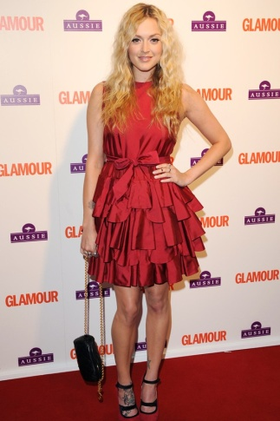
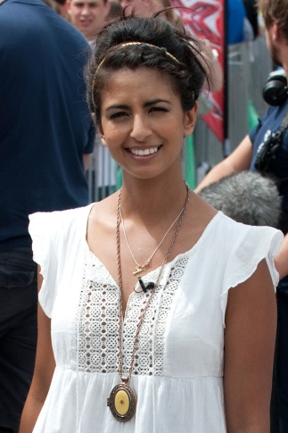
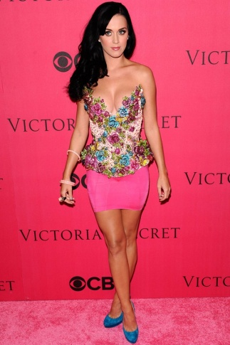
Celebrities who have made the decision not to drink
Fearne Cotton gave up alcohol completely four years ago.
"I wasn't a big drinker before so I found it quite easy to give up completely and now I feel brilliant,”
Fitness fanatic Konnie Huq has a teetotal lifestyle. The starlet’s enviably healthy glow is down to a combination of cycling, healthy eating and just saying no.
“I was brought up not drinking, so the taste never appealed to me and I never had the mentality that I need a drink to relax.”
California Girl Katy Perry gave up alcohol for good in 2010 to concentrate on her career and not because her drinking was getting out of hand.

Slide 3
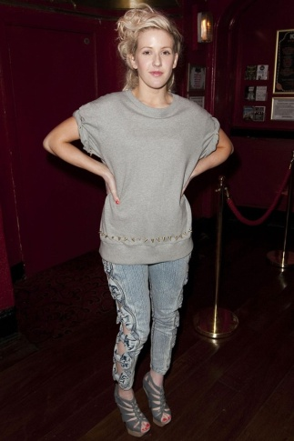
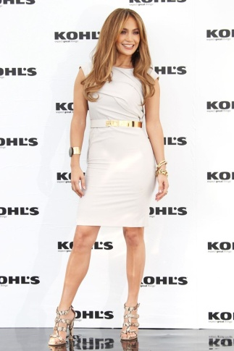
Celebrities who have made the decision not to drink
Brit popstral Ellie Goulding is back on track after her vocal expert slapped booze-ban on the starlet last year.
“I have noticed already just having a good diet and not smoking or drinking has made my vocal cords so much stronger.”
A health-conscious starlet, J – Lo doesn't drink or smoke.
"I think that ruins your skin. Of course, during celebratory toasts, everybody's like, 'You can't toast with water!' So I'll toast with alcohol and just take a sip."

Slide 4
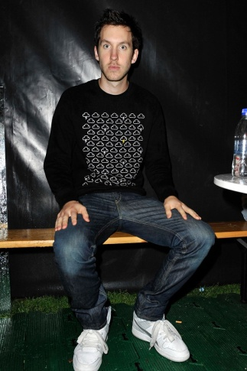
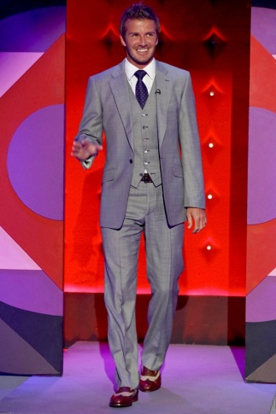
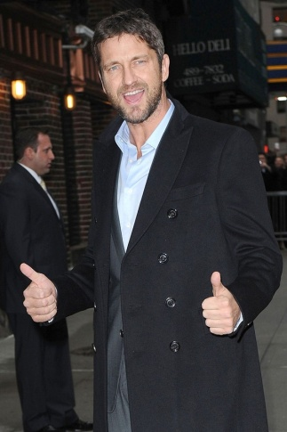
Celebrities who have made the decision not to drink
DJ supremo Calvin Harris quit drinking in 2008 to stop hangovers getting in the way of his chart-topping career.
“My live shows are a million times better now. If you drink, you can't even remember if it's a good show or not - and that's probably for the best, because it would have been rubbish because I'd have been drunk and not making any sense.”
England ambassador and all-round role-model David Beckham abstained from alcohol years ago, like many athletes (but unlike many footballers).
It’s been so long since Gerard Butler enjoyed a bevvy, the actor now claims he can’t even remember what it’s like to be drunk.
“I can’t remember drinking. When I stopped, I would look at a beer and think how great it would be. I’d get this pang in my stomach to go back out and have fun, but then I’d remember that I used up that right - that I did a full life’s worth of drinking between 14 and 27.”

Slide 5
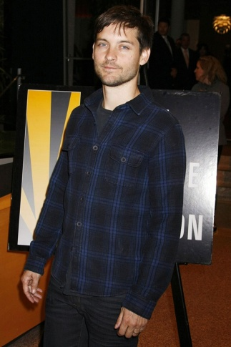
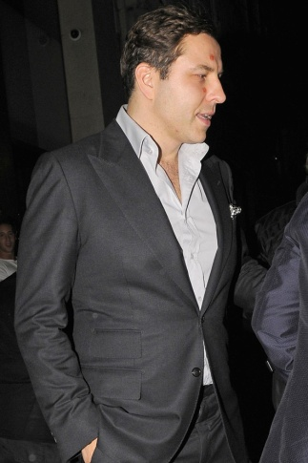
Celebrities who have made the decision not to drink
  In 2010, former Spider-Man Tobey Maguire confirmed that he hadn’t had a drop of the hard stuff for 15 years after admitting he struggled with booze as a teen. The 34-year-old said:
  “It doesn't seem like I'm made to have a little bit [of alcohol] - it seems to be I'm made to have more than a little bit! I had a lot of fun, but what it did cumulatively to my life was not worth it.“
Little Britain's David Walliams a noted man about town, is never seen with anything other than mineral water in hand.

Slide 6
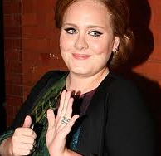
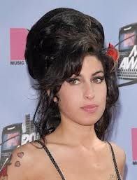
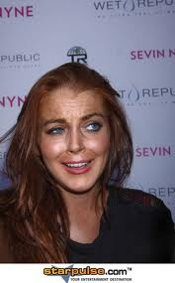

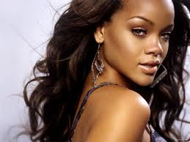


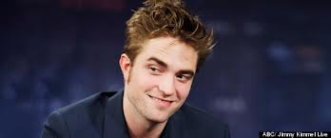


Celebrities who drink
Adele
Amy Winehouse
Lindsay Lohan
Katie Price
Rihanna
Daniel Radcliffe
Pete Doherty
Robert Pattinson
Ryan Tunn
Tinie Tempah

Slide 7
Celebrities who drink
Adele
Has revealed problems with drink in her past.
Amy Winehouse
Well documented problems with both alcohol and drugs. She died as a result of alcohol poisoning after binge drinking.
Lindsay Lohan
Well documented problems with prescription drugs and alcohol and lots of negative press. She does not feel she has a problem and only attends rehab to avoid jail.
Katie Price
Admits alcohol has caused her relationship failures. The star’s friends have been worried by her erratic behaviour and warned her she “needs to stop getting so drunk in public.”
Rihanna
Rihanna’s friends are so worried about her hard-partying ways they’re urging the singer to check into rehab – before she meets the same tragic fate as Amy Winehouse.

Slide 8
Celebrities who drink
Daniel Radcliffe
Revealed real problems in past has NOW given up alcohol because he used to blackout every time he drunk. He became a recluse at 20 as it really affected his personality, was unhealthy and was damaging his career.
Pete Doherty
Well known for drink and drugs offences.
Robert Pattinson
Rumours of drinking problems.
Ryan Tunn
Recently been in trouble for drunk driving.
Tinie Tempah
"I like the company of women and I do like a drink. But you know what? I think one day I'd like to be teetotal."
"A couple of my friends are athletes and, and when we go out together, the rest of us drinking, they just refuse it. I like that - there is something 'next level' about it. It's about purity and discipline and I aspire to that."

